Slide 1
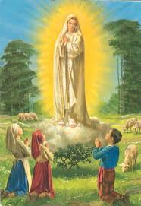
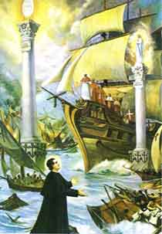
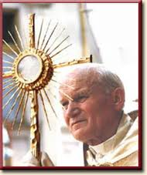
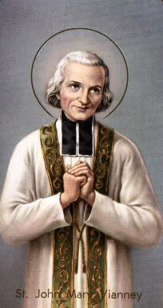
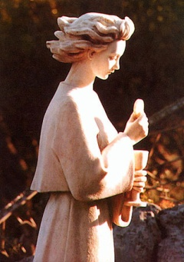
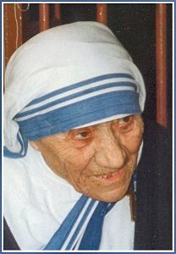
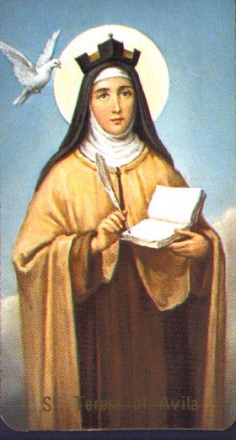
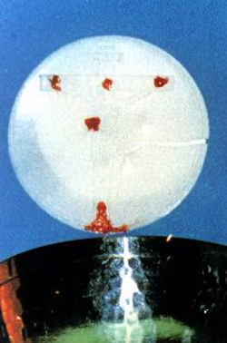
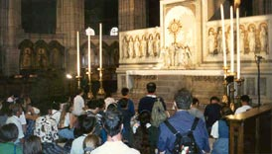
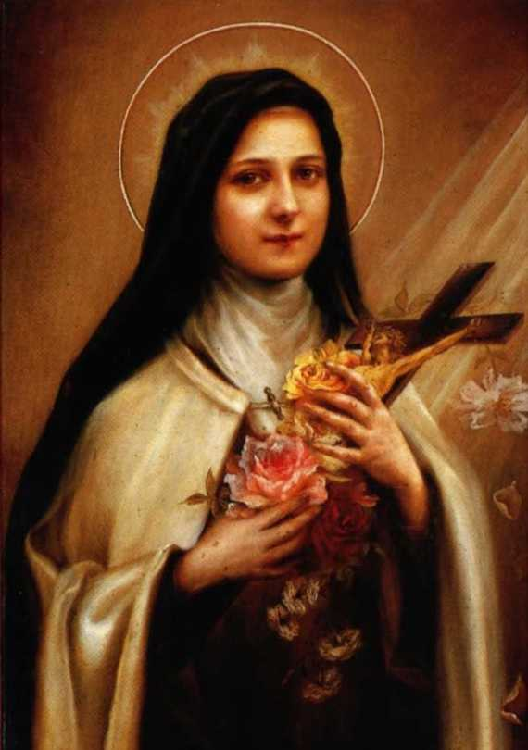

Slide 2
Healing us, our families and the whole world
When St. Faustina was praying before Jesus in the Holy Eucharist He showed her a vision. Each time a person entered the chapel and visited Jesus exposed in a monstrance, she saw His Divine Rays of Love and Mercy burst forth and encircle the whole world and everyone in it with graces and blessings! Through Perpetual Eucharistic Adoration Jesus unleashes His rays of healing upon us, our families and the whole world!
+1

Slide 3
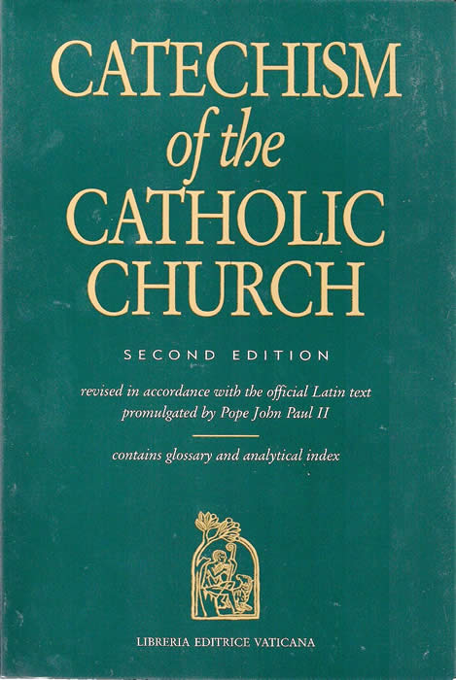
St. Pope Paul II (1920 - 2005)
The Church and the world have a great need of Eucharist adoration. Jesus waits for us in this sacrament of Love. Let us be generous with our time in going to meet Him in adoration and in contemplation that is full of faith and ready to make reparation for the great faults and crimes of the world. May our adoration never cease. (Dominicae cenae, 3) (CCC 1380)

Slide 4
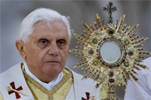
Pope Benedict XVI
Adoration is not a luxury but a priority
From Adoration compassion is born for all men, and from this compassion the thirst is born to evangelize.
Only by adoring this presence do we learn how to receive Him properly

Slide 5
Pope Benedict XVI Sacramentum Caritatis
Eucharistic adoration is simply the natural consequence of the Eucharistic celebration, which is itself the Church's supreme act of adoration. Receiving the Eucharist means adoring Him whom we receive. Only in this way do we become one with Him, and are given, as it were, a foretaste of the beauty of the heavenly liturgy. The act of adoration outside Mass prolongs and intensifies all that takes place during the liturgical celebration itself. Indeed, ‘only in adoration can a profound and genuine reception mature.’

Slide 6
Pope Francis
What I really prefer is adoration in the evening, even when I get distracted and think of other things, or even fall asleep praying. In the evening then, between seven and eight o’clock, I stay in front of the Blessed Sacrament for an hour in adoration.

Slide 7
July 30: St. Peter Chrysologus (406-450)
He is The Bread sown in the virgin, leavened in the Flesh, molded in His Passion, baked in the furnace of the Sepulcher, placed in the Churches, and set upon the Altars, which daily supplies Heavenly Food to the faithful.

Slide 8
July 31: St. Ignatius of Loyola (1491-1556)
The sovereigns of the earth do not always grant audience readily; on the contrary, the King of Heaven, hidden under the Eucharistic veils, is ready to receive anyone…

Slide 9
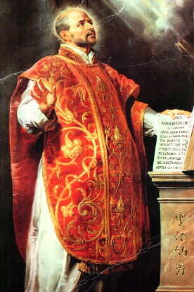
July 31: St. Ignatius of Loyola (1491-1556)
To withdraw from creatures and repose with Jesus in the Tabernacle is my delight; there I can hide myself and seek rest. There I find a life which I cannot describe, a joy which I cannot make others comprehend, a peace such as is found only under the hospitable roof of our best Friend.

Slide 10
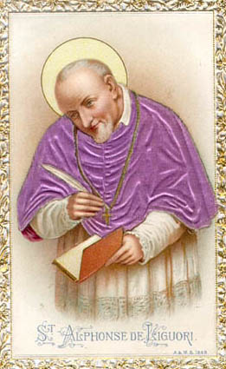
Aug 1: St. Alphonsus de Liguori (1696-1787)
5 steps in prayer and meditation for adoration:
1. Prayer before adoration
2. Visit Blessed Sacrament
3. Spiritual communion
4. Visit Blessed Mother
5. Prayer to Blessed Mother after adoration
8/11

Slide 11
Act of Spiritual Communion (St. Alphonsus de Liguori)
My Jesus, I believe that You are present in the Blessed Sacrament. I love You above all things and I desire You in my soul. Since I cannot now receive You sacramentally, come at least spiritually into my heart. As though You were already there, I embrace You and unite myself wholly to You; permit not that I should ever be separated from You. Amen.

Slide 12
Aug. 2: St. Peter Julian Eymard (1811-1868) Founder: Congregation of the Blessed Sacrament, Servants of the Blessed Sacrament
When your hour is particularly difficult, rejoice all the more; your love will be greater for its suffering more. It is a privileged hour that will count for two.

Slide 13
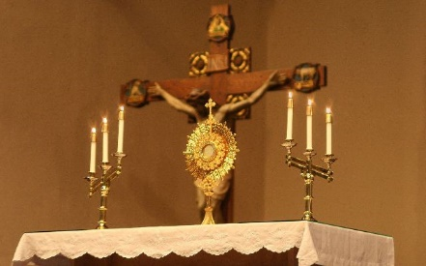
Aug. 2: St. Peter Julian Eymard (1811-1868) Founder: Congregation of the Blessed Sacrament, Servants of the Blessed Sacrament
What is the Eucharist but “the wheat of the elect” and “the living bread?” Now, wheat must be sown. It must fall into the soil, and spring up, and ripen, and be harvested, and be ground before it can be made into good bread. … This heavenly wheat was sown at Bethlehem, the “House of bread.”… Bethlehem is built on a hill facing Jerusalem. When this ear of wheat has ripened, it shall lean towards Calvary where it shall be ground and shall be set on the fire of suffering to become a living bread.

Slide 14
Aug. 2: St. Peter Julian Eymard (1811-1868) Founder: Congregation of the Blessed Sacrament, Servants of the Blessed Sacrament
It was truly a lambkin that was born at Bethlehem. Jesus was born like a lamb in a stable, and like a lamb knew no one but His mother. This little Lamb was to grow up close to its Mother; She would feed it with her pure and virginal milk, and would preserve it, for the day of sacrifice. This characteristic of victim was so evident in our Lord that when St. John the Baptist saw Him in the early days of His public life, he had no other name for Him than that of “Lamb of God.” “Behold the Lamb of God, behold Him Who takes away the sin of the world.” The sacrifice begun at Bethlehem is consummated on the altar at Holy Mass.

Slide 15
Aug. 2: St. Peter Julian Eymard (1811-1868) Founder: Congregation of the Blessed Sacrament, Servants of the Blessed Sacrament
And see how the Eucharist began at Bethlehem. He was even then the Emmanuel, “God with us,” Who was come to dwell among His people. On the first Christmas Day He began to live in our midst; the Eucharist perpetuates His presence. At Bethlehem, the Word was made flesh; in the Sacrament He is made bread in order to give us His flesh without stirring any feeling of repugnance in us.

Slide 16
Aug. 4: St. John Vianney (1786-1859)
Have a Holy Hour every week. Start praying. Pray for guidance and trust in God.
When you awake in the night, transport yourself quickly in spirit before the Tabernacle, saying: ‘Behold, my God, I come to adore You, to praise, thank, and love you, and to keep you company with all the Angels,’...

Slide 17
Aug 9: St. Teresa Benedicta of the Cross, Edith Stein (1891-1942)
A woman’s life must be a Eucharistic life. Only in daily, confidential relationship with the Lord in the tabernacle can one forget self, become free of all one’s wishes and pretensions, and have a heart open to all the needs and wants of others.

Slide 18
Aug 9: St. Teresa Benedicta of the Cross, Edith Stein (1891-1942)
The Lord is present in the tabernacle in his divinity and in his humanity. He is not present for his own sake but for ours: it is his delight to be with the ‘children of men.’ He knows, too, that, being what we are, we need his personal nearness. In consequence, every thoughtful and sensitive person will feel attracted and will be there as often and as long as possible. And the practice of the Church, which has instituted perpetual adoration, is just as clear.

Slide 19
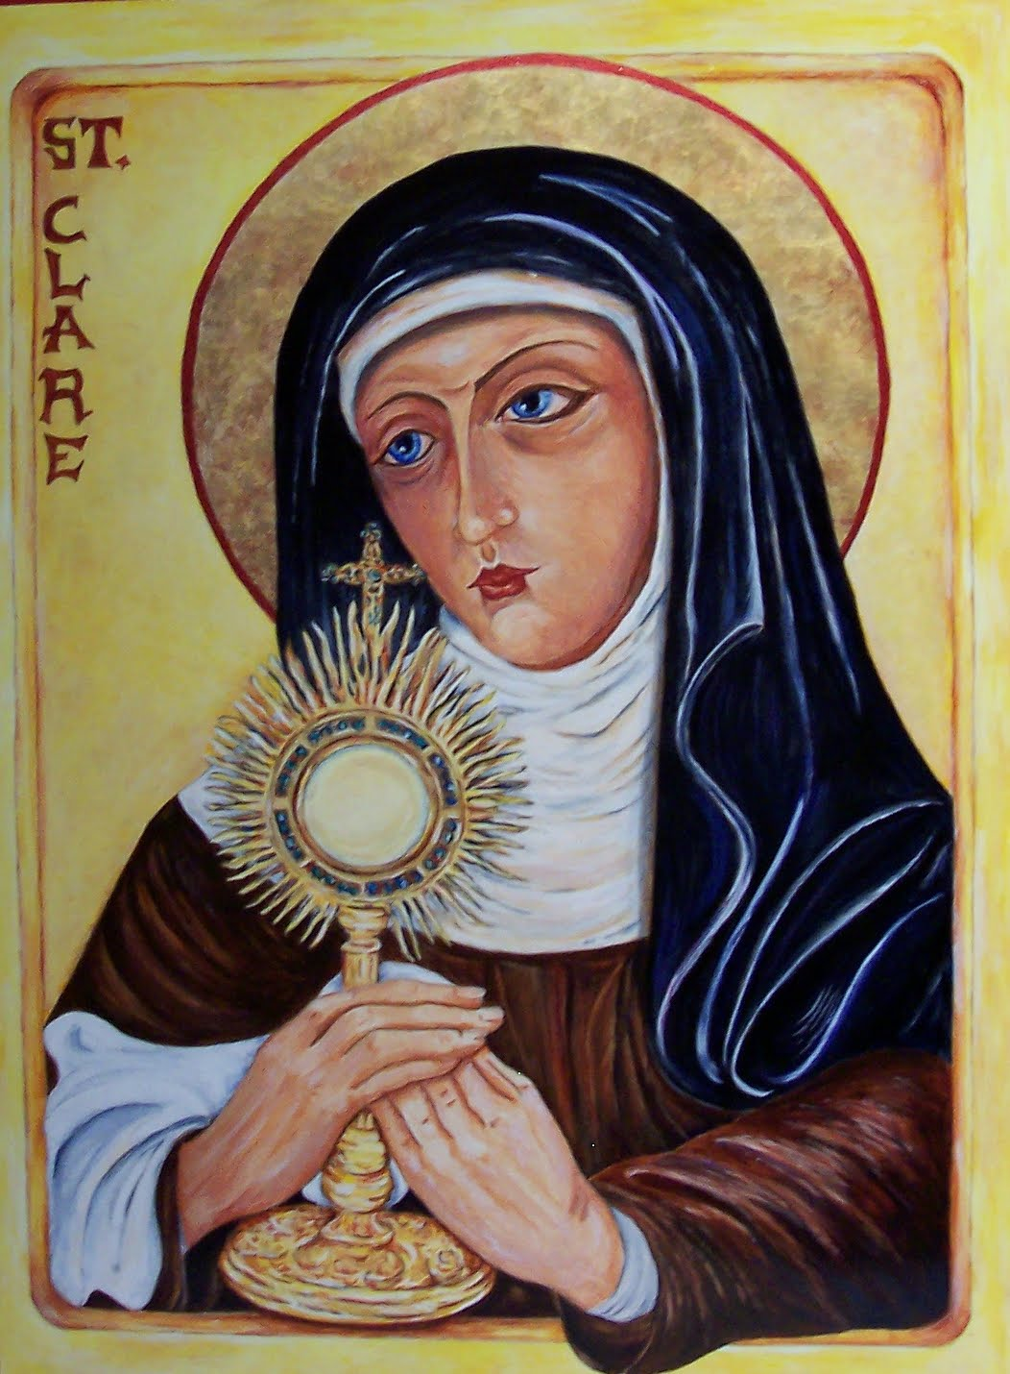
Aug 11: St. Clare of Assisi (1193-1253)
Gaze upon Him (in Eucharistic Adoration),
consider Him,
contemplate Him,
as you desire to imitate Him.

Slide 20
Aug. 14: St. Maximilian Mary Kolbe (1894-1941)
My aim is to institute Perpetual (Eucharistic) Adoration, for this is the most important activity.

Slide 21
Aug. 14: St. Maximilian Mary Kolbe (1894-1941)
Let us not forget to visit . . . Jesus. Let us tell Him we love Him. We might ask Him what He wants of us, what are His wishes. Sometimes we might ask Jesus something for ourselves and something for others. One can speak to Jesus as brother to brother, as friend to friend, more so, since it often happens that men do not understand us, whereas Jesus understands each of us always.”

Slide 22
Aug. 19: John Eudes (1601-1680) Priest and founder of the Congregation of Jesus and Mary (Eudists)
You should adore our Lord Jesus Christ, who makes himself present to us on the altar, so that we might offer him the homage and adoration we owe.
Your most loving Heart, O Jesus, dwells in this Sacrament burning with love for us. It is there continually performing thousands of good deeds towards us.

Slide 23
Aug 21: St. Pope Pius X (1835-1914) “Pope of the Blessed Sacrament”
first Pope to emphasize frequent, even daily, reception of the Eucharist.
Started Perpetual Eucharistic adoration while he was Cardinal of Venice, before he became Pope
I was born in poverty, I lived in poverty, and I wish to die in poverty.

Slide 24
Aug 21: St. Pope Pius X (1835-1914)
Perpetual Adoration of the Most Blessed Sacrament is the devotion which surpasses all others.
The daily adoration or visit to the Blessed Sacrament is the practice which is the fountainhead of all devotional works
Devotion to the Eucharist is the most noble, because it has God as its object; it is the most profitable for salvation, because it gives us the Author of Grace; it is the sweetest, because the Lord is Sweetness Itself.

Slide 25
Aug 23: St. Rose of Lima (1586-1617) First Saint and Patroness of the Americas
St. Rose had such a great love for the Blessed Sacrament that she started Perpetual Eucharistic Adoration in every parish in the village she lived in.

Slide 26
Aug 25: St. Louis King of France (1214-1270)
St. Louis, who, despite being King found time to visit the most Blessed Sacrament every day.

Slide 27
Aug 27: St. Monica (322-387)
St. Monica who, besides attending daily Mass, would also visit the Blessed Sacrament twice a day praying for her worldly child.

Slide 28
Aug 28: St. Augustine of Hippo (354-430)
To fall in love with God is the greatest of all romances; to seek Him, the greatest adventure; to find Him, the greatest human achievement.”
Late have I loved you
Our hearts are restless, until they can find rest in you

Slide 29
Aug 28: St. Augustine of Hippo (354-430)
“You called and cried out to me and broke open my deafness; you shone forth upon me and you scattered my blindness; you breathed fragrance, and I drew in my breath and I now pant for you; I tasted and I hunger and I thirst; you touched me, and I burned for your peace.” Confessions, Book 9

Slide 30
Aug 28: St. Augustine of Hippo (354-430)
God in his omnipotence could not give more, in His wisdom He knew not how to give more, in His riches He had not more to give, than the Eucharist.
Lord Jesus, our Savior, let us now come to You. Our hearts are cold; Lord, warm them with Your selfless Love. Our hearts are sinful; Lord, cleanse them with Your precious Blood. Our hearts are weak; Lord, strengthen them with Your joyous Spirit. Our hearts are empty; Lord, fill them with your Divine Presence. Lord Jesus, our hearts are Yours; possess them always and only for Yourself. Amen.”

Slide 31
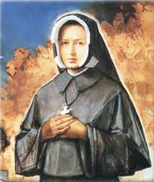
Sept 4: St. Dina Belanger (1897-1929)
I long to console my Jesus: oh, what suffering was His in the Garden of Olives. ... What a mysterious privilege to be specially chosen to console Him. ... [And Jesus said to her]: Very few souls wish to compassionate My Agony. ... I confide precious secrets to souls who are willing to console Me in My agony.

Slide 32
Sept 4: St. Dina Belanger (1897-1929)
I am making my retreat with the Eucharistic Heart. I am on fire, burning with the desire to love God and to bring others to love him. ‘Our Lady of the Eucharistic Heart, I beg you to give Jesus to souls’

Slide 33
Sept 4: St. Dina Belanger (1897-1929)
One day, before her Holy Hour, Jesus showed Dina a multitude of souls on the precipice of Hell. After her Holy Hour, Jesus showed the same souls go to Heaven, who otherwise would have gone to Hell. So one person can make up for what is lacking in the lives of others, by winning precious graces for their salvation.

Slide 34
Sept 5: St. Teresa of Calcutta (1910-1997)
Every Holy Hour we make so pleases the Heart of Jesus that it will be recorded in Heaven and retold for all eternity.
It opens up the floodgates of God’s merciful Love upon the world.
Adoration of the Blessed Sacrament is the best time you will spend on earth.
It will make your soul everlastingly more glorious and beautiful in Heaven.
A Holy Hour of adoration helps bring everlasting peace to earth.

Slide 35
Sept 5: St. Teresa of Calcutta (1910-1997)
It brings us a greater love for Jesus, for each other, and for the poor.
Every holy hour deepens our union with Him and bears much fruit.
Nowhere on earth are we more welcomed or loved than by Jesus in Eucharist.

Slide 36
Sept 5: St. Teresa of Calcutta (1910-1997)
When you look at the crucifix, you understand how much Jesus loved you. When you look at the Sacred Host you understand how much Jesus loves you now. This is why we need Perpetual Eucharistic Adoration in every Parish throughout the entire World.

Slide 37
Sept 5: St. Teresa of Calcutta (1910-1997)
What will convert America and save the world? My answer is prayer. What we need is for every parish to come before Jesus in the Blessed Sacrament in Holy Hours of prayer.
On the Cross Jesus said ‘I thirst’. From the Blessed Sacrament Jesus continues to say to each of us ‘I thirst’. He thirsts for our personal love, our intimacy, our union with Him in the Blessed Sacrament.

Slide 38
Sept 5: St. Teresa of Calcutta (1910-1997)
When the Sisters are exhausted, up to their eyes in work; when all seems to go awry, they spend an hour in prayer before the Blessed Sacrament. This practice has never failed to bear fruit: they experience peace and strength.

Slide 39
Sept 13: St. John Chrysostom (344-407)
What excuse shall we have, or how shall we obtain pardon, if we consider it too much to go to Jesus in the Eucharist, who descended from Heaven for our sake?
This Fountain of the Holy Eucharist is a fountain of light, shedding abundant rays of truth. And beside it the angelic powers from on high have taken their stand, gazing on the beauty of its streams, since they perceive more clearly than we the power of what lies before us and its unapproachable dazzling rays.”

Slide 40
Sept 13: St. John Chrysostom (344-407)
The wise men adored this body when it lay in the manger;…they prostrated themselves before it in fear and trembling….Now you behold the same body that the wise men adored in the manger, lying upon the altar;…you also know its power.”

Slide 41
Sept 13: St. John Chrysostom (344-407)
How many of you say: I should like to see His face, His garments, His shoes. You do see Him, you touch Him, you eat Him. He gives Himself to you, not only that you may see Him, but also to be your food and nourishment.”

Slide 42
Sept 17: St. Bellarmine (1542-1621) Doctor of the Church, Cardinal and Archishop of Capua Italy
During his youth, on his way back and forth to school, he would stop and pay a visit to Jesus four times a day.

Slide 43
Sept 23: St. Pio of Pietrelcina (1887-1968)
A thousand years of enjoying human glory is not worth even an hour spent in sweetly communing with Jesus in the Blessed Sacrament.
We must always have courage, and if some spiritual languor comes upon us, let us run to the feet of Jesus in the Blessed Sacrament, and let us place ourselves in the midst of the heavenly perfumes, and we will undoubtedly regain our strength.”
I weep and mourn at the feet of Jesus in the Blessed Sacrament for often I’m consoled.

Slide 44
Sept 23: St. Pio of Pietrelcina (1887-1968)
Kneel down and render the tribute of your presence and devotion to Jesus in the Blessed Sacrament. Confide all your needs to him, along with those of others. Speak to him with filial abandonment, give free rein to your heart, and give him complete freedom to work in you as he thinks best.

Slide 45
Sept 23: St. Pio of Pietrelcina (1887-1968)
When Mass ended I remained with Jesus to render Him thanks. My thirst and hunger do not diminish after I have received Him in the Blessed Sacrament, but rather, increase steadily. Oh, how sweet was the conversation I held with Paradise this morning. The Heart of Jesus and my own, if you will pardon my expression, fused. They were no longer two hearts beating but only one. My heart disappeared as if it were a drop in the ocean.

Slide 46
Sept 27: St. Vincent de Paul (1581-1660)
St. Vincent de Paul would make a Holy Hour asking the Lord blessings on important business transactions and, afterwards, returned to thank the Lord.

Slide 47
Sept 28: St. Wenceslaus (907-935)
This holy king was so enamored of Jesus there present, that he not only gathered the wheat and grapes, and made the hosts and wine with his own hands, and then gave them to be used in the Holy Sacrifice, but he used, even during the winter, to go at night to visit the church in which the Blessed Sacrament was kept.

Slide 48
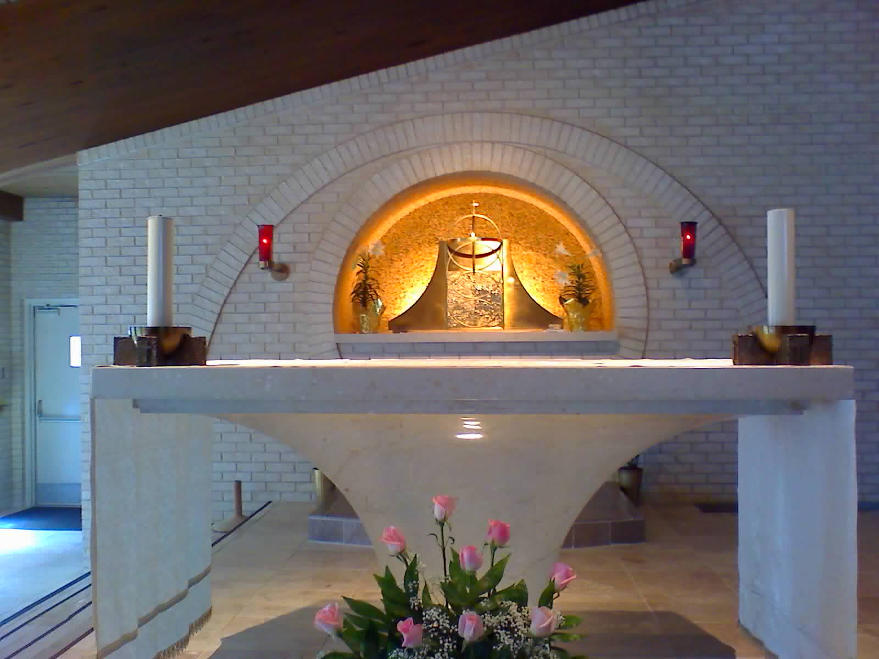
Oct 1: St. Therese of Lisieux (1873-1897)
It is not to remain in a golden ciborium that He comes down each day from Heaven, but to find another Heaven, the Heaven of our soul in which He takes delight.

Slide 49
Oct 1: St. Therese of Lisieux (1873-1897)
Do you realize that Jesus is there in the tabernacles expressly for you, for you alone? He burns with desire to come into your heart.
When I am before the tabernacle, I can say only one thing to Our Lord: ‘My God, you know that I love you’ and I feel my prayer does not tire Jesus.”

Slide 50
Oct 4: St. Francis Assisi (1182-1226)
Let the whole of mankind tremble, the whole world shake, and the heavens exult, when Christ the Son of the Living God is present on the altar in the hands of a priest.
O admirable heights and sublime lowliness! O sublime humility! O humble sublimity! That the Lord of the universe, God and the Son of God, so humbles Himself that for our salvation He hides Himself under the little form of Bread!

Slide 51
Oct 4: St. Francis Assisi (1182-1226)
Everyday, Jesus humbles himself just as He did when He came from His heavenly throne into the Virgin’s womb; everyday He comes to us and lets us see Him in abjection, when He descends from the bosom of the Father into the hands of the priest at the altar.
We adore You, Lord Jesus Christ, here and in all your Church in the whole world, and we bless you, because by Your holy cross You have redeemed the world.

Slide 52
Oct 4: St. Francis Assisi (1182-1226)
And just as He appeared before the holy Apostles in true flesh, so now He has us see Him in the Sacred Bread. Looking at Him with the eyes of their flesh, they saw only His Flesh, but regarding Him with the eyes of the spirit, they believed that He was God. In like manner, as we see bread and wine with our bodily eyes, let us see and believe firmly that it is His Most Holy Body and Blood, True and Living. For in this way our Lord is ever present among those who believe in him, according to what He said: “Behold, I am with you all days even to the consummation of the world.”

Slide 53
Oct 11: Pope St. John XXIII (1881-1963)
“Visit the Blessed Sacrament of some church at least once a day.” This was one of the many rules a young ‘Angelo Roncalli’ wrote out for himself. He later became Pope John XXIII.
“There are even some who, led by ideas foreign to traditional piety, look upon a Holy Hour of adoration as of minor importance.”
“The worship of Christ present in the Eucharist is not just a personal, solitary ‘Jesus and Me’ experience but involves the entire Church.”

Slide 54
Oct 11: Pope St. John XXIII (1881-1963)
Every time I hear anyone speak of the Sacred Heart of Jesus or of the Blessed Sacrament I feel an indescribable joy. It is as if a wave of precious memories, sweet affections and joyful hopes swept over my poor person, making me tremble with happiness and filling my soul with tenderness. These are loving appeals from Jesus who wants me wholeheartedly there, at the source of all goodness, his Sacred Heart, throbbing mysteriously behind the Eucharistic veils... I love to repeat today ‘Sweet Heart of my Jesus, make me love You more and more.’

Slide 55
Oct 11: Pope St. John XXIII (1881-1963)
O Jesus in the Blessed Sacrament, I would like to be filled with love for You; keep me closely united with You, may my heart be near to Yours. I want to be to You like the apostle John.

Slide 56
Oct 11: Pope St. John XXIII (1881-1963)
All shrines of Mary, scattered throughout the world, have become above all centers of devotion to the Eucharist, as if the Mother of Jesus had appeared, here or there, in order to lead the faithful to the adoration and love of her blessed Son.
O Mary of the Rosary, keep me recollected when I say these prayers of yours; bind me forever, with your rosary, to Jesus of the Blessed Sacrament. Blessed be Jesus, my love, blessed be the Immaculate Virgin Mary.

Slide 57
Oct 13: Blessed Alexandrina da Costa (1904-1955)
“Keep Me company in the Blessed Sacrament. I remain in the tabernacle night and day, waiting to give My love and grace to all who would visit Me. But so few come. I am so abandoned, so lonely, so offended... Many men do not believe that I live in the tabernacle. They curse Me. Others believe, but do not love Me and do not visit Me; they live as if I were not there.”

Slide 58
Oct 15: St. Teresa Avila (1515-1582)
To converse with You, O King of glory, no third person is needed. You are always ready in the Sacrament of the Altar to give audience to all. All who desire You always find You there, and converse with You face to face.
Let nothing trouble you, let nothing make you afraid. All things pass away. God never changes. Patience obtains everything. God alone is enough.

Slide 59
Oct 16: St. Margaret Mary Alacoque (1647-1690)
He made known to me in the affable marvels of His pure love and showed me to what an excess He had loved men, from whom He received only ingratitude and contempt: I feel this more, He said: than all that I suffered during My Passion. If only they would make Me some return for My love, I should think but little of all I have done for them and would wish, were it possible, to suffer still more. But the sole return they make for all My eagerness to do them good is to reject Me and treat Me with coldness. You at least do console Me by supplying for their ingratitude, as far as you are able.

Slide 60
Oct 16: St. Margaret Mary Alacoque (1647-1690)
Jesus spoke to St. Margaret Mary: ‘I have a burning thirst to be honored by men in the Blessed Sacrament, and I find hardly anyone who strives, according to My desire, to allay this thirst by making Me some return of love.’

Slide 61
Oct 16: St. Margaret Mary Alacoque (1647-1690)
Jesus spoke to St. Margaret Mary: “Make Reparation for the ingratitude of men. Spend an hour in prayer to appease divine justice, to implore mercy for sinners, to honor Me, to console Me for My bitter suffering when abandoned by My Apostles, when they did not watch one hour with Me.”
One just soul can attain pardon for a thousand sinners.

Slide 62
Oct 16: St. Margaret Mary Alacoque (1647-1690)
Oh, how fortunate you shall be to be able to receive every day this divine Sacrament, to hold this God of Love in your hands and place Him in your own heart! I desire but this one grace, and long to be consumed like a burning candle in His holy Presence every moment of the life that remains to me. For that I would be willing, I think, to suffer all the pains imaginable till judgment day, if only I should not have to leave His sacred presence. My only motive would be to be consumed in honoring Him and to acknowledge the burning love He shows us in this wonderful Sacrament. Here His love holds Him captive till the end of time. It is of this one can truly say, “Love triumphs, love enjoys, Love finds in God its joys!”

Slide 63
Oct 16: St. Margaret Mary Alacoque (1647-1690)
When we pray before the Blessed Sacrament, we should often take time to think about how much Jesus loves us and suffered for us. Jesus’ holy passion and death should fill us with joy and wisdom to help us love as He did.

Slide 64
Oct 16: St. Margaret Mary Alacoque (1647-1690)
“Let every knee bend before You, O greatness of my God, so supremely humbled in the Sacred Host. May every heart love You, every spirit adore You and every will be subject to You!”

Slide 65
Oct 16: St. Margaret Mary Alacoque (1647-1690)
My greatest happiness is to be before the Blessed Sacrament, where my heart is, as it were, in Its center.
I could have spent whole days and nights there (in Eucharistic Adoration), without eating or drinking, and without knowing what I was doing, except that I was being consumed in His presence like a burning taper, in order to return Him love for love.

Slide 66
Oct 16: St. Margaret Mary Alacoque (1647-1690)
“All for the Eucharist; nothing for me.”
“I need nothing but God, and to lose myself in the heart of Jesus.”

Slide 67
Oct 16: St. Margaret Mary Alacoque (1647-1690)
O Mary, Mother of Jesus Christ, and our dear Mother! O all you holy angels, who, by your adoration in our churches, make up for the little love which your God and our Savior receives from men, obtain for us the grace to comprehend, a little, the love of Jesus Christ in the Most Holy Sacrament.

Slide 68
Oct 16: St. Margaret Mary Alacoque (1647-1690)
One cannot love without suffering. He [Jesus] showed us this very clearly upon the cross, where He was consumed for love of us. And it is still the same every day in the Blessed Sacrament of the Altar... Since love makes lovers one in likeness, if we love, let us model our lives on His.

Slide 69
Oct 16: St. Margaret Mary Alacoque (1647-1690)
“Love keeps Him there [in the Blessed Sacrament] as a victim completely and perpetually delivered over to sacrifice for the glory of the Father and for our salvation. Unite yourself with Him, then, in all that you do. Refer everything to His glory. Set up your abode in this loving Heart of Jesus and you will there find lasting peace and the strength both to bring to fruition all the good desires He inspires in you, and to avoid every deliberate fault. Place in this Heart all your sufferings and difficulties. Everything that comes from the Sacred Heart is sweet. He changes everything into love.”

Slide 70
Oct 16: St. Margaret Mary Alacoque (1647-1690)
“In order to be like You, who are always alone in the Blessed Sacrament, I shall love solitude and try to converse with You as much as possible. Grant that my mind may not seek to know anything but You, that my heart may have no longings or desires but to love You. When I am obliged to take some comfort, I shall take care to see that it be pleasing to Your Heart. In my conversations, O divine Word, I shall consecrate all my words to You so that You will not permit me to pronounce a single one which is not for Your glory.... When I am thirsty, I shall endure it in honor of the thirst You endured for the salvation of souls.... If by chance, I commit some fault, I shall humble myself, and then take the opposite virtue from Your Heart, offering it to the eternal Father in expiation for my failure. All this I intend to do, O Eucharistic Jesus, to unite myself to You in every action of the day.”

Slide 71
St. Pope Paul II (1920 - 2005)
The Church and the world have a great need of Eucharist adoration. Jesus waits for us in this sacrament of Love. Let us be generous with our time in going to meet Him in adoration and in contemplation that is full of faith and ready to make reparation for the great faults and crimes of the world. May our adoration never cease. (Dominicae cenae, 3) (CCC 1380)

Slide 72
Nov 3: St. Martin de Porres (1579-1639)
The great social saints were in reality always the great Eucharistic saints. … the beloved figure of St Martin de Porres, who was born in 1579 in Lima, Peru, the son of an Afro-American mother and a Spanish nobleman. Martin lived from the adoration of the Lord present in the Eucharist, passing entire nights in prayer before the crucified Lord in the tabernacle, while during the day he tirelessly cared for the sick and assisted the socially outcast and despised, with whom he, as a mulatto, identified because of his origins. The encounter with the Lord, who gives himself to us from the cross, makes all of us members of the one body by means of the one bread, which when responded to fully moves us to serve the suffering, to care for the weak and the forgotten. (Lecture by H.E. Cardinal Ratzinger at The Bishops' Conference of The Region of Campania in Benevento, Italy on the topic: "Eucharist, Communion and Solidarity", Sunday 2 June 2002)

Slide 73
Nov 9: St. Elizabeth of The Trinity (1880-1906)
“When Jesus made in me His dwelling place, when God took possession of my heart, so well that since that hour, since that mysterious colloquy, that divine and delicious meeting, I have aspired to nothing else but to give my life in order to return a bit of His great love to the Beloved of the Eucharist Who reposed in my feeble heart, inundating it with all of His favors.” – Commemorating on her 1st Communion.

Slide 74
Nov 13: St. Frances Xavier Cabrini (1850-1917)
“In the shadow of Your tabernacle I can enjoy that intimate union with You which is paradise on earth.”

Slide 75
Nov 15: Bl. Mary of the Passion (Helene de Chappotin) (1839 to 1904)
Blessed Mary of the Passion spent many hours in Eucharistic Adoration. Listen to what the child Jesus, appearing to Blessed Mary, once told her: “I am in the Eucharist to dispense graces and extend mercy, but I receive only ingratitude, profanity and sacrileges...My beloved one, you make reparation with your adoration done in my presence.”

Slide 76
Nov 16: St. Gertrude (1256-1302)
As St. Gertrude was about to receive the Sacred Host, she asked “O Lord, what gift are You going to grant me?” And Jesus answered, “The gift of My Whole Being with My Divine nature, as formerly my Virgin Mother received it.” “When I give way to the kindness of My Heart,” said Christ to St. Gertrude, "When I humble Myself in the Sacrament of Life to be united to a soul which is free from mortal sin, all those who dwell in heaven, on earth, and in Purgatory receive inestimable favors.”

Slide 77
Nov 16: St. Joseph Moscati (1880-1927)
St. Joseph Moscati, the celebrated physician of Naples go to unbelievable lengths (at the cost of enormous inconvenience, especially in view of the frequent trips he had to make) to avoid missing daily Communion. If on any day it was quite impossible to receive Communion, he had not the courage that day to make his doctor's calls; for he said, “Without Jesus I do not have enough light to save my poor patients.”

Slide 78
Nov 19: St. Raphael Kalinowski (1835-1907)
“Our Redeemer ever present in the most Blessed Sacrament, extends His hands to everyone. He opens His heart and says, ‘Come to Me, all of you’.”

Slide 79
Nov 26: Bl. James Alberione (1884-1971)
“The Hour of Adoration prepares one for Holy Mass and Holy Communion. Frequent encounters and familiar conversation with Jesus produce friendship, resemblance, and identity of thought, of feeling and of willing with Jesus.”

Slide 80
Nov 27: St. Catherine Laboure (1806-1876)
“Whenever I go to the chapel, I put myself in the presence of our good Lord, and I say to him, ‘Lord, I am here. Tell me what you would have me to do’ . . . And then, I tell God everything that is in my heart. I tell him about my pains and my joys, and then I listen. If you listen, God will also speak to you, for with the good Lord, you have to both speak and listen. God always speaks to you when you approach him plainly and simply.”

Slide 81
Dec 1: St. Charles de Foucauld (1858 to 1916) Martyr, religious priest
Prayer is just conversation with God: listening to him; speaking with him; gazing upon him in silence. The best prayer is the one in which there is the most love. Adoration, wordless admiration, that is the most eloquent form of prayer: that wordless admiration which contains the most passionate declaration of love.

Slide 82
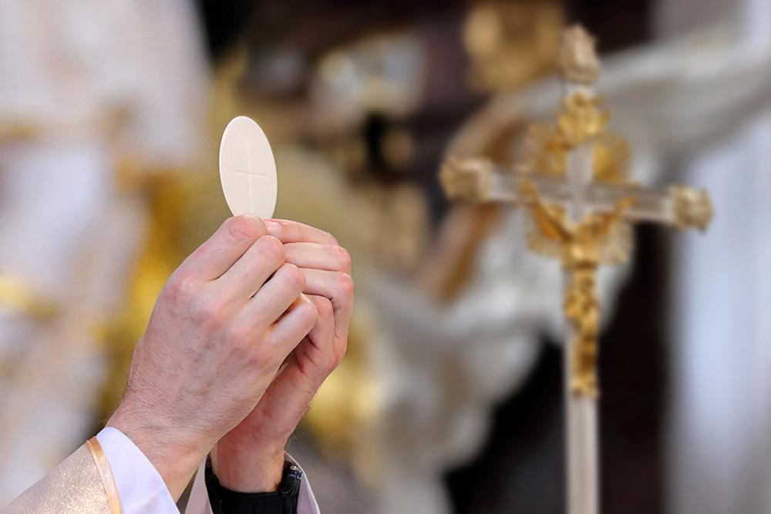
Dec 1: St. Charles de Foucauld (1858 to 1916) Martyr, religious priest
Jesus speaking to Blessed Charles - “In my unimaginable goodness, I did not merely give myself to you at my birth for a few hours or years: I am still in your hands, and shall be henceforth until the end of the world. Think of the unending good fortune I brought you in my birth: the ability to serve me—to serve me by serving your neighbor, to serve me myself, living there near you in the tabernacle. Not only can you serve me, you can also console me… How happy you should be to be able to console me at every moment of your lives!

Slide 83
Dec 1: St. Charles de Foucauld (1858 to 1916) Martyr, religious priest
Jesus speaking to Blessed Charles – “By becoming so small, so gentle a child, I was crying out to you: Have trust! Come close to me! Do not be afraid of me, come to me, give me what children need: loving embraces. Do not be afraid, do not be so frightened in the presence of such a gentle baby, smiling at you and holding out his arms to you. He is your God, but he is all smiles and gentleness. Do not be afraid.”

Slide 84
Dec 1: Ven. Leo Dupont (1806 to 1876) Apostle of The Holy Face
How short, above all, seems the (Eucharistic Adoration) hour which has fallen to our lot!...Some (read books) or simply say their rosaries, but the greater number place themselves as suppliants at the feet of our Lord, speak to Him, and receive good thoughts from Him; these last find the hour exceedingly short.

Slide 85
Dec 3: St. Francis Xavier (1506-1552) Missionary and cofounder of the Society of Jesus
St Francis Xavier found refreshment in the midst of his many labors in India; for he employed his days in toiling for souls, and his nights in the presence of the Most Blessed Sacrament.

Slide 86
Dec 3: St. Francis Xavier (1506-1552) Missionary and cofounder of the Society of Jesus
St. Francis Xavier at times when distributing Holy Communion felt so carried away by a sense of adoration toward Our Lord Who was in his hands, that he got on his knees and in that position continued giving Holy Communion.

Slide 87
Dec 4: St. Clement of Alexandria (150-216)
The Word is everything to a child: both Father and Mother, both Instructor and Nurse. ‘Eat My Flesh,’ He says, ‘and drink My Blood.’ The Lord supplies us with these intimate nutrients. He delivers over His Flesh, and pours out His Blood; and nothing is lacking for the growth of His children. O incredible mystery! (The Instructor of the Children, 202).
On the other hand, hear the Savior: “. . . . I am He that feeds you. I give Myself as Bread, of which he that has tasted experiences death no more; and I supply daily the Drink of immortality.” (Who is The Rich Man That shall be Saved? 190-210)

Slide 88
Dec 5: Bl. Nicholas Steno (1638 to 1686) Italian priest and father of the field of Geology
After a youth spent in studying and then in scientific research, Nicholas Steno at age 28 converted to the Catholic Church while watching the Corpus Christi procession, thus realizing the greatness and magnificence of the Eucharist; the Real Presence of Jesus in the Host. He then decided to become a priest and missionary in his own country.
As soon as I attentively pondered God’s favors to me, these appeared to be so many that I couldn’t help but offer to Him the best of myself and in the best way, from the bottom of my heart…Therefore, having come to know the great dignity of priesthood… I asked and obtained that I may offer the Immaculate Host to the Eternal Father for my good and the good of others.

Slide 89
Dec 7: St. Ambrose of Milan (315 to 367) Doctor of the Church and Bishop of Milan
“His poverty enriches, the fringe of His garment heals, His hunger satisfies, His death gives life, His burial gives resurrection. Therefore, He is a rich treasure, for His bread is rich. And ‘rich’ is apt for one who has eaten this bread will be unable to feel hunger. He gave it to the Apostles to distribute to a believing people, and today He gives it to us, for He, as a priest, daily consecrates it with His own words. Therefore, this bread has become the food of the saints.” (The Patriarchs, Ch. 9:38)

Slide 90
Dec 7: St. Mary Joseph Rossello (1811-1888) founder of the Daughters of Our Lady of Mercy
Go to Jesus. He loves you and is waiting for you to give you many graces. He is on the altar surrounded by angels adoring and praying. Let them make some room for you and join them in doing what they do.

Slide 91
Dec 9: Ven. Fulton Sheen (1895-1979)
A Holy Hour is not a devotion; it is a sharing in the work of redemption.
The only time our Lord asked the Apostles for anything was the night He went into agony. Not for activity did He plead but for an Hour of companionship.

Slide 92
Dec 9: Ven. Fulton Sheen (1895-1979)
I have found that it takes some time to catch fire in prayer. This has been one of the advantages of the daily Hour. It is not so brief as to prevent the soul from collecting itself and shaking off the multitudinous distractions of the world. Sitting before the Presence is like a body exposing itself before the sun to absorb its rays. Silence in the Hour is a tête-á-tête with the Lord. In those moments, one does not so much pour out written prayers, but listening takes its place. We do not say: “Listen, Lord, for Your servant speaks,” but “Speak, Lord, for Your servant hears.”

Slide 93
Dec 16: Bl. Clemente Marchisio (1833-1903) founder of the Institute of The Daughters of St. Joseph
You see, I too find myself sometimes overwhelmed by the weight of trials; but after five minutes in front of the Blessed Sacrament, which is our all, I feel entirely invigorated. Do the same when you are depressed and discouraged.

Slide 94
Dec 21: St. Peter Canisius (1521 to 1597) Doctor of The Church and Confessor
Often on fire with Love in Adoration
Why do we speak of someone being ‘on fire with love?’ The answer is simple. Fire not only strives for union with what it embraces, but seeks to transform whatever it embraces into itself. Love does likewise. As it happens to a coal, to be changed and totally converted into fire, so by a worthy reception of the Eucharist, we become changed in a wonderful manner into Christ, are made partakers of His divine nature, and grow somehow to be the very blood-brother (blood-sister) of Him (Jesus Who is), Our Head.

Slide 95
Dec 28: St. Caterina Volpicelli (1839-1893)
With a great devotion to the Eucharist, and to the Sacred Heart of Jesus, St. Caterina founded the Congregation of The Servants of the Sacred Heart and, at the request of Pope Leo XII, built a shrine in Ponticelli Italy for adoration and reparation. Throughout her life she strongly supported Eucharistic Adoration and took part in the first National Eucharistic Congress in Italy in 1891.

Slide 96
Dec 29: St. Thomas Beckett (1118-1170) martyr and archbishop of Canterbury England
St. Thomas Beckett, in his writings, indicates he was often in adoration before the Most Blessed Sacrament: “If you do not harken (heed) to me who have been wont (often) to pray for you in an abundance of tears and with groanings not a few before the Majesty of the Body of Christ.”

Slide 97
Dec 29: Sister Josefa Menendez (1890-1923) Servant of God
…, when being constrained by the fire that consumed My Heart, I devised the marvel of love, the Holy Eucharist. And while I looked at those many souls that would feed on this Heavenly Bread, I could not but see also the indifference by which so many others . . . consecrated souls . . . priests . . . would wound Me in this Sacrament. There were those who would grow cold . . . gradually yield to routine . . . and worse than routine . . . to weariness and lassitude, and little by little to tepidity

Slide 98
Dec 30: Ven. Andrew Beltrami (1870-1897) Salesian Priest
“Wherever I may be I will often think of Jesus in the Blessed Sacrament. I will fix my thoughts on the holy Tabernacle — even when I happen to wake up at night — adoring Him from where I am, calling to Jesus in the Blessed Sacrament, offering up to Him the action I am performing. I will install one telegraph cable from my study to the church, another from my bedroom, and a third from our refectory; and as often as I can, I will send messages of love to Jesus in the Blessed Sacrament.”

Slide 99
Jan 2: St. Basil the Great (330-379)
Eternal Son of the living God, Whom I here acknowledge really present! I adore Thee with all the powers of my soul. Prostrate with the Angels in the most profound reverence, I love Thee, O my Savior, Whom I now behold on the throne of Thy love! O dread Majesty, O infinite Mercy! Save me, forgive me! Grant that I may never more be separated from Thee.

Slide 100
Jan 4: St. Elizabeth Ann Seton (1774-1821)
How sweet, the presence of Jesus to the longing and harassed soul! He is instant peace and balm to every wound.

Slide 101
Jan 28: St. Thomas Aquinas (1225-1274)
St. Thomas Aquinas once said that he learned more from prayer before the Blessed Sacrament than from many hours of study.

Slide 102
Jan 31: St. John Bosco (1815-1888)
Trust all things to Jesus in the Blessed Sacrament and to Mary Help of Christians and you will see what miracles are.
There are two things the devil is deadly afraid of: fervent Communions and frequent visits to the Blessed Sacrament.

Slide 103
Jan 31: St. John Bosco (1815-1888)
We envy the shepherds who went to visit the grotto of Bethlehem to see Him, kissed His little hand, and offered Him their gifts. “Lucky shepherds!” we exclaim. And yet there is no reason to envy them, for their fortune is ours, too. The same Jesus they visited in the grotto is in our tabernacle. The only difference is that the shepherds saw Him with the eyes of the body, whereas we see Him with the eyes of faith. Nothing will please Him more than our frequent visits to Him.

Slide 104
Jan 31: St. John Bosco (1815-1888)
Do you want the Lord to give you many graces? Visit Him often. Do you want Him to give you few graces? Visit Him rarely. Do you want the devil to attack you? Visit Jesus rarely in the Blessed Sacrament. Do you want him to flee from you? Visit Jesus often!

Slide 105
Feb 8: St. Josephine Bakhita (1869-1947)
St. Josephine spent hours in Eucharistic Adoration and, when one Sister asked if it tired her, she said, “Not at all! I have been having a wonderful time with Him. He has waited so long for me.”

Slide 106
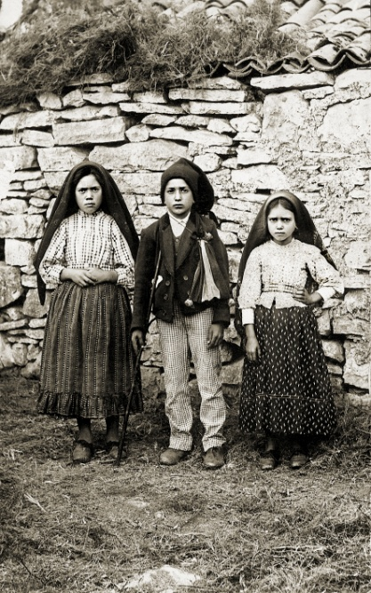
Feb 20: St. Francisco Marto (1908-1919) (shepherd to whom Our Lady appeared in Fatima)
“I was thinking of God who is so sad because of all the sins: if only I could comfort him!”
Francisco used to follow Lucia to go to a church on her way to school and stayed there with Jesus hidden in Eucharist until Lucia returned from school. Later, he was walking very slowly. “What’s the matter?” Lucia asked. “You seem unable to walk!” “I’ve such a bad headache, and I feel as though I’m going to fall.” “Then don’t come. Stay at home!” “I don’t want to. I’d rather stay in the church with the Hidden Jesus.”
When Francisco fell too ill to leave his room, he said to Lucia, “Look! Go to the church and give my love to the Hidden Jesus. What hurts me most is that I cannot go there myself and stay a while with the Hidden Jesus.”

Slide 107
Feb 20: St. Jacinta Marto (1910-1920) (shepherd to whom Our Lady appeared in Fatima)
When visited by Lucia, Jacinta in her sick bed often say,
“Listen! Tell the Hidden Jesus that I like Him very much, that I really love Him very much indeed.”
“Tell Jesus I send Him my love, and I long to see Him.”
Jacinta’s biggest consolation near her death was the Blessed Sacrament Chapel in the orphanage she stayed for two weeks before going to the hospital to die. She would sit for long periods of time communing with the Hidden Jesus.

Slide 108
Mar 3: St. Katharine Drexel (1858-1955)
My sweetest Joy is to be in the presence of Jesus in the holy Sacrament. I beg that when obliged to withdraw in body, I may leave my heart before the holy Sacrament. How I would miss Our Lord if He were to be away from me by His presence in the Blessed Sacrament.

Slide 109
Mar 3: Ven. Concepcion Cabrera de Armida (1862-1937)
Jesus speaking to Venerable Concepcion “I want souls who are dedicated with fervor, with determination and without looking for rest, to plead day and night (before the Blessed Sacrament) for my priests.”

Slide 110
Mar 8: St. John of God (1495-1550)
“Love our Lord Jesus Christ in the Eucharist above all things in the world.”

Slide 111
Mar 19: St. Joseph
Devotions to St. Joseph (Brian Moore SJ):
In your arms, Joseph, you carried the Bread of Life come down from heaven for the life of the world. At Bethlehem, in Egypt, in Nazareth you provided for Him a home the best you could. Come to my aid and help me to prepare my heart as best I can, so as to receive with faith and to house with charity, the Christ who comes to me in this great Sacrament.

Slide 112
Mar 19: St. Joseph
Ancient devotions for Holy Communion
Happy and blessed are you, O Joseph, to whom it was given not only to see and to hear that God Whom many kings desired to see and saw not, to hear and heard not; but also to bear Him in your arms, to embrace Him, to clothe Him and to guard and defend Him.
V Pray for us, O blessed Joseph,
R That we may be made worthy of the promises of Christ.

Slide 113
Mar 19: St. Joseph
O God, Who has given us a royal Priesthood, grant to us we beseech You, that as Blessed Joseph was found worthy to handle with his hands, and to bear within his arms, You Only-begotten Son, born of the Virgin Mary, so may we be made fit, by cleanness of heart and innocence of works, to wait upon Your Holy Altars that we may worthily receive the Most Sacred Body and Blood of Your Son now in this present world, and deserve to attain an everlasting reward in the world to come. Through the same Christ our Lord, Amen.

Slide 114
Apr 11: St. Gemma Galgani (1878-1903)
“Let us go to Jesus. He is all alone and hardly anyone thinks of Him. Poor Jesus!”
“Listen, Jesus, to what my confessor asks me: ‘What do you do, Gemma, when you are before Jesus?’ ‘What do I do? If I am before Jesus crucified, I suffer; and If I am with Jesus in His Sacrament, I love.’ ”

Slide 115
Apr 11: St. Gemma Galgani (1878-1903)
“Fire! Fire in my heart! This morning it is burning......Dear Jesus, I love you so much! I shall endeavor always to love You; I shall live to love You; I shall die to love You!....Give me wings oh Jesus, so I can fly to Your throne!”

Slide 116
Apr 11: St. Gemma Galgani (1878-1903)
“My God, open Your Heart to me. O Jesus, open to me Your sacramental breast, because I wish to place all my affections there. O Jesus, how much I love You! But why do You act towards me with so much love, while I offend You with countless ingratitude? This thought alone, if I could but comprehend it, should be enough to turn me into a furnace of love. Is it not an irresistible love to love Him who is not angry with one who always offends Him?”

Slide 117
Apr 11: St. Gemma Galgani (1878-1903)
“O Jesus, if I only considered attentively Your immense love for me, how greatly I should excel in every virtue! Pardon me, O Jesus, so much carelessness; pardon such great ignorance. My God! Jesus my love, infinite Goodness! What would have become of me if You had not drawn me to You? Open to me Your Heart, open to me Your sacramental breast; I open mine to You.”

Slide 118
Apr 21: St. Anselm of Canterbury (1033-1109)
“I adore and venerate you as much as ever I can, though my love is so cold, my devotion so poor. Thank you for the good gift of this your holy Body and Blood.”

Slide 119
Apr 28: St. Gianna Borella Molla (1922-1962)
Smile at Jesus who you approach at Mass, in Holy Communion and in Eucharistic Adoration.

Slide 120
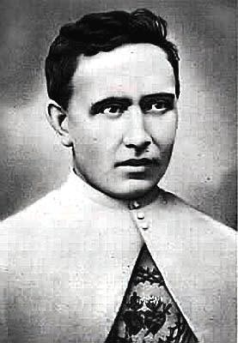
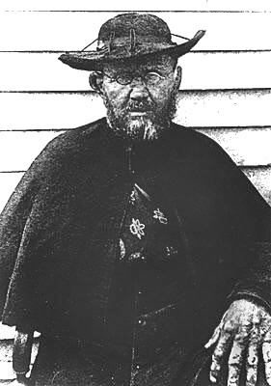
May 10: St. Damien of Molokai (1840-1889) Missionary priest for lepers
It is in the Blessed Sacrament that we find strength. Without my daily Holy Hour before the Blessed Sacrament, I could not have lasted one single day.

Slide 121
May 10: St. Damien of Molokai (1840-1889) Missionary priest for lepers
“The Blessed Sacrament is indeed the stimulus for us all, for me as it should be for you, to forsake all worldly ambitions. Without the constant presence of our Divine Master upon the altar in my poor chapels, I never could have persevered casting my lot with the lepers of Molokai; the foreseen consequence of which begins now to appear on my skin, and is felt throughout the body. Holy Communion being the daily bread of a priest, I feel myself happy, well pleased, and resigned in the rather exceptional circumstances in which it has pleased Divine Providence to put me.”

Slide 122
May 12: St. Leopold Mandic of Castelnuovo (1866-1942)
St. Leopold used to chase women out of church who were immodestly dressed, calling them “flesh for sale”.

Slide 123
May 13: Our Lady of Fatima, 1917
The Angel arose and gave Lucia the Host and the contents of the chalice was given to Francisco and Jacinta. Again he spoke: “Take and drink the Body and Blood of Jesus Christ, horribly outraged by ungrateful men. Make reparation for their crimes and console your God.”

Slide 124
May 13: Our Lady of Fatima, 1917
Do not offend the Lord our God anymore, because He is already so much offended.
Pray, pray very much, and make sacrifices for sinners; for many souls go to hell, because there are none to sacrifice themselves and to pray for them.
‘The sins that bring most souls to Hell are the sins of the flesh.’
‘Many marriages are not good; they do not please Our Lord and are not of God’
Certain fashions will be introduced that will offend Our Lord very much.

Slide 125
May 13: Our Lady of Fatima, 1917
‘Sacrifice yourselves for sinners and say many times, especially whenever you make some sacrifice: O Jesus it is for the love of You, for the conversion of sinners, and in the reparation for the sins committed against the Immaculate Heart of Mary.‘’

Slide 126
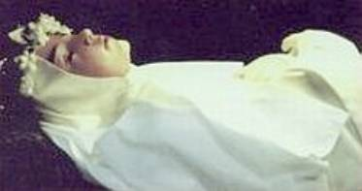
May 13: Bl. Imelda Lambertini (1322-1333) Patroness of First Communicants
Blessed Imelda had a fantastic devotion to the Eucharist and an overwhelming desire to receive her first communion at an early age. So much so that upon reception of her first communion God took her straight to Heaven.

Slide 127
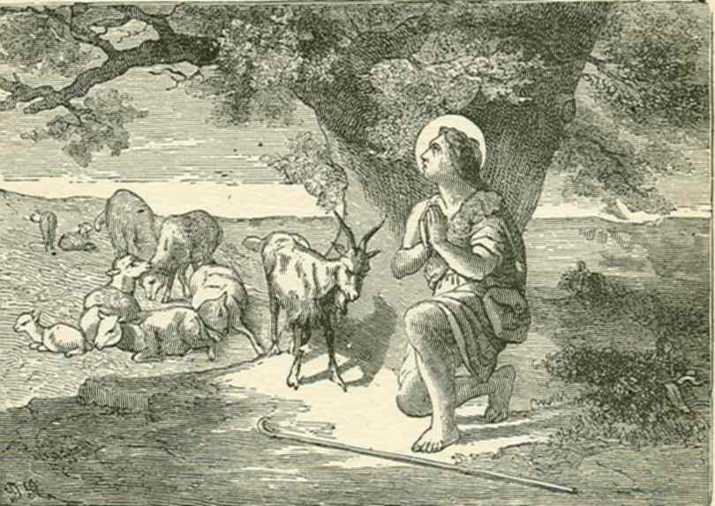
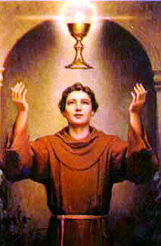
May 17: St. Paschal Baylon (1540-1592)
Kneel Down! Kneel Down! Do you not see on high the golden Chalice and the bright rays darting from the Host? It is the Blessed Sacrament of the Altar. The Angels are adoring It. Come let us join our adoration to theirs.

Slide 128
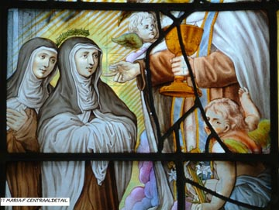
May 25: St. Mary Magdalene of Pazzi (1566-1607)
Jesus desired St. Mary Magdalene of Pazzi to visit Him in the Most Blessed Sacrament thirty three times a day; and this beloved spouse of His faithfully obeyed Him, and in all her visits to the altar approached it as near as she possibly could.

Slide 129
May 25: St. Mary Magdalene of Pazzi (1566-1607)
In all your visits to our Savior, frequently offer His precious Blood to the Eternal Father.
You will find visits to the Most Blessed Sacrament very conducive to increase in you Divine Love.
Come to love Love!

Slide 130
May 26: St. Philip Neri (1515-1595)
Devotion to the Blessed Sacrament and devotion to the Blessed Virgin are not simply the best way, but in fact are the only way to conserve purity.... Chastity is not possible without the Eucharist.
Can you feel the fragrance of Paradise which diffuses Itself from the Tabernacle?

Slide 131
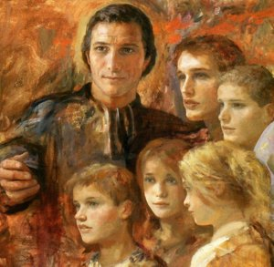
Jun 6: St. Marcellin Champagnat (1789-1840) Founder of Marist Brothers of the Schools
It is for us that, during 18 hundred years, our divine Savior has remained day and night on our altars that we may have recourse to Him in all our needs; and nothing so much afflicts His divine Heart as our ingratitude for such a favor, and our neglect to visit Him and ask His blessing.

Slide 132
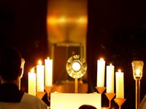
Jun 10: Bl. Edward Poppe (1890-1924)
Oftentimes, I just stay there, simply seated (in Eucharistic Adoration), receiving food. This calm unconscious repose does me good. I am nourished, my strength returns.
Oh Jesus, how little men love you! At least the two of us love each other.

Slide 133
Jun 14: Bl. Maria Candida (1884-1949)
Her deep devotion to the Blessed Sacrament dominated her entire spiritual life, so much so that she considered it a heavy and painful cross if ever deprived of daily Holy Communion.
I ask my Jesus (that I can) be a guardian of all the tabernacles of the world, until the end of time.

Slide 134
Jun 19: Ven. Matt Talbot (1856-1925)
How can anyone be lonely, with Our Lord in the Blessed Sacrament?

Slide 135
June 25: Maximus of Turin (380 - 465)
At Christmas he was born a man; today he is reborn sacramentally. Then he was born from the Virgin; today he is born in mystery. When he was born a man, his mother Mary held him close to her heart; when he is born in mystery, God the Father embraces him with his voice when he says: This is my beloved Son in whom I am well pleased: listen to him. The mother caresses the tender baby on her lap; the Father serves his Son by his loving testimony. The mother holds the child for the Magi to adore; the Father reveals that his Son is to be worshiped by all the nations.

Slide 136
July 3 Venerable Antonietta Meo 15-12-1930 to 3-7-1937
I always want to be Your lamp which burns night and day before You and near You in the Sacrament of the altar.
When you feel pain, you have to keep quiet and offer it to Jesus for a sinner. Jesus suffered so much for us, but he hadn’t committed any sin: He was God. How could we complain, we who are sinners and always offend Him?

Slide 137
July 3 Venerable Antonietta Meo 15-12-1930 to 3-7-1937
I want to stay with Him on the cross because I love Him.
Dear Jesus, I know people always offend You, I want to amend all these offences, dear Jesus if You were a man like us and if You locked Yourself inside a House You wouldn't hear all the offences caused to You, in the same way You could come into my heart and stay locked with me and I'll make a lot of sacrifices for You and I'll tell You some sweet words to comfort You.

Slide 138
July 4: Bl. Pier Giorgio Frassati (1901-1925)
All of Blessed Pier’s actions began with the contemplation of Jesus. He felt a strong constant urge to be near the Blessed Sacrament and would spend the whole night in adoration when it was offered.
“When you are totally consumed by the Eucharistic fire, then you will be able more consciously to thank God, who has called you to become part of His family. Then you will enjoy the peace that those who are happy in this world have never experienced, because true happiness, oh young people, does not consist in the pleasures of this world, or in earthly things, but in peace of conscience, which we only have if we are pure of heart and mind,”

Slide 139
July 14: St. Kateri Tekakwitha (1656-1680)
First native American saint in USA, Lily of the Mohawks and Lily of the Holy Eucharist
“Every morning, even in bitterest winter, she stood before the chapel door until it opened at four and remained there until after the last Mass.”

Slide 140
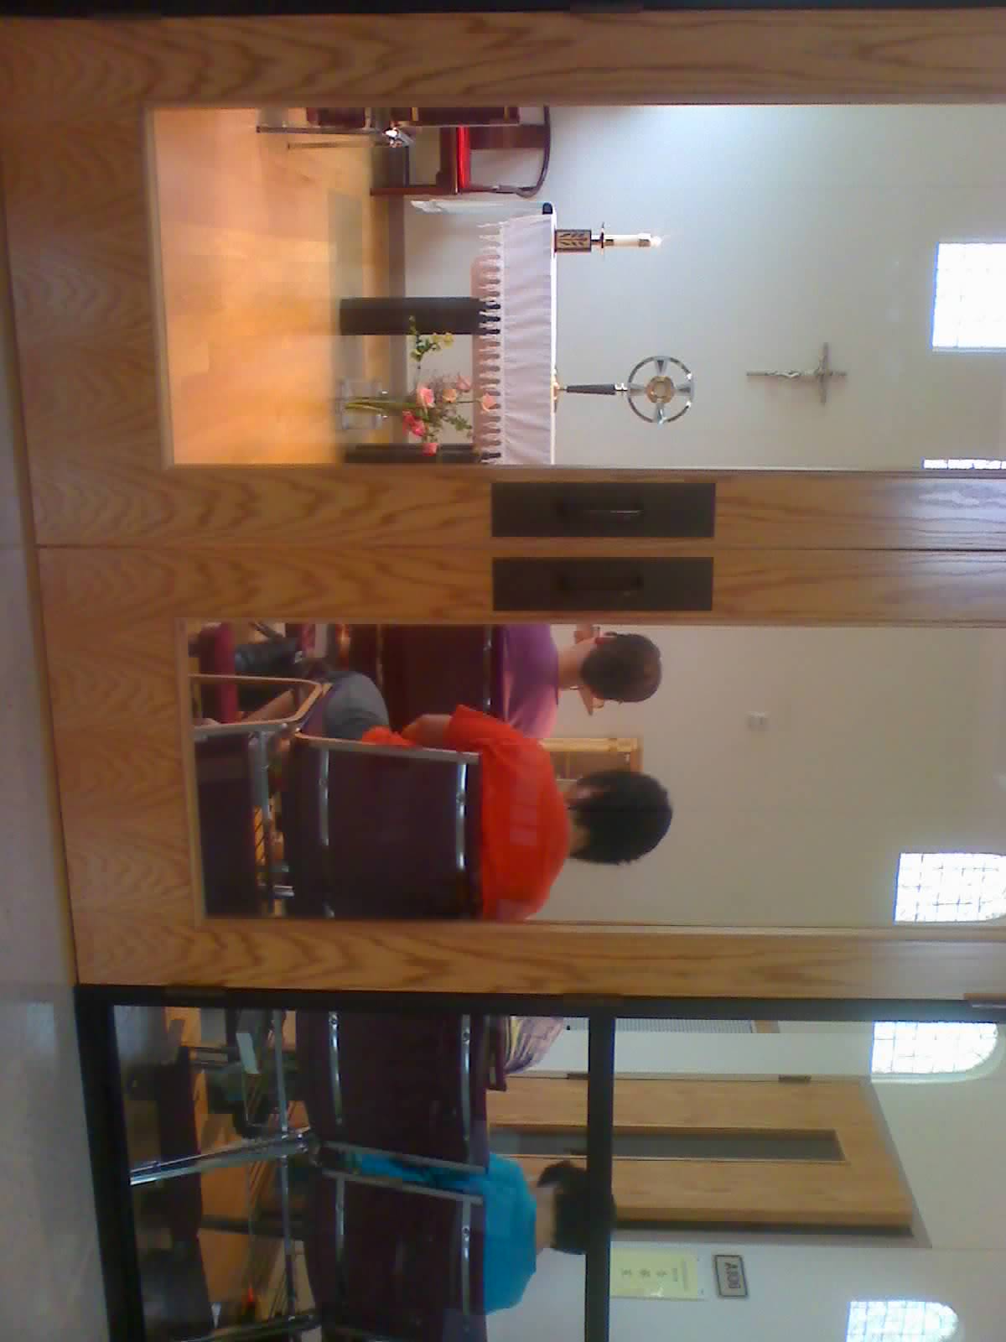
Eucharistic adoration
This hour that Jesus wants you to spend with Him is spent any way you want to: reading the Holy Bible; praying the Holy Rosary; with your favorite prayer book; speaking to Jesus heart to Heart, as one does with a friend;

Slide 141
Eucharistic adoration
you may be so tired or troubled or worn out, that you may just want to sit, and relax, and enjoy the sweet peace that comes from simply being with the One who loves you the most, Jesus in the Most Blessed Sacrament.

Slide 142
Please sign up for an hour per week to accompany Jesus
“I am the bread of life; whoever comes to me will never hunger, and whoever believes in me will never thirst.” (John 6:35)

Slide 143
Please sign up for an hour per week to accompany Jesus
so marred was his look beyond that of man, and his appearance beyond that of mortals (Isaiah 52:14)

Slide 144
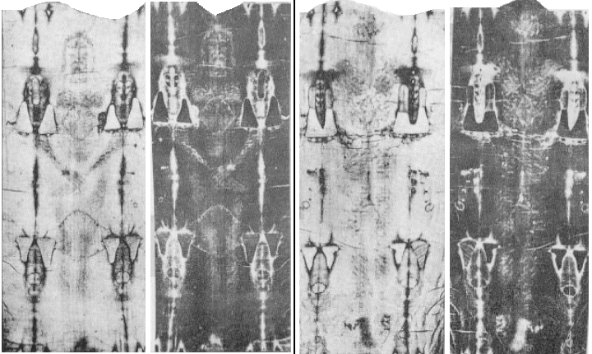
so marred was his look beyond that of man, and his appearance beyond that of mortals (Isaiah 52:14)
Please sign up for an hour per week to accompany Jesus.

Slide 145
Fatima prayer taught by angel
My God, I believe, I adore, I hope, and I love You! I ask pardon of You for those who do not believe, do not adore, do not hope, and do not love You.
O most Holy Trinity, Father, Son, and Holy Spirit, I adore You profoundly and offer You the most Precious Body, Blood, Soul, and Divinity of Jesus Christ, present in all the tabernacles of the earth, in reparation for the outrages, sacrileges, and indifferences with which He Himself is offended. And through the infinite merits of His Most Sacred Heart and of the Immaculate Heart of Mary, I beg of You the conversion of poor sinners. Amen.

Slide 146
Please sign up for an hour per week to accompany Jesus
“My soul is sorrowful even unto death. Could you not watch one hour with me?” (Mathew 26:38,40)
The only time our Lord asked the Apostles for anything was the night He went into agony. Not for activity did He plead but for an Hour of companionship. – Fulton Sheen

Slide 147
Please sign up for an hour per week to accompany Jesus
He had said to him a third time, “Do you love me?” (John 21:17)

Slide 148
Please sign up for an hour per week to accompany Jesus
May we come to share in the divinity of Christ, who humbled himself to share in our humanity

Slide 149
Please sign up for an hour per week to accompany Jesus
Oh Sacrament Most Holy
Oh Sacrament Divine
All praise and all thanksgiving
be every moment Thine.

Slide 150
Father Alexander Men (1935 to 9-9-1990)
Christ never left us any book, any school, any doctrine. He only left us His own Self.
The summit and center of the Eucharist is incarnation of Christ in us.

Slide 151
This is my body which will be given up for you Please sign up for an hour per week to accompany Jesus

Slide 152
It will be shed for you and for all, so that sins may be forgiven Please sign up for an hour per week to accompany Jesus

Slide 153
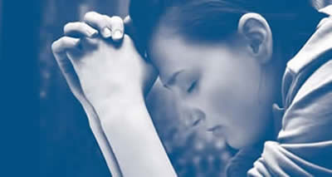
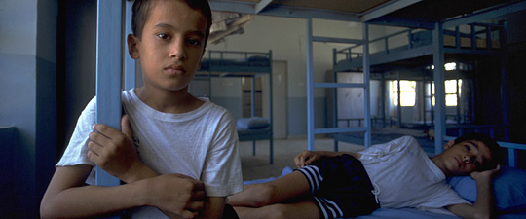
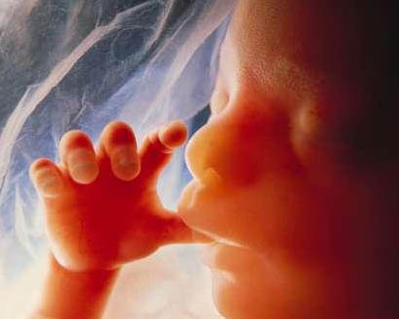
“Come to me, all you who labor and are burdened, and I will give you rest.” (Mathew 11:28)
Please sign up for an hour per week to accompany Jesus

