Slide 1
Accompanying Jesus in the Eucharist Eucharist meditations: http://www.catholicworld.info/eucharist/ files: http://www.catholicworld.info/eucharist/files/ IT Education: http://www.catholicworld.info/cis/scholarship.html Adore Jesus to save HK http://www.peam.org/40/
h.a.chan@ieee.org
I do not possess anything. All I have is only borrowed from God so that I may serve others.

Slide 2
Anima Christi (Soul of Christ)
Soul of Christ, sanctify me. Body of Christ, save me. Blood of Christ, inebriate me. Water from Christ's side, wash me. Passion of Christ, strengthen me. O good Jesus, hear me. Within Your wounds hide me. Suffer me not to be separated from You. From the malicious enemy defend me. In the Hour of my death, call me and bid me come to You. That, with Your Saints, I may praise You forever and ever. Amen
+1

Slide 3
Act of Spiritual Communion (St. Alphonsus Liguori)
My Jesus, I believe that You are present in the Blessed Sacrament. I love You above all things and I desire You in my soul. Since I cannot now receive You sacramentally, come at least spiritually into my heart. As though You were already there, I embrace You and unite myself wholly to You; permit not that I should ever be separated from You. Amen.
+1

Slide 4
St. Francis Xavier 聖方濟各沙勿略
Not to escape hell’s fire,
nor to win heaven’s grace,
but because you loved us, Lord.
我的天主，我愛祢，
不是因為我怕下地獄，
也不是因為我想升天堂，
而是因為你愛了我！

Slide 5
Accompanying Jesus
1. Why so important today?
2. Fatima messages
3. Commitment even in my weaknesses.
4. Commitment and the largest pearl.
5. Sweetness vs dryness
6. Heart of the church with St. Therese
7. Eucharist Experience at mass
8. Could you not watch an hour with me
9. May I borrow your Immaculate Heart!
10. Questions, comments, and commitment
11. Spiritual Communion
+1

Slide 6
Accompanying Jesus
1. Why so important today?
2. Fatima messages
3. Commitment even in my weaknesses.
4. Commitment and the largest pearl.
5. Sweetness vs dryness
6. Heart of the church with St. Therese
7. Eucharist Experience at mass
8. Could you not watch an hour with me
9. May I borrow your Immaculate Heart!
10. Questions, comments, and commitment
11. Spiritual Communion
+1

Slide 7
Vision of Pope Leo XIII on Oct 13 1884
Pope Leo XIII in a vision heard the following:
Satan: “I can destroy your Church.” “75 to 100 years, and a greater power over those who will give themselves over to my service.”
St. John Paull II on 1994: Surely, this scene was very present to Pope Leon XIII, when, at the end of the previous century, he introduced to the entire Church a special prayer to St. Michael

Slide 8
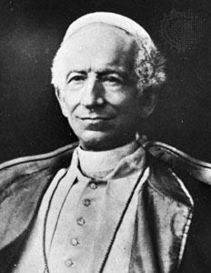
Prayer to Saint Michael
Saint Michael the Archangel, defend us in battle. Be our protection against the wickedness and snares of the devil; may God rebuke him, we humbly pray. O Prince of the heavenly host, by the power of God, thrust into hell Satan and all the evil spirits who wander through the world seeking the ruin of souls. Amen.

Slide 9
The world today
Having spent the majority of my career in science and technology, I am most thankful to God,
who has entrusted us with talents to participate in God’s work to continue to buildup the world and the society.
The work of God in creating the world is continuing today through our participation.

Slide 10
The world today
+
The work of God in creating the world is continuing today through our participation.
Only 2% of USA population in farming has produced enough food for the entire country and for export,
Only 3% in construction is able to produce enough housing.
No one should starve or be homeless!
Many new professions to produce products and services to enable more abundant life
“I came so that they might have life and have it more abundantly.” (John 10:10)

Slide 11
The world today
+
Today, God has gifted human beings with information technology, with hi-tech, with …,
This generation has far more material wealth than all our ancestors throughout the history
In return God receives from the greater number nothing but ingratitude
They have rejected God to follow the idols of wealth, fame, power, sex for pleasure

Slide 12
In this generation that has rejected God
+
At work: economy, fear, cannot trust
Many people are working long hours
Economy problem, jobless rate, contaminate environment and food
How to live out faith in profession?
At home: disintegration of family (nearly 50% marriages separate in advanced countries)

Slide 13
Spreading the errors to the world
At work: economy, fear, cannot trust
The gift to build the society is misused in seeking the falseness of the world.
At home: disintegration of family
The gift to build up family has been largely misused. The gift of medicine is misused as a tool of death and is used to downgrade sex to a mere lust of the flesh without commitment and without children.
The culture of death is spreading throughout the world.
+5

Slide 14
Morality over several thousand years in human history
Children are ordinarily entitled to a relationship with father and mother
Marriage
Family
Sex
Children

Slide 15
Morality over several thousand years in human history
60
Children are ordinarily entitled to a relationship with father and mother
Mothers and fathers are not interchangeable as a general principle; each makes unique contributions
Biology (not government) is the primary way to define parenthood
M
F
Marriage
Family
Sex
Children

Slide 16
wander through the world seeking the ruin of souls
Reject absolute truth
separates sex and children bearing from each other and from marriage
M/F
F/M
Marriage
X
X
Sex
Children
X

Slide 17
wander through the world seeking the ruin of souls
60
Reject absolute truth
separates sex and children bearing from each other and from marriage
men and women are interchangeable
M/F
F/M
Marriage
X
X
Sex
Children
X

Slide 18
Rejection of Absolute Truth
+
Sexual revolution results in:
harm to children of divorce, 3/4 divorces involve a reluctant spouse, donor conceived issues, heart-broken career women
Secular society’s interpretation of birth control, co-habitation, and abortion as new norms generated an incredible mistrust among the sexes, including alarming statistical data on unplanned pregnancy rate, abortion rate, births outside marriage
M/F
F/M
Marriage
X
X
Sex
Children
X

Slide 19
Do not offend the Lord our God any more, because He is already so much offended.
Our Lady of Fatima (1917 and later):
‘The sins that bring most souls to Hell are the sins of the flesh.’
‘Many marriages are not good; they do not please Our Lord and are not of God.’
‘Certain fashions will be introduced that will offend Our Lord very much.’

Slide 20
The Church teaching of Truth
1930: Pope Pius XI Catholic teaching on contraception
1968: Pope Paul VI Humane Vitae (on the regulation of Birth)
1980: Protestants also found contraceptive pills abortive
1981-84: St. John Paul II Theology of the Body
2016: Pope Francis: children have right to be brought up in family of father and mother

Slide 21
Pornography Statistics: 2015 Report www.covenanteyes.com
64% college men and 18% college women use porn at least once a week
1/3 women according to Marie Claire survey
Increasing rapidly with mobile phone, especially for women
56% of divorce case involve one party having an obsessive interest in pornographic websites
Prolonged exposure to pornography leads to:
a diminished trust between intimate couples
the belief that promiscuity is the natural state
cynicism about love or the need for affection between sexual partners
the belief that marriage is sexually confining
a lack of attraction to family and child-raising

Slide 22
The Church teaching of Truth
During year 33–2000, number of Christians martyred
70,000,000
Among which martyred during year 1901–2000 were
45,000,000
e.g., 1,000,000 Catholics were martyred for opposing Nazis and defending Jews

Slide 23
Sexual revolution
1960: Contraceptive pills introduced
Immodest dress spread throughout the world
Pornography from magazine/newspaper to movie/TV to Internet
Divorce rate rapidly increased to over 50%
1974: legalize abortion in US, 1 in 4 babies surgically aborted. “Planned Parenthood” push abortion law throughout the world
1980: discovered AIDs transmitted among gay in USA, spread to heterogeneous transmission in Africa, condoms in school, then China and India
Chemical abortion pills available to anybody
Homosexual rights law, same sex marriage, teach in school
Sex as a choice

Slide 24
So stubborn in the errors of rejecting morality
In all the countries in southern Africa, an estimated 1/3 of the population have HIV.
It is already spreading fast in Asia
HIV was originally transmitted through sex among gays, but have later transmitted to women, and to their children through pregnancy – many are innocent. In particular, many innocent children have lost their parents through HIV and these orphans are also infected.
Yet the primary response from United Nation is to distribute condoms to all school children!
+2

Slide 25
Students’s sexual behavior
high school students 2013 survey www.cdc.gov/mmwr/pdf/ss/ss6304.pdf |  | Boys | Girls
before age 13: had first sex | 5.6% | 8.3% | 3.1%
9-12 grade: had sex | 47%
9 grade: sexually active (within past 3 months) | 19.6%
12 grade: sexually active(within past 3months) | 49.3%
Youth: first sex with stranger or casual friend |  | 28% | 16%

Slide 26
Students’s sexual behavior
univ students 2015 survey www.acha-ncha.org/reports_ACHA-NCHAIIc.html
In past 12 months: had sex with ≥1 partner |  | 65% | 68%
In past 12 months: had sex with ≥3 partners |  | 17% | 12%
Have sexually transmitted disease | 25%

Slide 27
Some figures
Pornography addiction
50% men, 20% women
20.9 million globally
Estimated (2016) 1 in 6 reported endangered runaways were likely child sex trafficking victims
4.5 million of trafficked persons are sexually exploited
Up to 300,000 Americans under 18 are lured into the commercial sex trade every year

Slide 28
Sin and immorality standing up in coalition/kingdom to trample morality and truth
To sin has become a right:
abortion
contraceptives
homosexual behavior
redefine marriage
sex workers
artificial fertilization
sex education

Slide 29
Immorality standing up in kingdom of sin to trample morality and truth (abortion, contraceptives, homosexual marriage, sex workers, artificial fertilization)
e.g., homosexuality in US military:
Unlawful
Don’t ask, don’t tell (Clinton)
Legal (Obama)
Against homosexuality (sexual act): penalty by law
Guidance/Therapy (psychology) for homosexual orientation: penalty by law

Slide 30
Sex education
e.g., homosexuality in US military:
Unlawful
Don’t ask, don’t tell (Clinton)
Legal (Obama)
Against homosexuality (sexual act): penalty by law
Guidance/Therapy (psychology) for homosexual orientation: penalty by law
Change education on homosexuality from childhood

Slide 31
Sexual revolution
1960: Contraceptive pills introduced
Immodest dress spread throughout the world
Pornography from magazine/newspaper to movie/TV to Internet
Divorce rate rapidly increase to over 50%
1974: legalize abortion in US, 1 in 4 babies surgically aborted. “Planned Parenthood” push abortion law throughout the world throughout the world
1980: discovered AIDs transmitted among gay in USA, spread to heterogeneous transmission in Africa, condoms in school, then China and India
Chemical abortion pills available to anybody
Homosexual rights law, same sex marriage, teach in school
Sex as a choice

Slide 32
The world today
Sexual revolution:
separates sex and children bearing from each other and from marriage
men and women are interchangeable
harmful to children of divorce, 3/4 divorces involve a reluctant spouse, donor conceived issues, heart-broken career women
Secular society’s interpretation of birth control, co-habitation, and abortion as new norms generated an incredible mistrust among the sexes, including alarming statistical data on unplanned pregnancy rate, abortion rate, births outside marriage
Children are ordinarily entitled to a relationship with father and mother
Mothers and fathers are not interchangeable as a general principle, each makes unique contributions
Biology (not government) is the primary way to define parenthood

Slide 33
In this generation that has rejected God
Even in our Church:
80-90% Catholics in advanced countries do not practice
Out of the 10-20% practicing Catholics, only 10% are performing 90% of the services

Slide 34
Misuse of God’s gift
Misuse of God’s gift of sex
About 50% of marriages results in separation
Families disintegrated, marriage redefined
Misuse of God’s gift of technology, medicine
1945: 100,000 innocent people killed in A-bomb

Slide 35
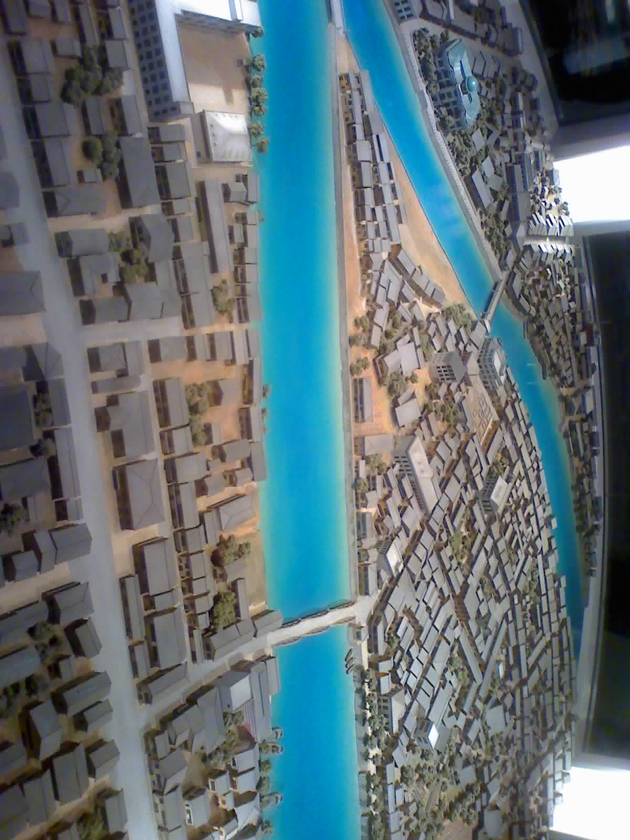
Hiroshima before A-bomb

Slide 36
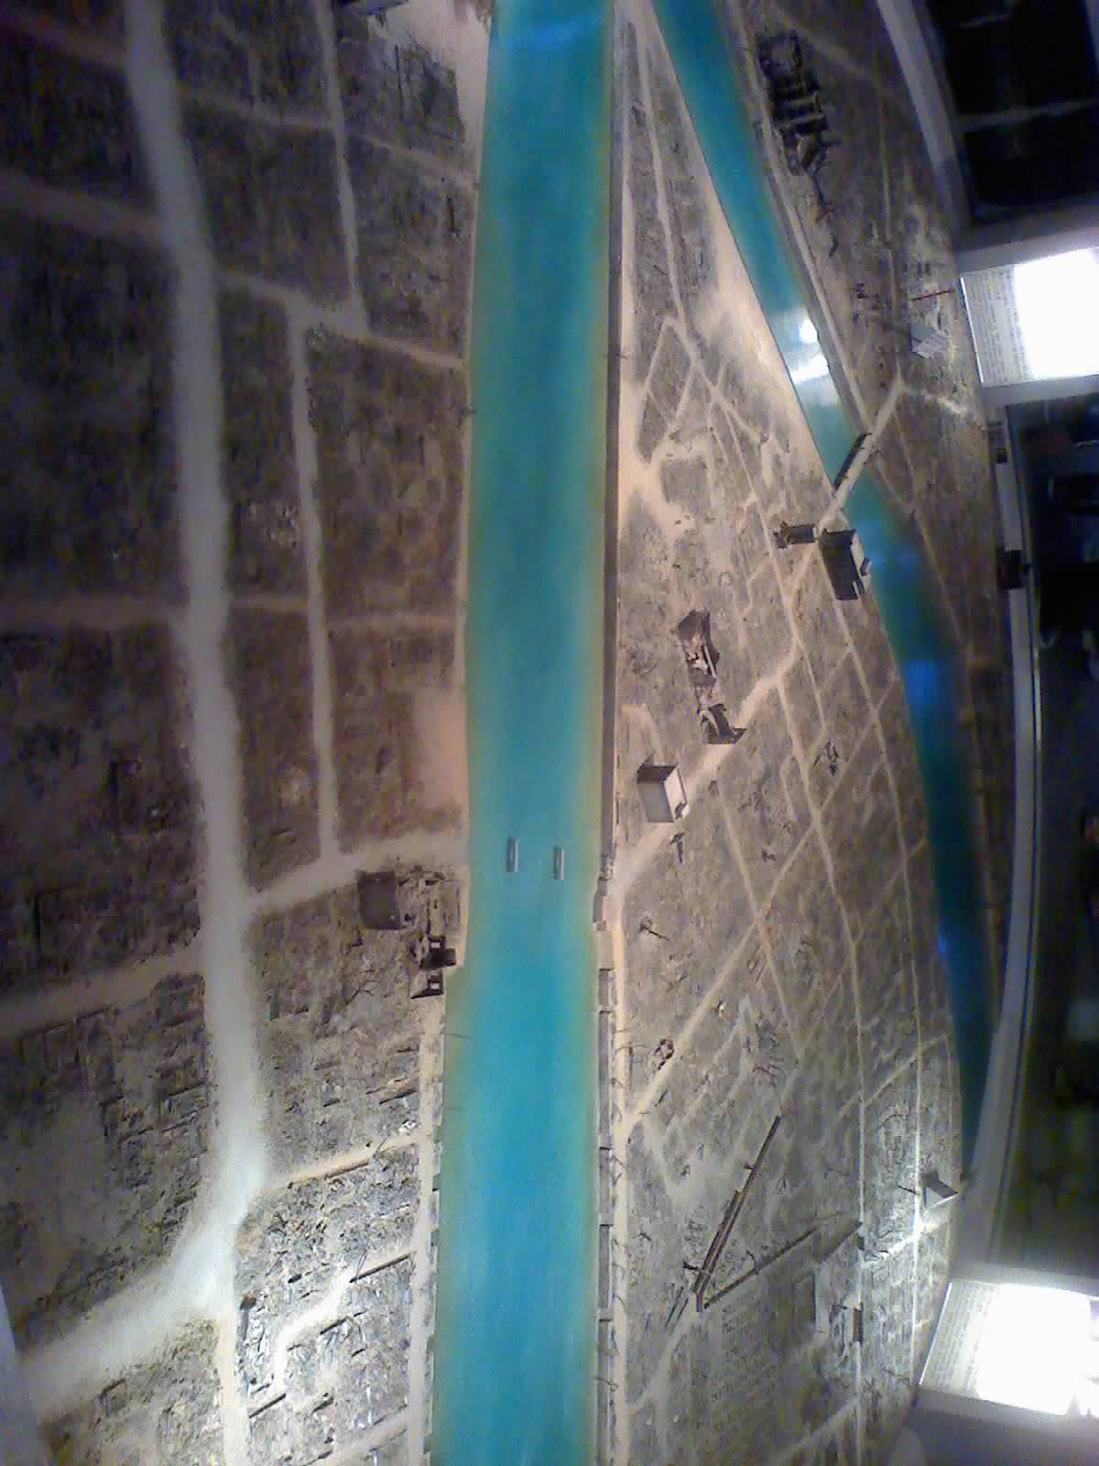
Hiroshima after A-bomb

Slide 37
Atomic bomb on Aug 6 1945 in Hiroshima
Blast, heat, radiation:
Within 2 km from hypocenter: leveled
Within 25 km: black, radioactive rain
100,000 deaths by end of 1945
Many more injured and with lifelong suffering

Slide 38
Atomic bomb on Aug 6 1945 in Hiroshima
Blast, heat, radiation:
Within 2 km from hypocenter: leveled
Within 25 km: black, radioactive rain
100,000 deaths by end of 1945
Many more injured and with lifelong suffering
Damage of the Atomic bomb, which kills people so discriminately and without warning, has shown people how much evil can be caused when misusing the gift of science and technology from God.
+1

Slide 39
Memorial Cathedral for World Peace
The priest of the former parish building which is 1.6 km from the hypocenter at this site was critically injured. In 1950 he started the project to build this memorial cathedral to pray for peace and to heal the wound of the people. It had taken 4 years to complete. Today, people come to this Cathedral to pray, and it is joined by other churches too.

Slide 40
Other ignorance and misuse of technology
Worldwide, 50 million innocent lives yearly (140,000 daily) are being killed in abortion.
We are killing more each day than the atomic bomb in Hiroshima!
Life as usual?
one A-bomb is dropped on Earth each day!
Would the entire world: government, army, navy, air-force, police not sleep until it is stopped
Yet with our blind eyes not visually seeing these babies and in our ignorance, the world let the errors continue.
+2

Slide 41
State of Emergency
Misuse of God’s gift of sex
About 50% of marriages results in separation
Families disintegrated, marriage redefined
Misuse of God’s gift of technology, medicine
1945: 100,000 innocent people killed in A-bomb
Today: 140,000 innocent babies killed every day – as serious as if an A-bomb is dropped on Earth on each year
24% population in USA Catholics
Yet 78% of them are not practicing

Slide 42
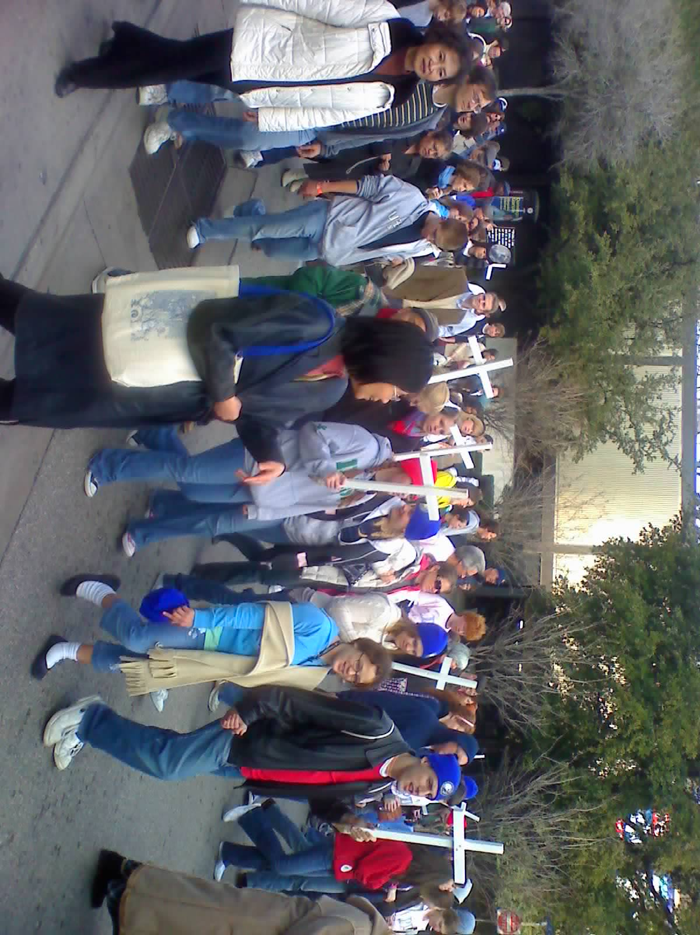
Annual Pro-life march in Dallas

Slide 43
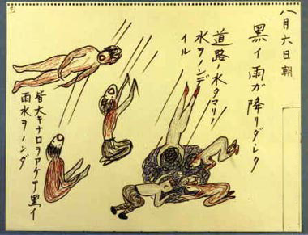
Ignorant people drinking black (radioactive) raindrops

Slide 44
So stubborn in the errors of rejecting morality
60
In all the countries in southern Africa, an estimated 1/3 of the population have HIV.
It is already spreading fast in Asia
HIV was originally transmitted through sex among gays, but have later transmitted to women, and to their children through pregnancy – many are innocent. In particular, many innocent children have lost their parents through HIV and these orphans are also infected.
Yet the primary response from United Nation is to distribute condoms to all school children!
+2

Slide 45
wander through the world for the ruin of souls
60
Besides the physical deaths caused by ignorance and obstinacy,
Many more souls perish every day.
… many are unaware of the danger when evil is disguised

Slide 46
wander through the world for the ruin of souls
60
Besides the physical deaths caused by ignorance and obstinacy,
Many more souls perish every day.
… many are unaware of the danger when evil is disguised
Our children are growing up in a world that has no room for Jesus. They promote the idolatry of life for worldly pleasure and have lost the sense of sin – difficult to raise children today.
+1

Slide 47
60
Hopeless
(from human point of view)

Slide 48
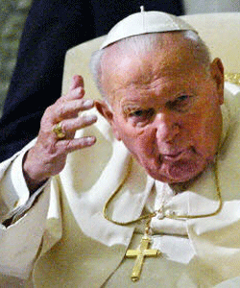
Be not afraid! Pope St. John Paul II, Crossing the Threshold of Hope
“Peoples of the entire world need to hear these words. Their conscience needs to grow in the certainty that Someone exists who holds in His Hands the destiny of this passing world...
And this Someone is Love—
Love that became Man,
Love crucified and risen,
Love unceasingly present among men.
It is Eucharistic Love.”
+1

Slide 49
Sickness
60
in Body
Lepers (Matthew 8:2-4)
Blind (Mark 10:46-52)
Paralytic (Mark 2:3-12)
+2

Slide 50
Sickness
60
in Body
Lepers (Matthew 8:2-4)
Lose sense
Blind (Mark 10:46-52)
Paralytic (Mark 2:3-12)
+2

Slide 51
Sickness
60
in Body
in Soul (very sinful)
Lepers (Matthew 8:2-4)
Lose sense
Blind (Mark 10:46-52)
Paralytic (Mark 2:3-12)
Shameless to sin
“The sin of this century is loss of sense of sin” (Pope Pius XII)
+2

Slide 52
Sickness
60
in Body
in Soul (very sinful)
Lepers (Matthew 8:2-4)
Lose sense
Blind (Mark 10:46-52)
Paralytic (Mark 2:3-12)
Shameless to sin
“The sin of this century is loss of sense of sin” (Pope Pius XII)
Reject absolute truth
+2

Slide 53
Sickness
60
in Body
in Soul (very sinful)
Lepers (Matthew 8:2-4)
Lose sense
Blind (Mark 10:46-52)
Paralytic (Mark 2:3-12)
Shameless to sin
“The sin of this century is loss of sense of sin” (Pope Pius XII)
Reject absolute truth
Helplessly hurt
+2

Slide 54
Go to Jesus
60
In Bible’s time
With no hope in life, the lepers, blind, and paralytic go to Jesus, speak to Jesus, touch Jesus

Slide 55
Go to Jesus
In Bible’s time
Today
With no hope in life, the lepers, blind, and paralytic go to Jesus, speak to Jesus, touch Jesus
Don’t we in this valley of tears need to go to Jesus, see Jesus, speak to Jesus?

Slide 56
Go to Jesus
60
Where
“I am with you always, until the end of the age.” (Matthew 28:20)

Slide 57
Luke 22
19. Then he took the bread, said the blessing, broke it, and gave it to them, saying, "This is my body, which will be given for you; do this in memory of me."
“memory “Hebrew: anamnesis. (bring to the present together with the past)
Catholic: study the meaning instead of taking it out of context

Slide 58
John 6: I am the bread of life
35. “I am the bread of life;
43. “Stop murmuring among yourselves.48. I am the bread of life.
50. this is the bread that comes down from heaven so that one may eat it and not die.
51. “I am the living bread that came down from heaven;” “and the bread that I will give is my flesh for the life of the world."
52. The Jews quarreled among themselves, saying, “How can this man give us (his) flesh to eat?”
53. “unless you eat the flesh of the Son of Man and drink his blood, you do not have life within you.”
54. “Whoever eats my flesh and drinks my blood has eternal life”

Slide 59
John 6: I am the bread of life
55. For my flesh is true food, and my blood is true drink.
56. Whoever eats my flesh and drinks my blood remains in me and I in him.
58. This is the bread that came down from heaven. …, whoever eats this bread will live forever.
60. many of his disciples …, “This saying is hard; who can accept it?”
61. Jesus …, “Does this shock you?”
66. …, many (of) his disciples returned to their former way of life and no longer accompanied him.
67. Jesus then said to the Twelve, “Do you also want to leave?”
68. Simon Peter answered him, “Master, to whom shall we go? You have the words of eternal life.

Slide 60
1 Corinthians 11:
28. A person should examine himself, and so eat the bread and drink the cup.
29. For anyone who eats and drinks without discerning the body, eats and drinks judgment on himself.
And many teaching from the early fathers

Slide 61
2 Thessalonians 2:
15 Therefore, brothers, stand firm and hold fast to the traditions that you were taught, either by an oral statement or by a letter of ours.
After Martin Luther had separated from the Catholic church to form a Christian denomination in 1517, these denominations continue to divide with over 33,000 denomination now. (World Christian Encyclopedia)
Sola scriptura: scripture alone includes all truth about salvation. Yet bible did not mention such.

Slide 62
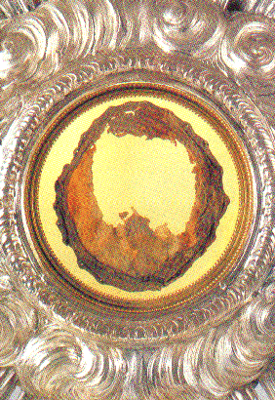
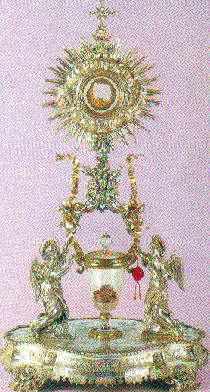
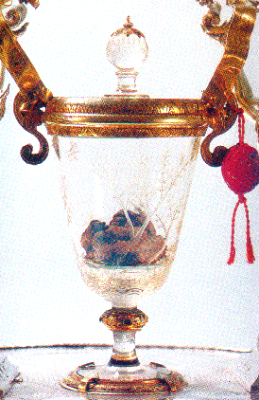
Lanciano Eucharist Miracle (~700)
With unbelief and danger to the soul, Eucharistic miracles help people to recognize Jesus in the Eucharist to strengthen their faith.
+3

Slide 63
Ven. Marthe Robin(1902-81): 30 years on Eucharist https://www.martherobin.com/en/sa-vie/
1918 early symptoms encephalitis,
1925 Act of surrender
1927 totally bedridden
Over 100,000 visitors find comfort, counsel
Over 60 Foyers de Charite
30 without eating or drinking except to receive Eucharist

Slide 64
Eyes of faith
And just as He appeared before the holy Apostles in true flesh, so now He has us see Him in the Sacred Bread. Looking at Him with the eyes of their flesh, they saw only His Flesh, but regarding Him with the eyes of the spirit, they believed that He was God. In like manner, as we see bread and wine with our bodily eyes, let us see and believe firmly that it is His Most Holy Body and Blood, True and Living. (St. Francis of Assisi)

Slide 65
Aug 28: St. Augustine of Hippo (354-430)
God in his omnipotence could not give more, in His wisdom He knew not how to give more, in His riches He had not more to give, than the Eucharist.

Slide 66
Oct 4: St. Francis Assisi (1182-1226)
And just as He appeared before the holy Apostles in true flesh, so now He has us see Him in the Sacred Bread. Looking at Him with the eyes of their flesh, they saw only His Flesh, but regarding Him with the eyes of the spirit, they believed that He was God. In like manner, as we see bread and wine with our bodily eyes, let us see and believe firmly that it is His Most Holy Body and Blood, True and Living. For in this way our Lord is ever present among those who believe in him, according to what He said: “Behold, I am with you all days even to the consummation of the world.”

Slide 67
Go to Jesus
60
Who
Where
Centurion’s paralyzed servant (Matthew 8:5-13)
Synagogue official Jairus’s daughter (Luke 8:41-42,49-56)
Pralytic carried by four men (Mark 2:3-12)
“I am with you always, until the end of the age.” (Matthew 28:20)

Slide 68
Dec 9: Ven. Fulton Sheen (1895-1979)
A Holy Hour is not a devotion; it is a sharing in the work of redemption.

Slide 69
Heart of Jesus pierced for us, from which water and blood gush.
When St. Faustina was praying before Jesus in the Holy Eucharist He showed her a vision. Each time a person entered the chapel and visited Jesus exposed in a monstrance, she saw His Divine Rays of Love and Mercy burst forth and encircle the whole world and everyone in it with graces and blessings! Through Perpetual Eucharistic Adoration Jesus unleashes His rays of healing upon us, our families and the whole world!
+1

Slide 70
The Eucharistic Miracle of Lanciano, Italy around the year 700
Many times in history when church is being tested, Eucharist came to rescue and strengthen the faithful
+3

Slide 71
St. Pope John Paul II (1920 - 2005)
60
The Church and the world have a great need of Eucharist adoration. Jesus waits for us in this sacrament of Love. Let us be generous with our time in going to meet Him in adoration and in contemplation that is full of faith and ready to make reparation for the great faults and crimes of the world. May our adoration never cease. (Dominicae cenae, 3) (CCC 1380)

Slide 72
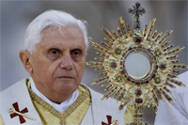
Pope Benedict XVI Sacramentum Caritatis
60
Eucharistic adoration is simply the natural consequence of the Eucharistic celebration, which is itself the Church's supreme act of adoration. Receiving the Eucharist means adoring Him whom we receive. Only in this way do we become one with Him, and are given, as it were, a foretaste of the beauty of the heavenly liturgy. The act of adoration outside Mass prolongs and intensifies all that takes place during the liturgical celebration itself. Indeed, only in adoration can a profound and genuine reception mature.

Slide 73
Pope Francis
60
What I really prefer is adoration in the evening, even when I get distracted and think of other things, or even fall asleep praying. In the evening then, between seven and eight o’clock, I stay in front of the Blessed Sacrament for an hour in adoration.
+1

Slide 74
St. Pope John Paul II
Has there ever been a time in human history when we have needed God's Divine Mercy, love and guidance more? Pope St. John Paul II said, “Anyone who prays to our Savior (in the Blessed Sacrament) draws the whole world with him and raises it to God . . . . Through adoration, the Christian mysteriously contributes to the radical transformation of the world” (letter to the Bishop of Liege, 1996). “Especially from the Eucharist, grace is poured forth upon us as from a fountain” (Constitution on the Sacred Liturgy, 10).

Slide 75
Pope St. John Paul II, Dominicae Cenae, 3
Many who attend Eucharistic adoration report miracles and healings, for themselves and their loved ones, such as: the strengthening of marriages and families, personal peace and spiritual growth. Parishes experience increased mass attendance, service, unity, conversions, the return of fallen away Catholics as well as vocations to the priesthood and religious life, and many blessings. “Jesus waits for us in this sacrament of love”

Slide 76
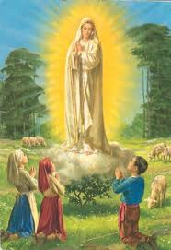
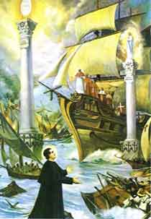
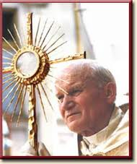
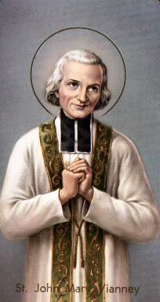
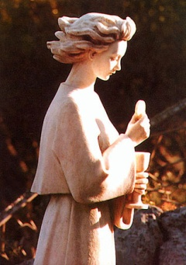
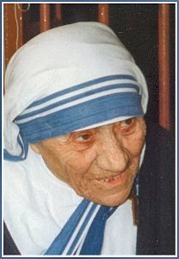
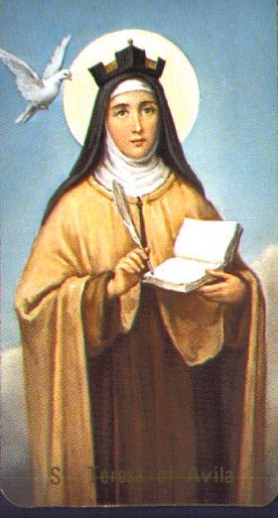
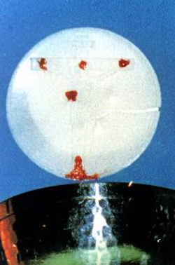
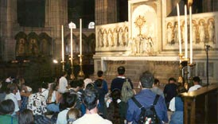
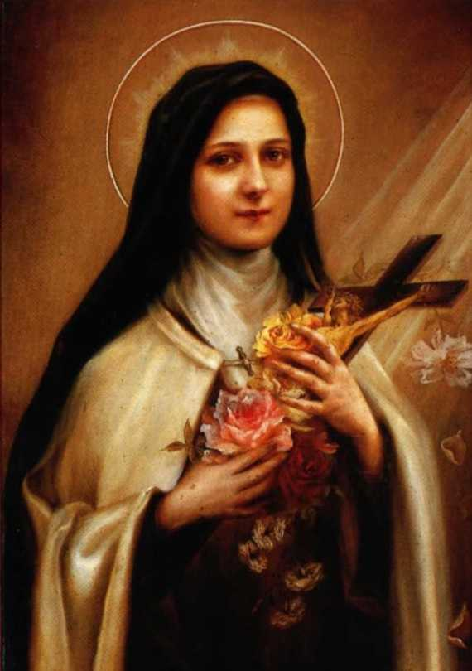
60

Slide 77
Touches the Creator, Who touches everything and everyone
60
“People ask me: ‘What will convert America and save the world?’ My answer is prayer. What we need is for every parish to come before Jesus in the Blessed Sacrament in Holy Hours of prayer.” - St. Teresa of Calcutta
“Adoration will heal our Church and thus our nation and thus our world... Adoration is more powerful for construction than nuclear bombs are for destruction” - Peter Kreeft, philosopher at Boston College
+1

Slide 78
Heart of Jesus pierced for us, from which water and blood gush.
60
When St. Faustina was praying before Jesus in the Holy Eucharist He showed her a vision. Each time a person entered the chapel and visited Jesus exposed in a monstrance, she saw His Divine Rays of Love and Mercy burst forth and encircle the whole world and everyone in it with graces and blessings! Through Perpetual Eucharistic Adoration Jesus unleashes His rays of healing upon us, our families and the whole world!
+1

Slide 79
What else can save the world?
60
In this gravely sinful world, so capable of destroying itself with its soul, the grace of Jesus in the Eucharist continues to flow.
+4

Slide 80
What else can save the world?
60
If everyone will come to Jesus in the Eucharist, the world will be healed.
“The Eucharist is the heart of the Church. Where Eucharistic life flourishes, there the life of the church will blossom.”

Slide 81
Evangelization
+
“Evangelization for the Eucharist, in the Eucharist and from the Eucharist ...” (St. Pope John Paul II, Seville, Spain, 1993)

Slide 82
Accompanying Jesus
1. Why so important today?
2. Fatima messages
3. Commitment even in my weaknesses.
4. Commitment and the largest pearl.
5. Sweetness vs dryness
6. Heart of the church with St. Therese
7. Eucharist Experience at mass
8. Could you not watch an hour with me
9. May I borrow your Immaculate Heart!
10. Questions, comments, and commitment
11. Spiritual Communion
+1

Slide 83
Fatima in 1917
May 13 is the feast of what?

Slide 84
Fatima in 1917
May 13 is the feast of what?
Our Lady of Fatima (only since 1917)

Slide 85
Fatima in 1917
May 13 is the feast of what?
Our Lady of Fatima (only since 1917)
Mother of Eucharist (originally already)

Slide 86
Fatima in 1917
May 13 is the feast of what?
Our Lady of Fatima (only since 1917)
Mother of Eucharist (originally already)
Did the Blessed Mother picked this date for a good reason to begin her apparitions in Fatima!

Slide 87
Apparition in Fatima
Prior to apparition, angel of Portugal taught the children Eucharistic adoration
The children then pray with the adoration prayer very often very day

Slide 88
Fatima prayer taught to the children by an angel
My God, I believe, I adore, I hope, and I love You! I ask pardon for those who do not believe, do not adore, do not hope, and do not love You.

Slide 89
Fatima prayer taught to the children by an angel
O most Holy Trinity, Father, Son, and Holy Spirit, I adore You profoundly and offer You the most Precious Body, Blood, Soul, and Divinity of Jesus Christ, present in all the tabernacles of the earth, in reparation for the outrages, sacrileges, and indifferences with which He Himself is offended. And through the infinite merits of His Most Sacred Heart and of the Immaculate Heart of Mary, I beg of You the conversion of poor sinners. Amen

Slide 90
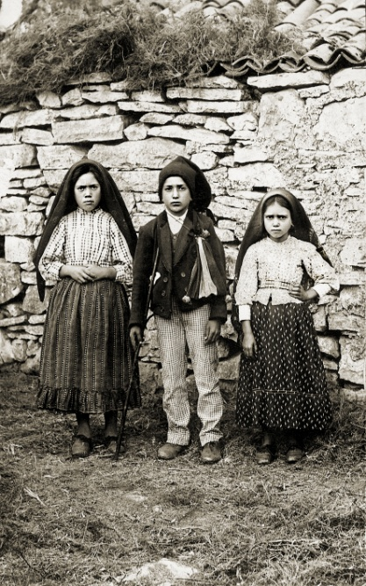
Feb 20: St. Francisco Marto (1908-1919) (shepherd to whom Our Lady appeared in Fatima)
“I was thinking of God who is so sad because of all the sins: if only I could comfort him!”
Francisco used to follow Lucia to go to a church on her way to school and stayed there with Jesus hidden in Eucharist until Lucia returned from school. Later, he was walking very slowly. “What’s the matter?” Lucia asked. “You seem unable to walk!” “I’ve such a bad headache, and I feel as though I’m going to fall.” “Then don’t come. Stay at home!” “I don’t want to. I’d rather stay in the church with the Hidden Jesus.”

Slide 91
Feb 20: St. Francisco Marto (1908-1919) (shepherd to whom Our Lady appeared in Fatima)
When Francisco fell too ill to leave his room, he said to Lucia, “Look! Go to the church and give my love to the Hidden Jesus. What hurts me most is that I cannot go there myself and stay a while with the Hidden Jesus.”

Slide 92
Feb 20: St. Jacinta Marto (1910-1920) (shepherd to whom Our Lady appeared in Fatima)
When visited by Lucia, Jacinta in her sick bed often say,
“Listen! Tell the Hidden Jesus that I like Him very much, that I really love Him very much indeed.”
“Tell Jesus I send Him my love, and I long to see Him.”
Jacinta’s biggest consolation near her death was the Blessed Sacrament Chapel in the orphanage she stayed for two weeks before going to the hospital to die. She would sit for long periods of time communing with the Hidden Jesus.

Slide 93
Accompanying Jesus
1. Why so important today?
2. Fatima messages
3. Commitment even in my weaknesses.
4. Commitment and the largest pearl.
5. Sweetness vs dryness
6. Heart of the church with St. Therese
7. Eucharist Experience at mass
8. Could you not watch an hour with me
9. May I borrow your Immaculate Heart!
10. Questions, comments, and commitment
11. Spiritual Communion
+1

Slide 94
Commitment
When inviting people to adoration, the most common answer I am so tired of hearing is:
only if convenient, only if I have spare time, only if I have nothing else to do, only if I feel like it, and only if … !
+2

Slide 95
Commitment
Then tell your loved one and see what happens!
only if convenient, only if I have spare time, only if I have nothing else to do, only if I feel like it, and only if … !

Slide 96
Commitment
Will you tell your loved one that everyday:
Honey, I will come home after work
only if convenient, only if I have spare time, only if I have nothing else to do, only if I feel like it, and only if … !
Many people only knows to behave properly in the Church before God who is far high up, but would not want to spend an hour with Jesus in the Eucharist.
+1

Slide 97
Commitment
Will you tell your family that everyday
Honey, I will prepare dinner
only if convenient, only if I have spare time, only if I have nothing else to do, only if I feel like it, and only if … !
I would worry more not only on how we honor Jesus as God but rather that we do not even treat Jesus as a human friend.
+5

Slide 98
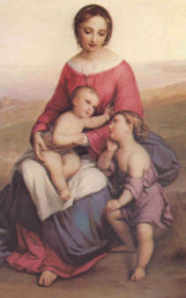
May we come to share
in the divinity of Christ,
who humbled himself
to share in our humanity
then treat Jesus at least as an intimate human friend, talk/listen to him this way, care about him this way!

Slide 99
Diary of St. Faustina
"The mercy of God, hidden in the Blessed Sacrament, the voice of the Lord who speaks to us from the throne of mercy: Come to Me, all of you...
"Behold, for you I have established a throne of mercy on earth — the tabernacle — and from this throne I desire to enter into your heart. I am not surrounded by a retinue of guards. You can come to me at any moment, at any time; I want to speak to you and I desire to grant you grace.

Slide 100
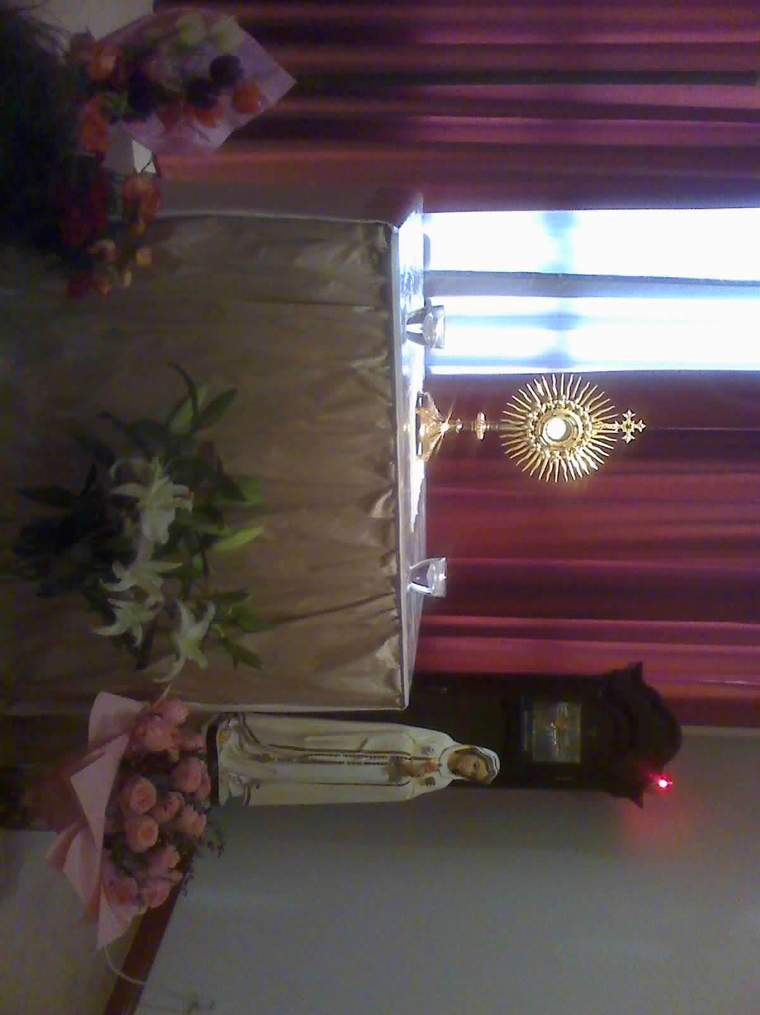
St. Peter’s Church, Shanghai

Slide 101
Sign up
It is customary in some churches to ask people to sign up for one hour per week.
The choice is either
Yes (once a week), or
No
Many have already signed up, but very many people have not.

Slide 102
Sharing: Even for Busy People http://www.catholicworld.info/eucharist/accompanyingjesus-1.htm
60
Ordinary, and with the weaknesses that many people may have.
I had a very demanding profession. My wife and I both had busy full time job, and our children were small at that time.
I could not imagine how I could spent an additional hour each week.
I was also too weak to make the commitment
but the love of Jesus continued to invite me.
+1

Slide 103
St. Pope John Paul II at the 45th International Eucharistic Congress, Seville, Spain, June 1993.
“I hope that this form of Adoration, with permanent exposition of the Blessed Sacrament, will continue into the future. Specifically, I hope that the fruit of this Congress results in the establishment of Perpetual Eucharistic Adoration in all parishes and Christian communities throughout the world,”
+1

Slide 104
An ordinary experience
60
Yet I read
about Venerable Archbishop Fulton Sheen,
about Pope St. John Paul II
about St. Teresa of Calcutta,
They all make daily adoration out of their extremely busy schedule.
+1

Slide 105
Dec 9: Ven. Fulton Sheen (1895-1979)
A Holy Hour is not a devotion; it is a sharing in the work of redemption.

Slide 106
Heart of Jesus pierced for us, from which water and blood gush.
When St. Faustina was praying before Jesus in the Holy Eucharist He showed her a vision. Each time a person entered the chapel and visited Jesus exposed in a monstrance, she saw His Divine Rays of Love and Mercy burst forth and encircle the whole world and everyone in it with graces and blessings! Through Perpetual Eucharistic Adoration Jesus unleashes His rays of healing upon us, our families and the whole world!
+1

Slide 107
St. Teresa of Calcutta
60
In our congregation, we used to have adoration once a week for one hour, and then in 1973, we decided to have adoration one hour every day. We have much work to do. Our homes for the sick and dying destitute are full everywhere. And from the time we started having adoration every day, our love for Jesus became more intimate, our love for each other more understanding, our love for the poor more compassionate, and we have double the number of vocations. God has blessed us with many wonderful vocations.
+1

Slide 108
An ordinary experience
+
I fully understood the need for commitment but I continued to be weak.
The love of Jesus continued to invite me
Then I decided to start with a very small commitment: just try for a while, so insignificant that I had no reason not to keep this commitment at that time no matter how busy my schedule was.
+1

Slide 109
Accompanying Jesus
1. Why so important today?
2. Fatima messages
3. Commitment even in my weaknesses.
4. Commitment and the largest pearl.
5. Sweetness vs dryness
6. Heart of the church with St. Therese
7. Eucharist Experience at mass
8. Could you not watch an hour with me
9. May I borrow your Immaculate Heart!
10. Questions, comments, and commitment
11. Spiritual Communion
+1

Slide 110
An ordinary experience
60
Even such a small and insignificant commitment at that time had attracted me to taste of the irresistible love of Jesus so that I later had the strength to make more commitments.
It has changed the way I go to mass. (will share later)
It has changed my love in my family. (if time permits)
It has changed the way I serve the church.
+1

Slide 111
Heart of Jesus pierced for us, from which water and blood gush.
When St. Faustina was praying before Jesus in the Holy Eucharist He showed her a vision. Each time a person entered the chapel and visited Jesus exposed in a monstrance, she saw His Divine Rays of Love and Mercy burst forth and encircle the whole world and everyone in it with graces and blessings! Through Perpetual Eucharistic Adoration Jesus unleashes His rays of healing upon us, our families and the whole world!
+1

Slide 112
Sign up sheet
+
The choices have been either
Yes, once a week: -- only about 10%
No: -- the large majority
Change the choices to
Yes, once a week, or
Not yet, but will try according to what I can manage
I had proved that everyone can make a commitment.
Let everyone commit and save the world!
+1

Slide 113
Barriers
+
Today many people often work overtime.
Some friends may miss the appointment when they are too tired.
I too have a heavy burden at work and often lack sleep.
It is still important for me to keep the appointment even though I may fall asleep.
+2

Slide 114
He is the easiest to befriend with and to be pleased
St. Therese could not help to fall asleep when she was praying in the church. She was so upset and felt complete failure in prayer that she was even tempted to leave the monastery.
Jesus reminded her that she used to sleep on daddy’s lap when she was small, and Jesus asked whether she remembers what her father said.
Therese recalled her father said: whether you are sleeping on my lap or are awake talking to me, I am likewise pleased.
Jesus replied, So am I.
Jesus simply wanted her to enjoy the peace he gave.

Slide 115
He is the easiest person in the world to be with the easiest person to please
“That I fall asleep so often during meditation, and thanksgiving after Communion, should distress me. Well, I am not distressed. I reflect that little children are equally dear to their parents whether they are asleep or awake; that, in order to perform operations, doctors put their patients to sleep;”

Slide 116
Prayer before Eucharist (Bl. Angela of Foligno)
“O Jesus Christ true God and true Man! My soul rejoices to find You in the Blessed Sacrament, You the uncreated God who became man, a creature! In this sacrament, O Christ, I find both Your humanity and Your divinity; from Your humanity I rise to Your divinity; and from it I go back to Your humanity. I see Your ineffable divinity which contains all the treasures of wisdom, of knowledge, of incorruptible riches. I see the inexhaustible fountain of delights which alone can satisfy our intelligence. I see Your most precious soul, O Jesus, with all the virtues and gifts of the Holy Spirit, a holy and unspotted oblation; I see Your sacred Body, the price of our redemption; I see Your Blood, which purifies and vivifies us; in brief, I find treasures which are so precious and so great that I cannot comprehend them.”

Slide 117
Accompanying Jesus
1. Why so important today?
2. Fatima messages
3. Commitment even in my weaknesses.
4. Commitment and the largest pearl.
5. Sweetness vs dryness (with practical advice on adoration)
6. Heart of the church with St. Therese
7. Eucharist Experience at mass
8. Could you not watch an hour with me
9. May I borrow your Immaculate Heart!
10. Questions, comments, and commitment
11. Spiritual Communion
+1

Slide 118
Initial barriers
+
some people don’t know how to pray in front of Jesus!
some people feel dry.
some people …
So some discontinued,
Only those who persist will then taste the sweetness.
It is for those who may discontinue that I share my experience.
+1

Slide 119
My very first hour of adoration
+
Do: Take the front seat

Slide 120
My very first hour of adoration
+
Do: Take the front seat
Just like taking dinner at home everyday during which we share our lives with each other in the family

Slide 121
My very first hour of adoration
+
Do: Take the front seat
Do not: check the time

Slide 122
My very first hour of adoration
+
Do: Take the front seat
Do not: check the time
Just like taking dinner with a dignity or close friend

Slide 123
Initial barriers
+
At first I too did not know what to do. It seemed dry and merely 10-20 minutes already seemed so long.
It is then important to persist while continuing to search and learn.
+1
+1

Slide 124
To learn
+
I had asked and learned from some friends I knew including religious and lay people, especially those who regularly adore Jesus in Eucharist.
I had also learned from many more elder brothers and sisters who are now eternally adoring Jesus in heaven. They have left with us many writings to learn from them. They include St. Therese, St. Faustina, and many others.
They taught me also how to receive Eucharist at mass.
+2

Slide 125
+

Slide 126
A Short Visit to the Blessed Sacrament (St. John Henry Newman)
I place myself in the presence of Him, in whose Incarnate Presence I am before. I place myself there.
I adore You, O my Savior, present here as God and man, in soul and body, in true flesh and blood.
I acknowledge and confess that I kneel before that Sacred Humanity, which was conceived in Mary’s womb and lay in Mary’s bosom; which grew up to man’s estate, and by the Sea of Galilee called the Twelve, wrought miracles, and spoke words of wisdom and peace; which in due season hung on the cross, lay in the tomb, rose from the dead, and now reigns in heaven.
I praise, and bless, and give myself wholly to Him, Who is the true Bread of my soul, and my everlasting joy.

Slide 127
Accompanying Jesus
1. Why so important today?
2. Fatima messages
3. Commitment even in my weaknesses.
4. Commitment and the largest pearl.
5. Sweetness vs dryness
6. Heart of the church with St. Therese
7. Eucharist Experience at mass
8. Could you not watch an hour with me
9. May I borrow your Immaculate Heart!
10. Questions, comments, and commitment
11. Spiritual Communion
+1

Slide 128
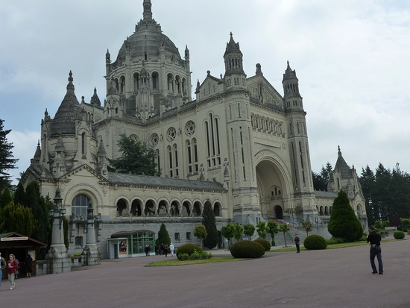
Dear St. Therese, teach me love Jesus
I feel that my mission is about to begin, my mission of making God loved as I love Him.

Slide 129
Dear St. Therese, teach me love Jesus
Yet I live, no longer I, but Christ lives in me; insofar as I now live in the flesh, I live by faith in the Son of God who has loved me and given himself up for me. (Galatians 2:20)
+4

Slide 130
Start Adoration from young age

Slide 131
St. Pope John Paul II 1996 letter to the Bishop of Liege: "Eucharist: Sacrament to be Adored"
I urge priests, religious and lay people to continue and redouble their efforts to teach the younger generations the meaning and value of Eucharistic adoration and devotion. How will young people be able to know the Lord if they are not introduced to the mystery of his presence?

Slide 132
Eucharistic Prayer III (Corinthians 11:23-25)
For on the night he was betrayed he himself took bread, and giving you thanks he said the blessing, broke the bread and gave it to his disciples, saying:
Take this, all of you, and eat of it, for this is my body, which will be given up for you.
+1

Slide 133
Eucharistic Prayer III (Corinthians 11:23-25)
In a similar way, when supper was ended, he took the chalice, and giving you thanks he said the blessing, and gave the chalice to his disciples, saying,
Take this, all of you, and drink from it, for this is the chalice of my blood, the blood of the new and eternal covenant, which will be poured out for you and for many for the forgiveness of sins.
Do this in memory of me.
+1

Slide 134
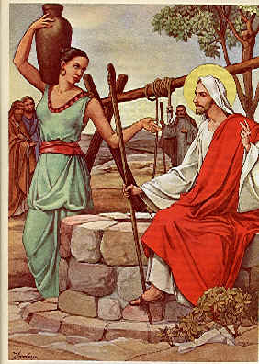
“I am the bread of life;
whoever comes to me
will never hunger,
and whoever believes in me
will never thirst.” (John 6:35)
Please sign up for an hour per week to accompany Jesus.

Slide 135
Please sign up for an hour per week to accompany Jesus.
“Come to me, all you who labor and are burdened, and I will give you rest.” (Mathew 11:28)

Slide 136
Mary sat beside the Lord at his feet
Martha had a sister named Mary (who) sat beside the Lord at his feet listening to him speak. Martha, burdened with much serving, came to him and said, “Lord, do you not care that my sister has left me by myself to do the serving? Tell her to help me.” The Lord said to her in reply, “Martha, Martha, you are anxious and worried about many things. There is need of only one thing. Mary has chosen the better part and it will not be taken from her.” (Luke 10:40-42）

Slide 137
My vocation is love!
I feel as if I were called to be a fighter, a priest, an apostle, a doctor, a martyr; … Beside myself with joy, I cried out ‘Jesus, my Love! I’ve found my vocation, and my vocation is love!’
In the heart of the Church, my Mother, I shall be love; thus I shall be everything.
+2

Slide 138
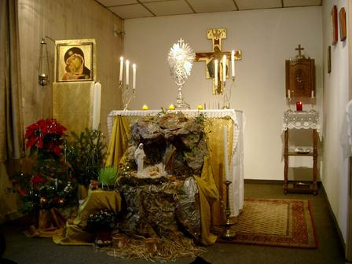
Adoration at German House of Beatitudes

Slide 139
Act of Oblation as a Victim of Divine Love in the Gospels which St. Therese carried night and day close to her heart.
O my God, O Most Blessed Trinity, I desire to love You and to make You loved.
In order that my life may be one Act of perfect Love, I offer myself as a Victim of Holocaust to Your Merciful Love, imploring You to consume me unceasingly, and to allow the floods of infinite tenderness gathered up in You to overflow into my soul, that so I may become a very martyr of Your Love, O my God! May this martyrdom, after having prepared me to appear in Your Presence, free me from this life at the last, and may my soul take its flight—without delay—into the eternal embrace of Your Merciful Love!
O my Beloved, I desire at every beat of my heart to renew this Oblation an infinite number of times, “till the shadows retire,” and everlastingly I can tell You my love face to face.

Slide 140
St. Therese, teach me to love Jesus
Remember that this sweet Jesus is there in the Tabernacle expressly for you and you alone. Remember that He burns with the desire to enter your heart.
He gave Himself to me in Holy Communion.
He does not come down from Heaven each day in order to remain in a golden ciborium, but to find another Heaven — the Heaven of our souls in which He takes such delight.

Slide 141
St. Therese, teach me to love Jesus
I had the unspeakable consolation of receiving Holy Communion every day. How sweet it was!
What can I tell you about my thanksgivings after Communion? There is no time when I taste less consolation. But this is what I should expect. I desire to receive Our Lord, not for my own satisfaction, but simply to give Him pleasure.

Slide 142
Accompanying Jesus
1. Why so important today?
2. Fatima messages
3. Commitment even in my weaknesses.
4. Commitment and the largest pearl.
5. Sweetness vs dryness
6. Heart of the church with St. Therese
7. Eucharist Experience at mass
8. Could you not watch an hour with me
9. May I borrow your Immaculate Heart!
10. Questions, comments, and commitment
11. Spiritual Communion
+1

Slide 143
Jesus told St. Faustina Kowalska
60
My great delight is to unite Myself with souls. Know, My daughter, that when I come to a human heart in Holy Communion, My hands are full of all kinds of graces which I want to give to the souls. But souls do not even pay any attention to Me; they leave Me to Myself and busy themselves with other things. Oh, how sad I am that souls do not recognize Love! They treat Me as a dead object. (1385)
+1

Slide 144
Jesus told St. Faustina Kowalska
Oh, how painful it is to Me that souls so seldom unite themselves to Me in Holy Communion. I wait for souls, and they are indifferent toward Me. I love them tenderly and sincerely, and they distrust Me. I want to lavish My graces on them, and they do not want to accept them. They treat Me as a dead object, whereas My Heart is full of love and mercy. (1447)
+1

Slide 145
“Souls so seldom unite themselves to Me in Holy Communion”
I read these words from Jesus in the Diary of St. Faustina again and again trying to understand. I then realized that in the past I only spent may be 2 or 3 minutes after communion to state my petitions, and will then be busy with other things after mass.
Yet when my close friends come to visit me, I don’t just allow them to stay for 3 minutes and then tell them to leave. Had I been treating Jesus worse than a friend?
+1

Slide 146
“How painful it is to Me that souls …”
I read these word again and again. Then I made a small promise. That is, from that time on, my dear Jesus, every time I receive Communion, I will not … ever … hurt Jesus … again.
It is only a simple commitment. I understand I had hurt Jesus before when I received Communion, and I decided not to do that again. It is that simple. It is only a small commitment that is doable, and it is a promise that I beg Mother help me keep it till eternity.
+1

Slide 147
alleged apparitions in Medjugorje (currently under church investigation)
60
at least 10 minutes after receiving Eucharist

Slide 148
Pope Benedict XVI Sacramentum Caritatis
60
Eucharistic adoration is simply the natural consequence of the Eucharistic celebration, which is itself the Church's supreme act of adoration. Receiving the Eucharist means adoring Him whom we receive. Only in this way do we become one with Him, and are given, as it were, a foretaste of the beauty of the heavenly liturgy. The act of adoration outside Mass prolongs and intensifies all that takes place during the liturgical celebration itself. Indeed, only in adoration can a profound and genuine reception mature.

Slide 149
Oct 22: St. John Paul II (1920 – 2005)
60
“Our communal worship at Mass must go together with our personal worship of Jesus in Eucharistic adoration in order that our love may be complete.” (Redeemer of Man Encyclical, 1979)

Slide 150
St. Faustina with the Blessed Sacrament
60
The most solemn moment of my life is the moment when I receive Holy Communion. I long for each Holy Communion, and for every Holy Communion I give thanks to the Most Holy Trinity. (1804)
+1

Slide 151
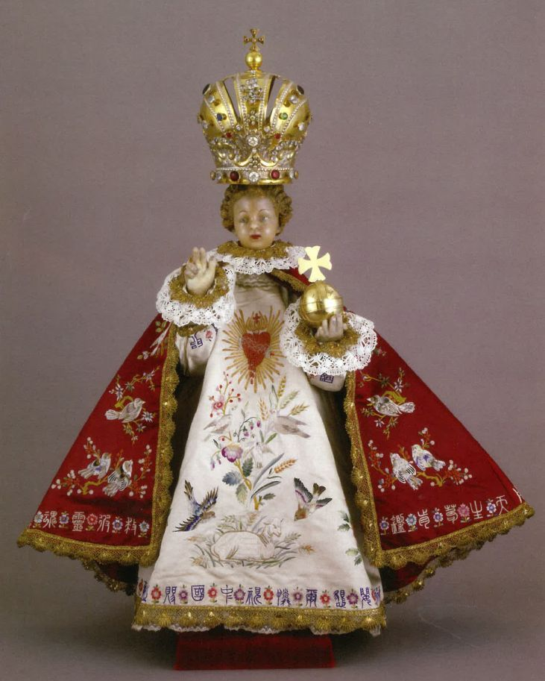
St. Faustina with the Blessed Sacrament
60
Today, I prepare for the Coming of the King.
+1

Slide 152
St. Faustina with the Blessed Sacrament
60
Today, I prepare for the Coming of the King. What am I, and who are You, O Lord, King of eternal glory? O my heart, are you aware of who is coming to you today? Yes, I know, but – strangely – I am not able to grasp it. Oh, if He were just a king, but He is the King of kings, the Lord of lords. Before Him, all power and dominion tremble. He is coming to my heart today. (1810)
Then I learn how to receive Jesus from St. Faustina and memorize the following words
+1

Slide 153
St. Faustina with the Blessed Sacrament
60
But I hear Him approaching. I go out to meet Him and invite Him. When He entered the dwelling of my heart, it was filled with such reverence that it fainted with fear, falling at His feet. Jesus gave her his hand and graciously permits her to take her place beside Him. He reassures her, saying, See, I have left My heavenly throne to become united with you. What you see is just a tiny part and already your soul swoons with love. How amazed will your heart be when you see Me in all My glory. (1810)
+1

Slide 154
St. Faustina with the Blessed Sacrament
60
But I want to tell you that eternal life must begin already here on earth through Holy Communion. Each Holy Communion makes you more capable of communing with God throughout eternity. (1811)
+1

Slide 155
Adoration Prayer (St. Faustina)
I adore You, Lord and Creator, hidden in the Most Blessed Sacrament. I adore You for all the works of Your hands, that reveal to me so much wisdom, goodness and mercy, O Lord. You have spread so much beauty over the earth and it tells me about Your beauty, even though these beautiful things are but a faint reflection of You, incomprehensible Beauty.
+1

Slide 156
Adoration Prayer (St. Faustina)
60
And although You have hidden Yourself and concealed Your beauty, my eye, enlightened by faith, reaches You and my soul recognizes its Creator, its Highest Good, and my heart is completely immersed in prayer of adoration.
He was spurned and avoided by men.” (Is 53:3)
+1

Slide 157
Adoration Prayer (St. Faustina)
60
My Lord and Creator, Your goodness encourages me to converse with You. Your mercy abolishes the chasm which separates the Creator from the creature. To converse with You, O Lord, is the delight of my heart. In You I find everything that my heart could desire. Here, Your light illumines my mind, enabling it to know You more and more deeply. Here streams of graces flow down upon my heart. Here my soul draws eternal life.
+1

Slide 158
Adoration Prayer (St. Faustina)
60
O my Lord and Creator, You alone, beyond all these gifts, give Your own self to me and unite Yourself intimately with Your miserable creature. Here, without searching for words, our hearts understand each other. Here, no one is able to interrupt our conversation. What I talk to You about, Jesus, is our secret, which creatures shall not know ... . These are secret acts of forgiveness, known only to Jesus and me; this is the mystery of His mercy, which embraces each soul separately.
+2

Slide 159
Adoration Prayer (St. Faustina)
60
For this incomprehensible goodness of Yours, I adore You, O Lord and Creator, with all my heart and all my soul. And, although my worship is so little and poor, I am at peace because I know that You know it is sincere, however inadequate ... .
+2

Slide 160
Please sign up for an hour per week to accompany Jesus.
Oh Sacrament Most Holy Oh Sacrament Divine All praise and all thanksgiving be every moment Thine.

Slide 161
Adoration Prayer (St. Faustina)
O Christ, let my greatest delight be to see You loved and Your praise and glory proclaimed, especially the honor of Your mercy. O Christ, let me glorify Your goodness and mercy to the last moment of my life, with every drop of my blood and every beat of my heart. Would that I be transformed into a hymn of adoration of You. When I find myself on my deathbed, may the last beat of my heart be a loving hymn glorifying Your unfathomable mercy. Amen.

Slide 162
Accompanying Jesus
1. Why so important today?
2. Fatima messages
3. Commitment even in my weaknesses.
4. Commitment and the largest pearl.
5. Sweetness vs dryness
6. Heart of the church with St. Therese
7. Eucharist Experience at mass
8. Could you not watch an hour with me
9. May I borrow your Immaculate Heart!
10. Questions, comments, and commitment
11. Spiritual Communion
+1

Slide 163
“Could you not watch one hour with me?
60
“My soul is sorrowful even unto death.” (Mathew 26:38)
The only time our Lord asked the Apostles for anything was the night He went into agony. Not for activity did He plead but for an Hour of companionship. – Fulton Sheen
+10

Slide 164
2nd sorrowful mystery: The scourging at the pillar
+
like wheat which is beaten, broken, and crushed before it becomes bread,
Jesus, our Divine Wheat, was willing to be beaten at the pillar, broken in Heart, and crushed in humiliation that He might become for us “the Living Bread come down from Heaven.”
For He said: “The Bread I will give is my flesh for the life of the world.”

Slide 165
1st sorrowful mystery: The agony in the Garden
+
“My Heart is filled with sorrow to the point of death. Could you not watch one hour with Me?” (Mk 14:34b, 37b)
Meditation: The Wound of Rejection
“He was spurned and avoided by men.” (Is 53:3)
+1

Slide 166
1st sorrowful mystery: The agony in the Garden
+
On this Holy Thursday night Jesus showed us the very ‘depth of His love’ by giving us the complete gift of Himself and His total love in the Holy Eucharist. Then He appealed to his apostles for the first holy hour of prayer when He took them into the garden in the middle of the night, and asked them to watch and pray with Him.
+1

Slide 167
Dec 9: Ven. Fulton Sheen (1895-1979)
The only time our Lord asked the Apostles for anything was the night He went into agony. Not for activity did He plead but for an Hour of companionship.

Slide 168
1st sorrowful mystery: The agony in the Garden
+
As He started to pray, He began to sweat blood. The agony He suffered was the realization that the Holy Eucharist would be rejected by so many and appreciated by so few.
+1

Slide 169
1st sorrowful mystery: The agony in the Garden
+
He saw down through the ages how He would be left alone, spurned and avoided by men in so many tabernacles of the world, while He comes to bring so much love and so many blessings. How few would believe in His Real Presence; and fewer will respond to His appeal to be loved in the Blessed Sacrament! And His Heart was “filled with sorrow to the point of death.” The blood He sweated was grief poured out from a broken Heart caused by the sorrow of His Eucharistic love being so rejected.
+1

Slide 170
1st sorrowful mystery: The agony in the Garden
+
Then an angel brought Jesus indescribable strength and consolation by showing Him every holy hour that you would ever make. At that moment in the garden, Jesus saw you praying before Him now and He knew that His love would be returned. This is why your visit today is so important to Him. Your holy hour consoles Him for those who do not love Him and wins countless graces for many to be converted to Him.
+3

Slide 171
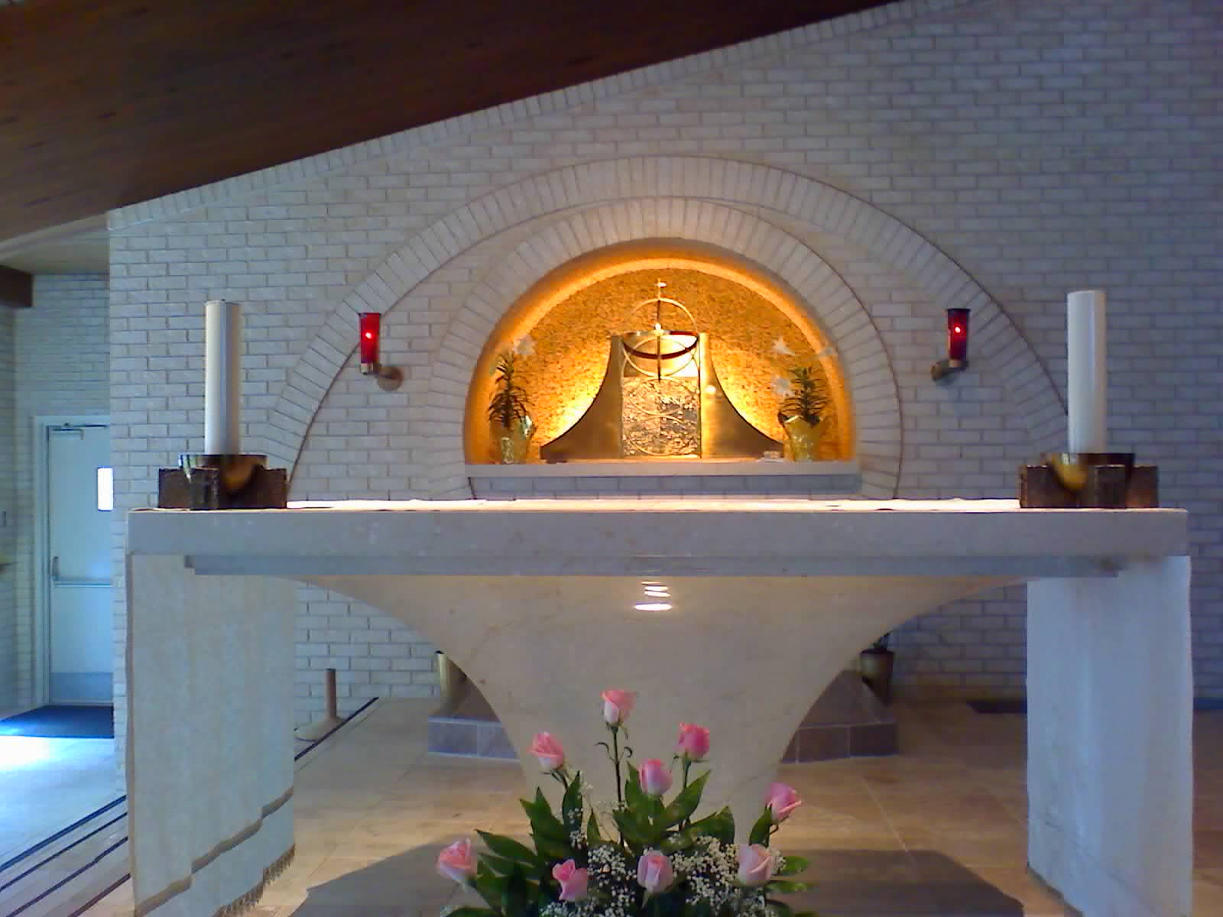

Slide 172
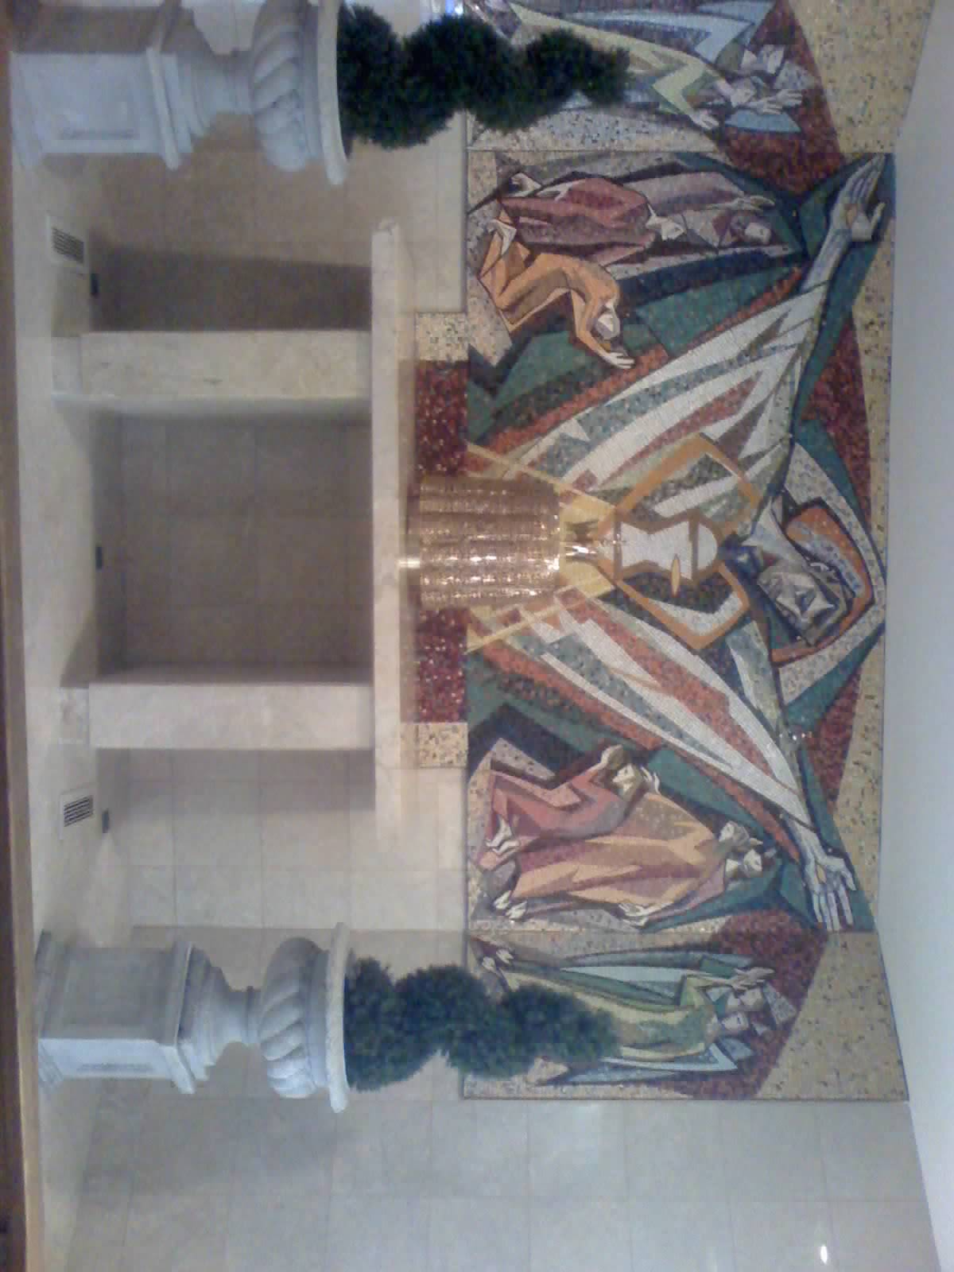
Chapel in Guardian Angel Church in Las Vegas

Slide 173
The soul hungers for God, and nothing but God can satiate it.
“If we really loved the good God, we should make it our joy and happiness to come and spend a few moments to adore Him, and ask Him for the grace of forgiveness; and we should regard those moments as the happiest of our lives.” – St. John Vianney

Slide 174
Adoration
The Church and the world have a great need for Eucharistic worship. Jesus awaits us in this sacrament of love. Let us not refuse the time so to meet Him in adoration, in contemplation full of faith, and open to making amends for the serious offenses and sins of the world. Let our adoration never cease. (Pope St. John Paul II in Dominicae Cenae)

Slide 175
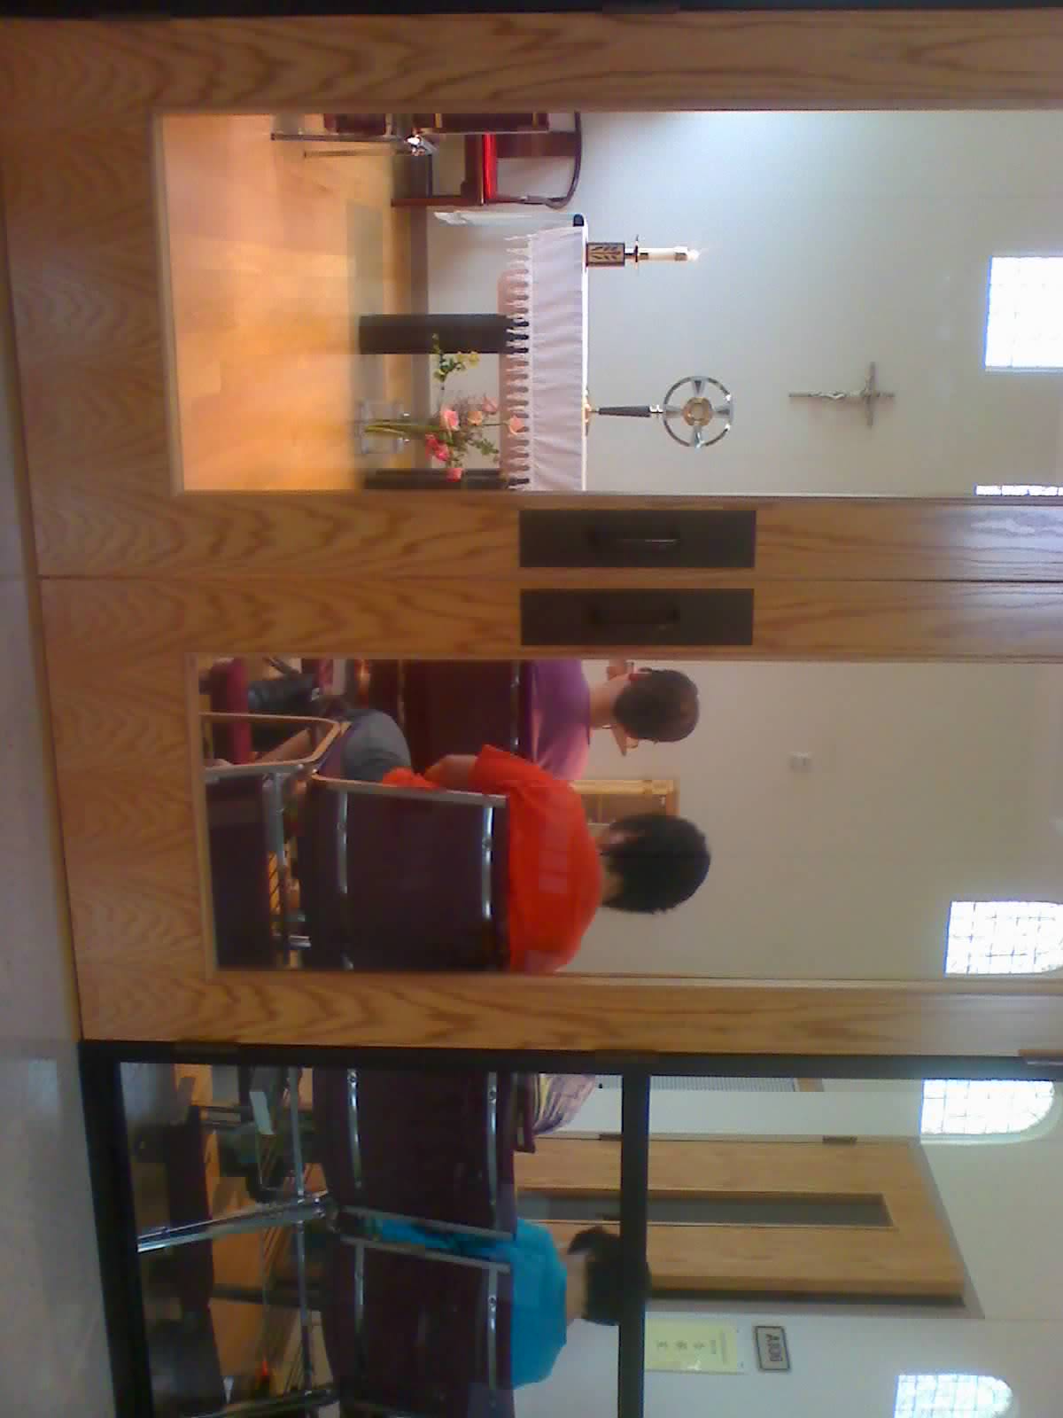
Sacred Heart Church, Dallas

Slide 176
Accompanying Jesus
1. Why so important today?
2. Fatima messages
3. Commitment even in my weaknesses.
4. Commitment and the largest pearl.
5. Sweetness vs dryness
6. Heart of the church with St. Therese
7. Eucharist Experience at mass
8. Could you not watch an hour with me
9. May I borrow your Immaculate Heart!
10. Questions, comments, and commitment
11. Spiritual Communion
+1

Slide 177
Mother, may I borrow your Immaculate Heart?
60
Now there stood by the cross of Jesus, his mother, and his mother's sister, Mary of Cleophas, and Mary Magdalen
+1

Slide 178
Mother, may I borrow your Immaculate Heart?
60
Now there stood by the cross of Jesus, his mother, and his mother's sister, Mary of Cleophas, and Mary Magdalen and me
+1

Slide 179
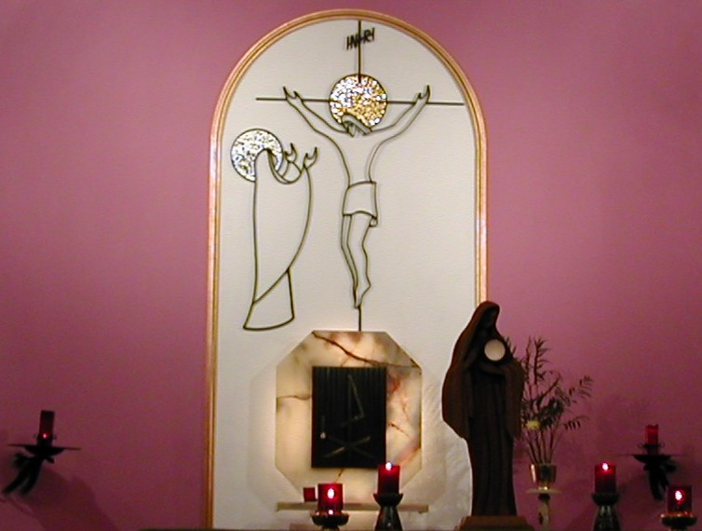
Mother, may I borrow your Immaculate Heart http://www.catholicworld.info/eucharist/accompanyingjesus-4.htm
60
Though your sins be like scarlet,; Though they be red like crimson,
Her Immaculate Heart will triumph to the end.
+1

Slide 180
Accompanying Jesus
1. Why so important today?
2. Fatima messages
3. Commitment even in my weaknesses.
4. Commitment and the largest pearl.
5. Sweetness vs dryness
6. Heart of the church with St. Therese
7. Eucharist Experience at mass
8. Could you not watch an hour with me
9. May I borrow your Immaculate Heart!
10. Questions, comments, and commitment
11. Spiritual Communion
+1

Slide 181
Fatima prayer taught to the children by an angel
My God, I believe, I adore, I hope, and I love You! I ask pardon for those who do not believe, do not adore, do not hope, and do not love You.
O most Holy Trinity, Father, Son, and Holy Spirit, I adore You profoundly and offer You the most Precious Body, Blood, Soul, and Divinity of Jesus Christ, present in all the tabernacles of the earth, in reparation for the outrages, sacrileges, and indifferences with which He Himself is offended. And through the infinite merits of His Most Sacred Heart and of the Immaculate Heart of Mary, I beg of You the conversion of poor sinners. Amen

Slide 182
Accompanying Jesus
1. Why so important today?
2. Fatima messages
3. Commitment even in my weaknesses.
4. Commitment and the largest pearl.
5. Sweetness vs dryness
6. Heart of the church with St. Therese
7. Eucharist Experience at mass
8. Could you not watch an hour with me
9. May I borrow your Immaculate Heart!
10. Questions, comments, and commitment
11. Spiritual Communion
+1

Slide 183
Aug. 4: St. John Vianney (1786-1859)
+
Have a Holy Hour every week. Start praying. Pray for guidance and trust in God.
When you awake in the night, transport yourself quickly in spirit before the Tabernacle, saying: ‘Behold, my God, I come to adore You, to praise, thank, and love you, and to keep you company with all the Angels,’...

Slide 184
Act of Spiritual Communion (St. Alphonsus de Liguori)
+
My Jesus, I believe that You are present in the Blessed Sacrament. I love You above all things and I desire You in my soul. Since I cannot now receive You sacramentally, come at least spiritually into my heart. As though You were already there, I embrace You and unite myself wholly to You; permit not that I should ever be separated from You. Amen.
→1

Slide 185
Aug. 4: St. John Vianney (1786-1859)
I love You, O my God, and my only desire is to love You until the last breath of my life. I love You, O my infinitely lovable God, and I would rather die loving You, than live without loving You. I love You, Lord and the only grace I ask is to love You eternally....My God, if my tongue cannot say in every moment that I love You, I want my heart to repeat it to You as often as I draw breath. Amen.

Slide 186
Rosary Meditations from St. Teresa of Calcutta, Loving Jesus With the Heart of Mary
“Mary, mother of Jesus, give us your heart, so beautiful, so pure, so immaculate, so full of love and humility, that we may be able to receive Jesus in the bread of life, love him as you love him, and serve him in the distressing disguise of the poor.” St. Teresa of Calcutta

Slide 187
Epilogue
Dear Jesus, there will be no need to implore my friends to accompany You when You return in glory. At that time, many people will want to accompany You. Yet I pray that we do not wait till that time. I pray that we desire to accompany You now when the world is rejecting You.

Slide 188
Thank you for Accompanying Jesus and for inviting your friends
You may optionally leave your name and email address to receive the full set of slides and my monthly email on Eucharist. Please PRINT clearly and if you don’t receive my email, please send me an email. If you also like to share your own experience with people in my email list, you are more than welcome to send to me.
H Anthony Chan, h.a.chan@ieee.org

Slide 189
Accompanying Jesus
1. Commitment: Tell Jesus I will spend an hour with You every week
2. Survey: Fill in survey form on what day and time and which parish you are available for adoration
3. Holy Spirit: Father will lay hand over you to be filled with Holy Spirit:
take turn to come out, hand in the form and receive laying of hands
4. Confession: every month

Slide 190
John 6
35 Jesus said to them, "I am the bread of life; whoever comes to me will never hunger, and whoever believes in me will never thirst.
36 But I told you that although you have seen (me), you do not believe.
37 Everything that the Father gives me will come to me, and I will not reject anyone who comes to me,
38 because I came down from heaven not to do my own will but the will of the one who sent me.

Slide 191
John 6
39 And this is the will of the one who sent me, that I should not lose anything of what he gave me, but that I should raise it (on) the last day.
40 For this is the will of my Father, that everyone who sees the Son and believes in him may have eternal life, and I shall raise him (on) the last day."
41 The Jews murmured about him because he said, "I am the bread that came down from heaven,"
42 and they said, "Is this not Jesus, the son of Joseph? Do we not know his father and mother? Then how can he say, 'I have come down from heaven'?"

Slide 192
John 6
43 Jesus answered and said to them, "Stop murmuring 18 among yourselves.
44 No one can come to me unless the Father who sent me draw him, and I will raise him on the last day.
45 It is written in the prophets: 'They shall all be taught by God.' Everyone who listens to my Father and learns from him comes to me.
46 Not that anyone has seen the Father except the one who is from God; he has seen the Father.

Slide 193
John 6
47 Amen, amen, I say to you, whoever believes has eternal life.
48 I am the bread of life.
49 Your ancestors ate the manna in the desert, but they died;
50 this is the bread that comes down from heaven so that one may eat it and not die.
51 I am the living bread that came down from heaven; whoever eats this bread will live forever; and the bread that I will give is my flesh for the life of the world."

Slide 194
John 6
52 The Jews quarreled among themselves, saying, "How can this man give us (his) flesh to eat?"
53 Jesus said to them, "Amen, amen, I say to you, unless you eat the flesh of the Son of Man and drink his blood, you do not have life within you.
54 Whoever eats my flesh and drinks my blood has eternal life, and I will raise him on the last day.
55 For my flesh is true food, and my blood is true drink.

Slide 195
John 6
56 Whoever eats my flesh and drinks my blood remains in me and I in him.
57 Just as the living Father sent me and I have life because of the Father, so also the one who feeds on me will have life because of me.
58 This is the bread that came down from heaven. Unlike your ancestors who ate and still died, whoever eats this bread will live forever."
59 These things he said while teaching in the synagogue in Capernaum.
60 20 Then many of his disciples who were listening said, "This saying is hard; who can accept it?"

Slide 196
John 6
61 Since Jesus knew that his disciples were murmuring about this, he said to them, "Does this shock you?
62 What if you were to see the Son of Man ascending to where he was before?
63 It is the spirit that gives life, while the flesh is of no avail. The words I have spoken to you are spirit and life.
64 But there are some of you who do not believe." Jesus knew from the beginning the ones who would not believe and the one who would betray him.

Slide 197
John 6
65 And he said, "For this reason I have told you that no one can come to me unless it is granted him by my Father."
66 As a result of this, many (of) his disciples returned to their former way of life and no longer accompanied him.
67 Jesus then said to the Twelve, "Do you also want to leave?"
68 Simon Peter answered him, "Master, to whom shall we go? You have the words of eternal life.
69 We have come to believe and are convinced that you are the Holy One of God."

Slide 198
Pope leo XIII 18-19
Family 24-29
Student 37-38
Helpless 54
JPII 55, lepers 57-67
Fatima 92-106
Busy 119-127
King family 142-145
Saints 147
Therese 150
Mass 160
Rosary 174
Immaculate heart 247

