Slide 1
Deeper relationship
With the Blessed Trinity
Through
Eucharistic adoration

Slide 2
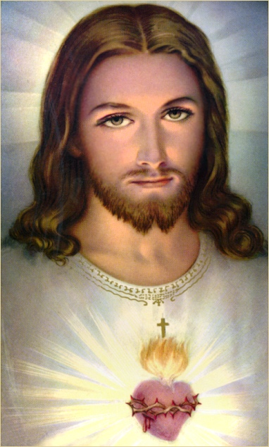
Part I (The Son):
The Lord Comes to Me,
He Calls Me,
I Respond to Him

Slide 3
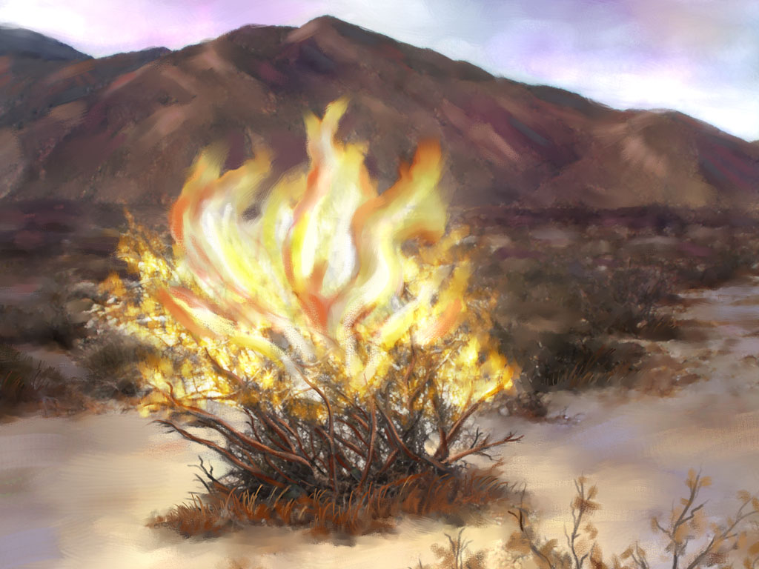
God Comes to Meet Me
Moses: The burning bush

Slide 4
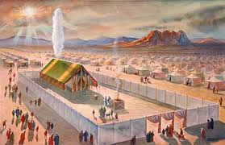
The tent of meeting

Slide 5
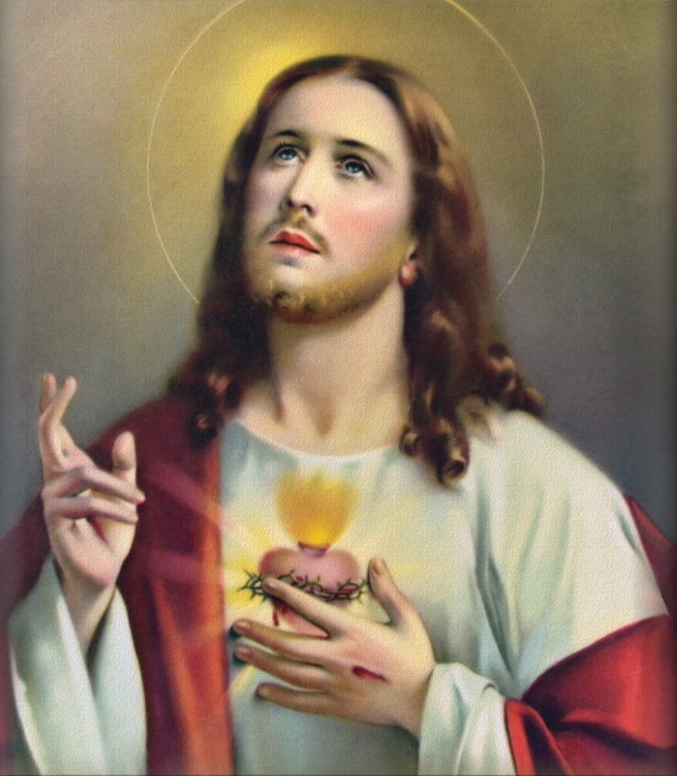
God alone shall you worship,
“choose life”

Slide 6
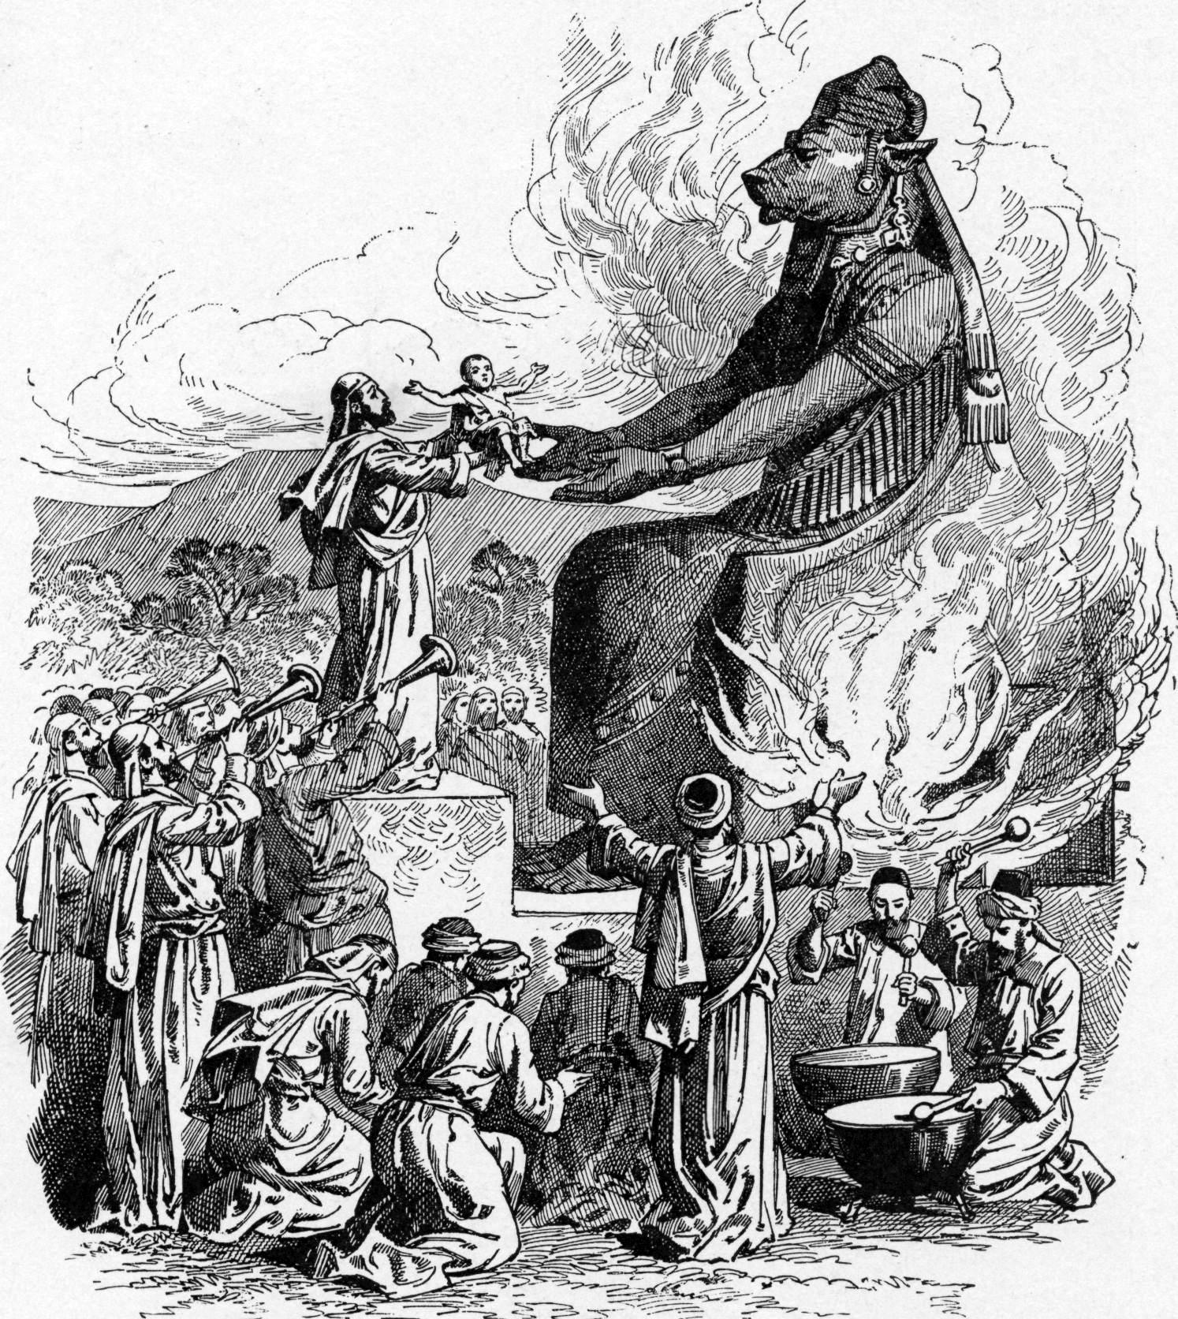
God frees me from idols

Slide 7
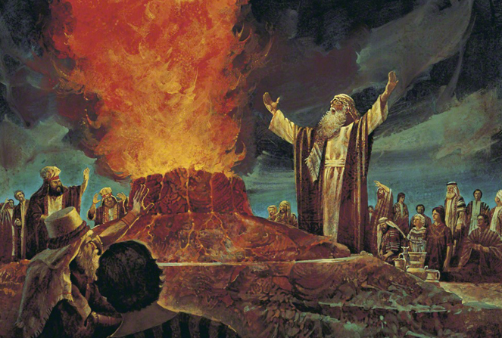
Prophets: meet God on Mountain

Slide 8
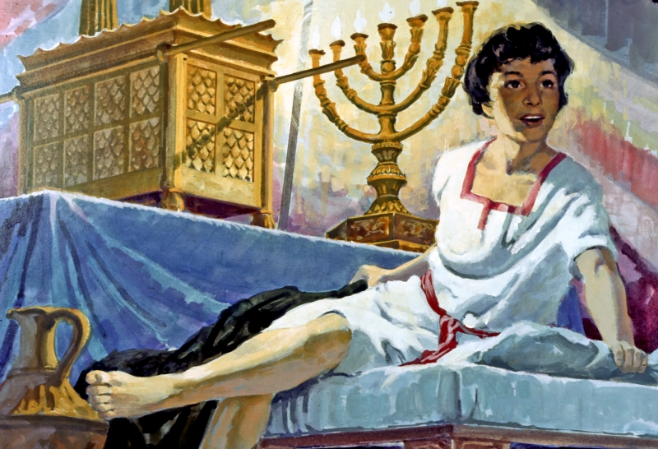
The calling of Samuel

Slide 9
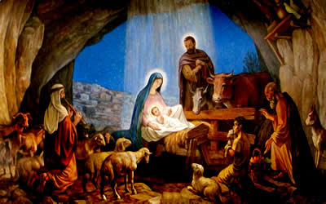
The Incarnation, and the birth of Jesus at Bethlehem

Slide 10
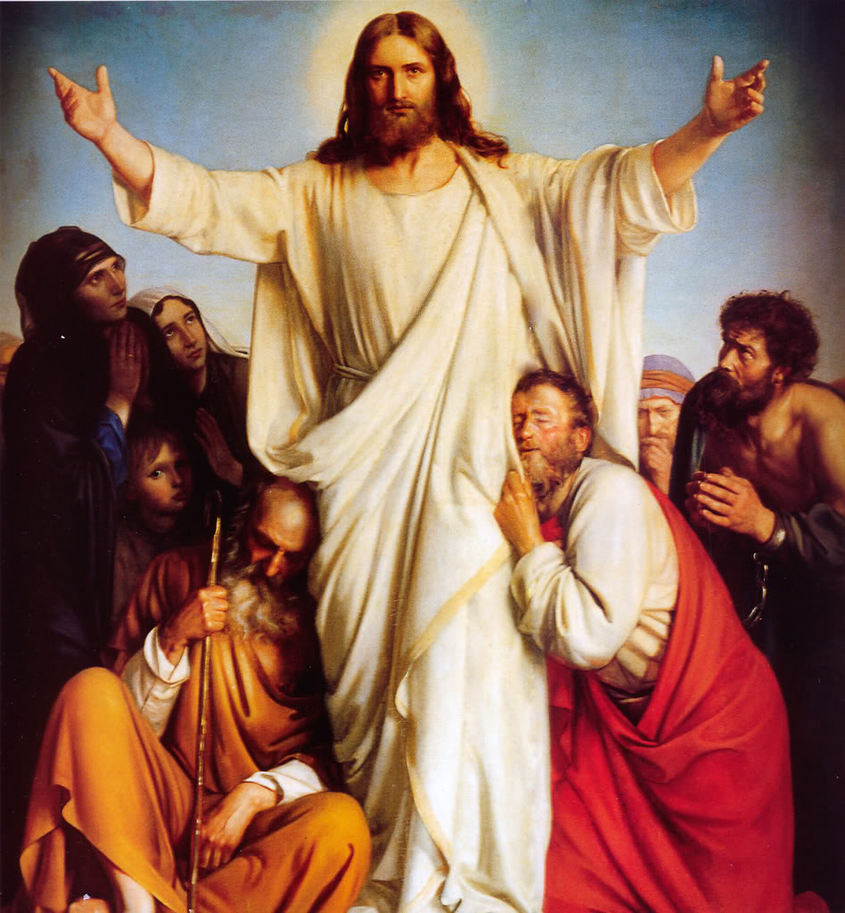
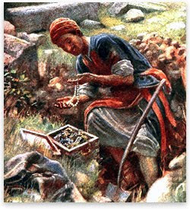
I Respond, by Faith, to Jesus Love
Everlasting love and the parable of the hidden treasure

Slide 11
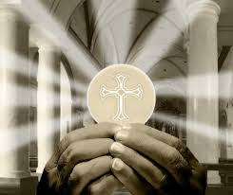
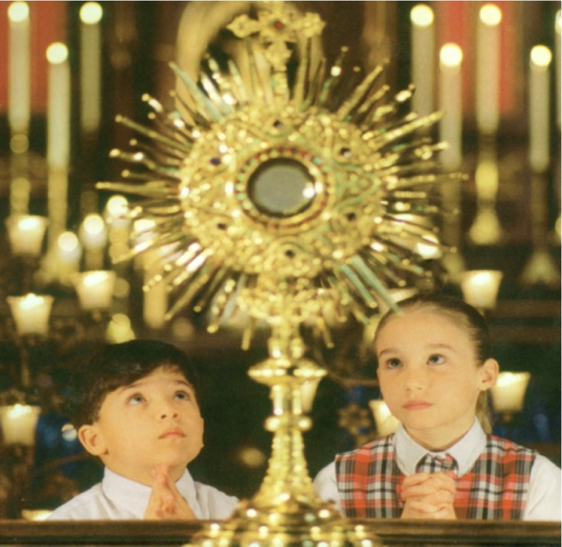
“Come to me”, the Eucharist is the invention of love

Slide 12
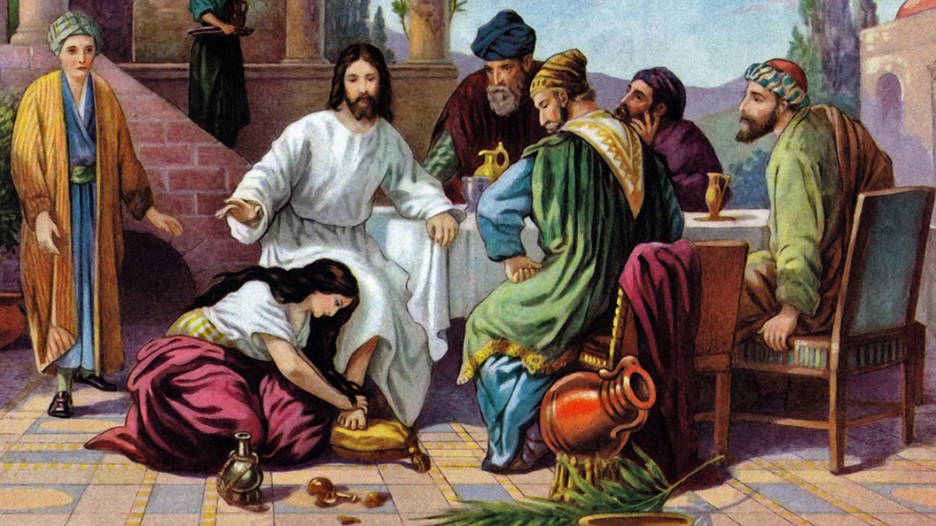
The anointing at Bethany

Slide 13
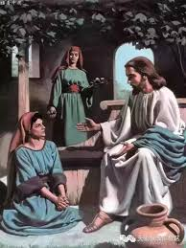
Martha and Mary
and the great commandment of love

Slide 14
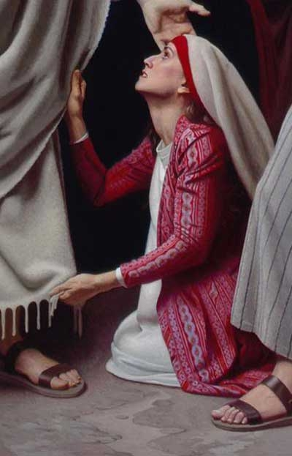
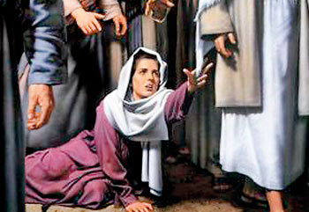
the hemorrhaging woman and the act of faith

Slide 15
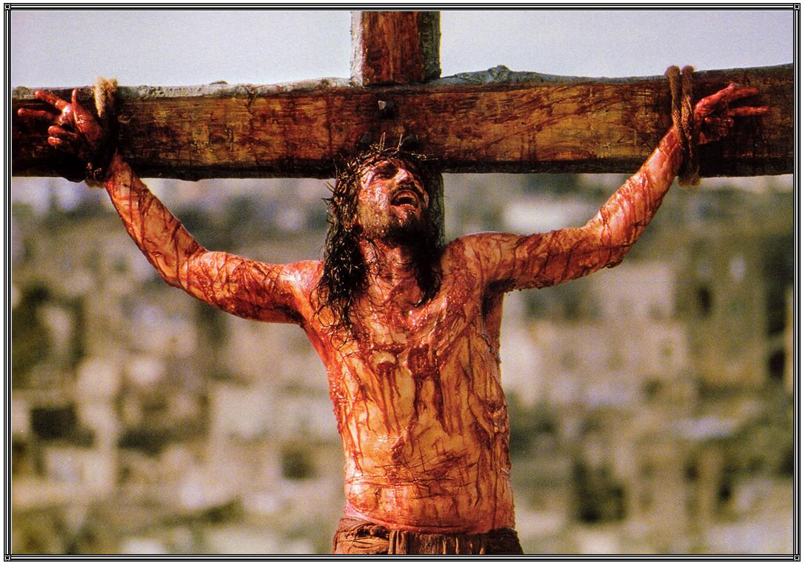
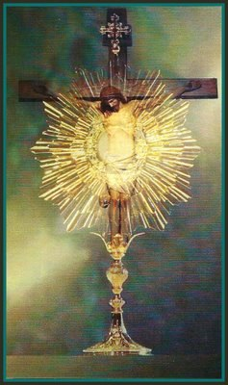
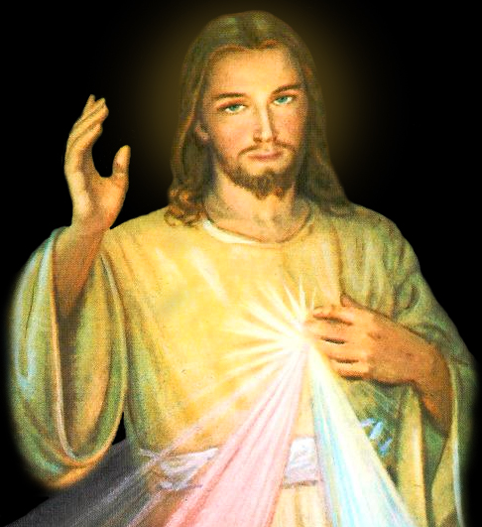
Modes of Christ’s presence and extensions of the Incarnation

Slide 16
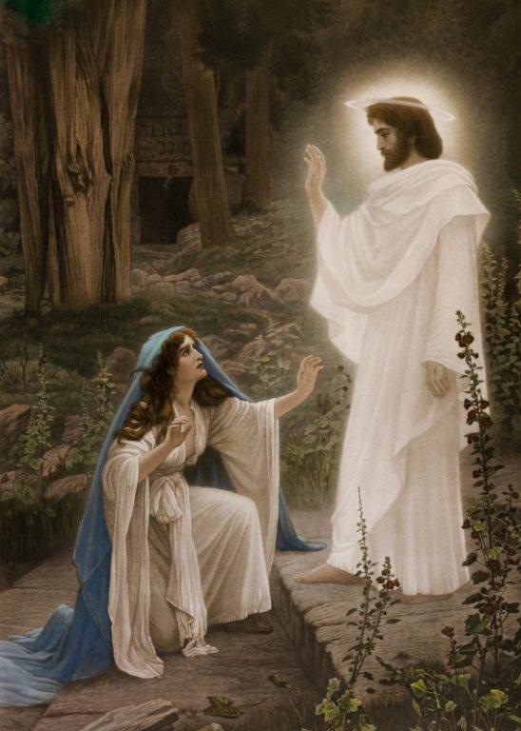
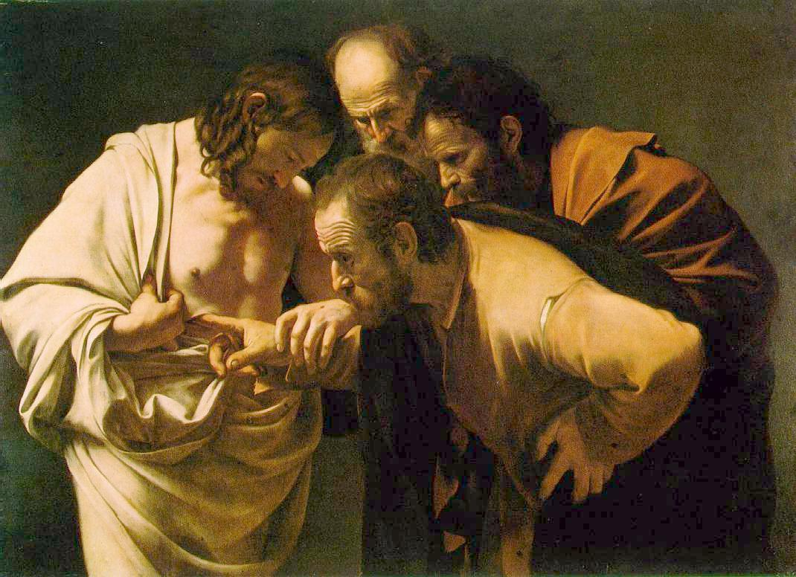
The shock of the bodily
presence of the Resurrected One

Slide 17
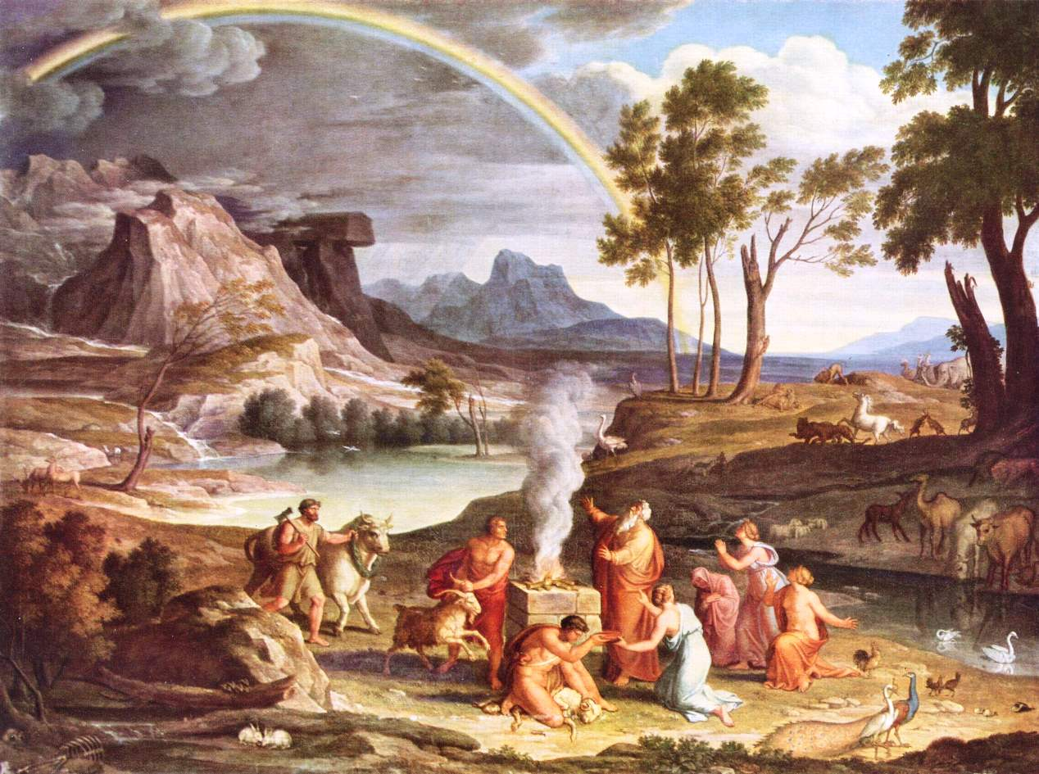
The Signs of the Covenant
Covenants in the Bible

Slide 18
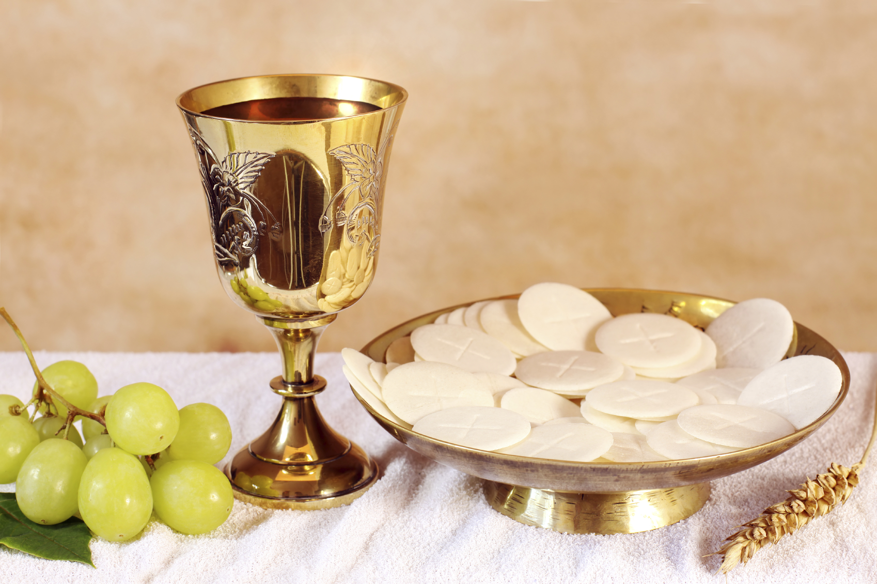
The memorial

Slide 19
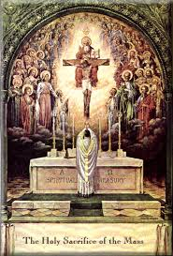
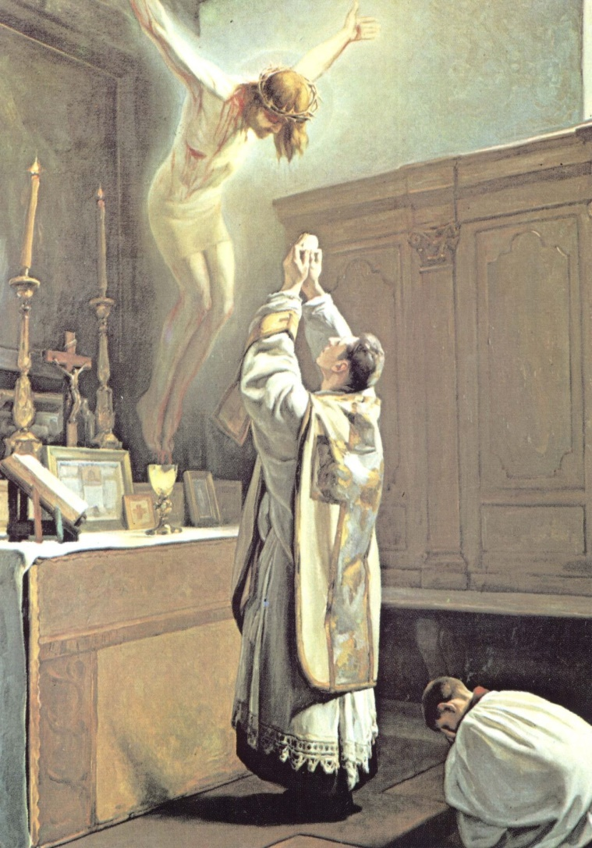
The Holy Sacrifice
of the Mass

Slide 20
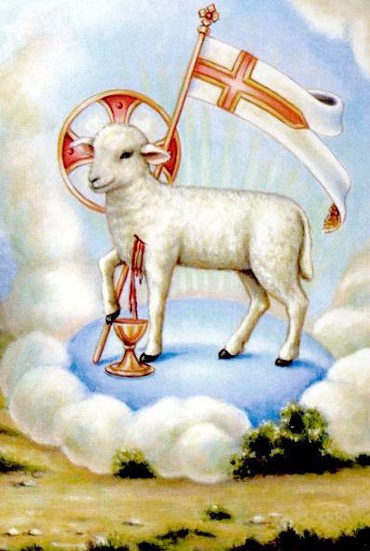
The Paschal Lamb

Slide 21
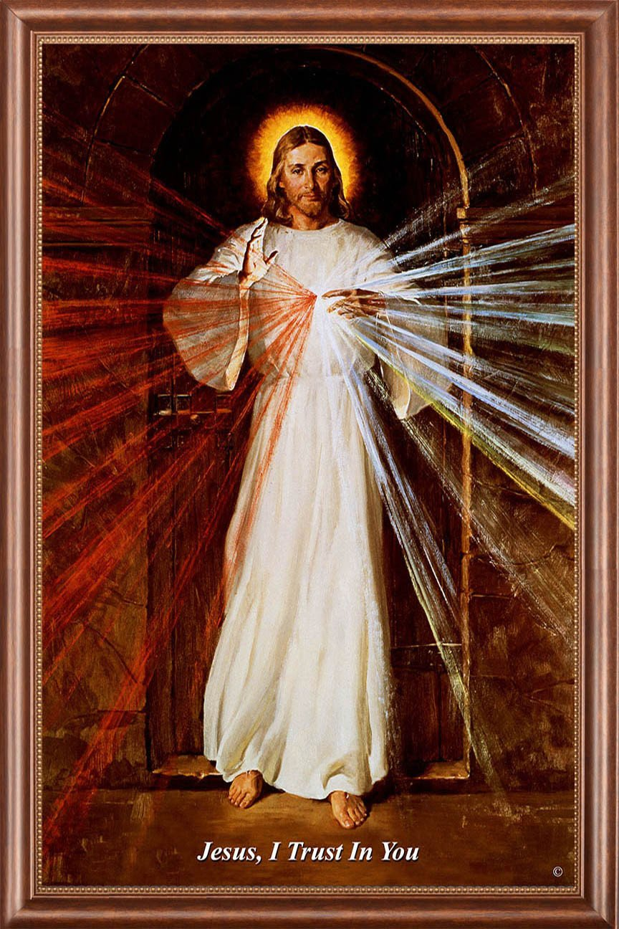
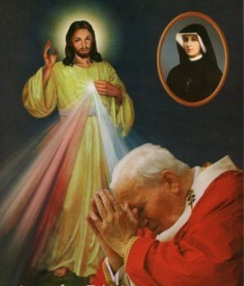
Divine Mercy

Slide 22
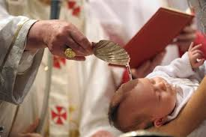
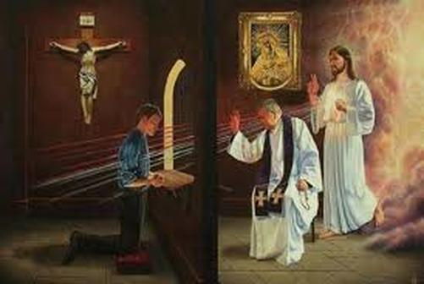
Parable of the marriage feast (Baptism and Confession)

Slide 23
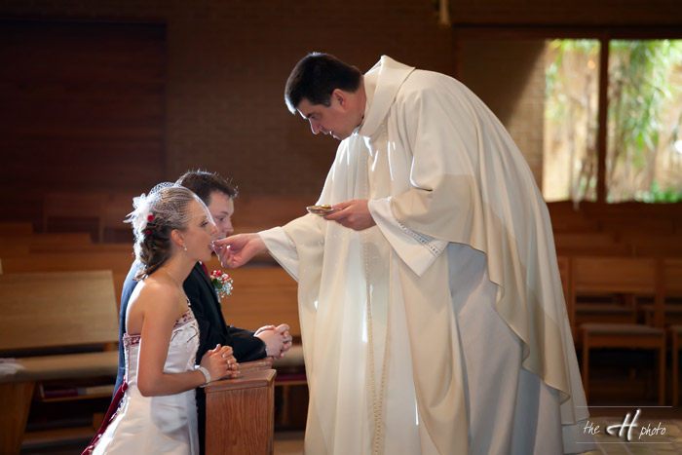
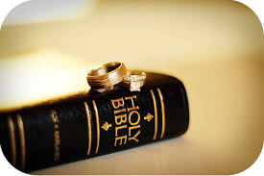
Marriage in the Bible

Slide 24
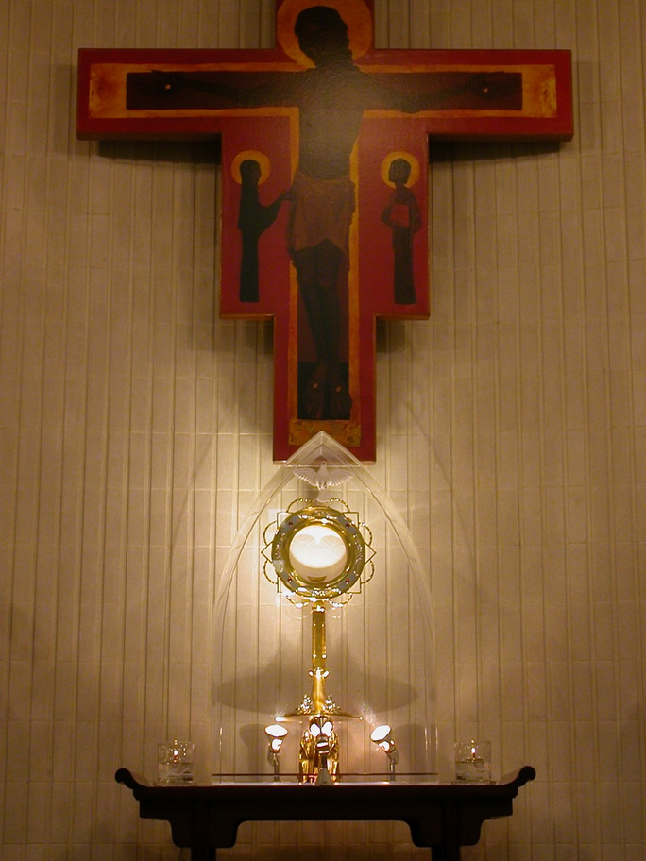
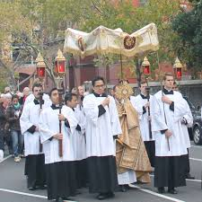
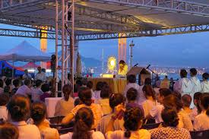
The Eucharist makes the Church (incorporation into the Church)

Slide 25
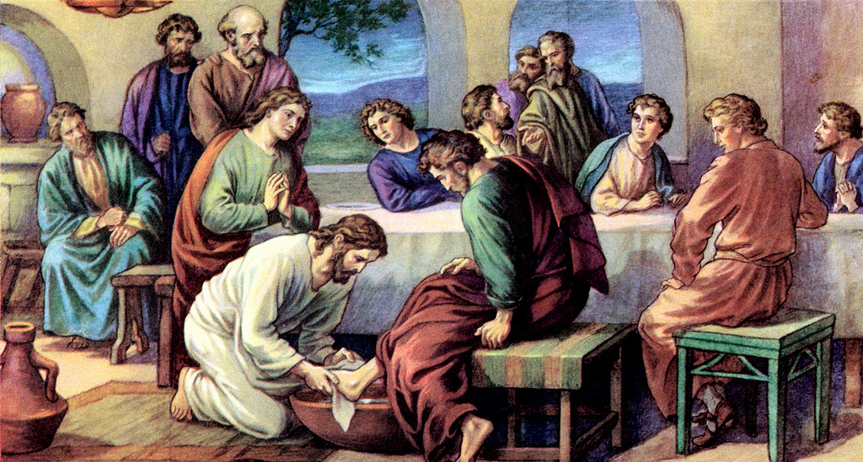
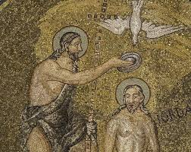
The suffering servant and kenosis

Slide 26
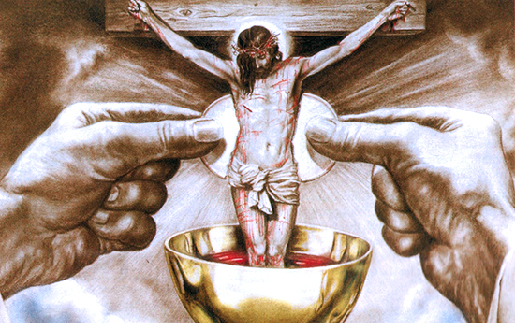
“I am the living bread”
– John 6 parts 1 and 2

Slide 27
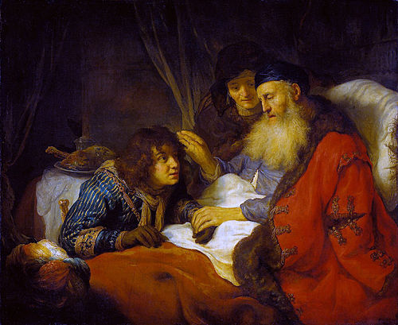
Isaac’s blessing and transubstantiation

Slide 28
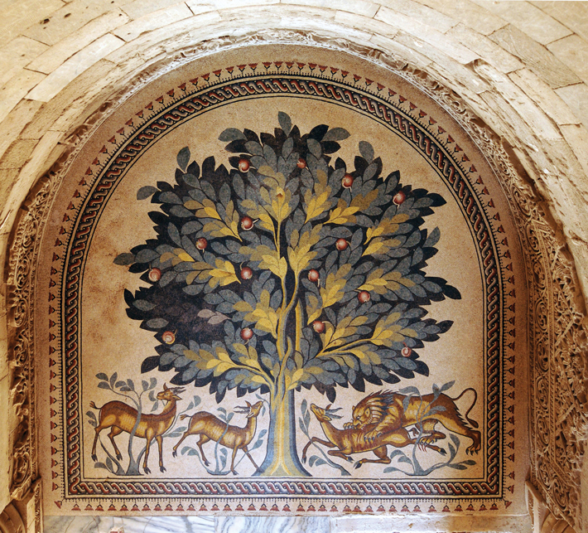
The tree of life recovered

Slide 29
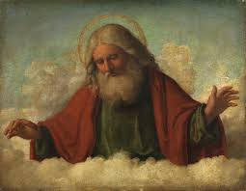
Part II (The Father): Through the Son, Ascending to the Father and Letting Oneself Be Transformed by His Love

Slide 30
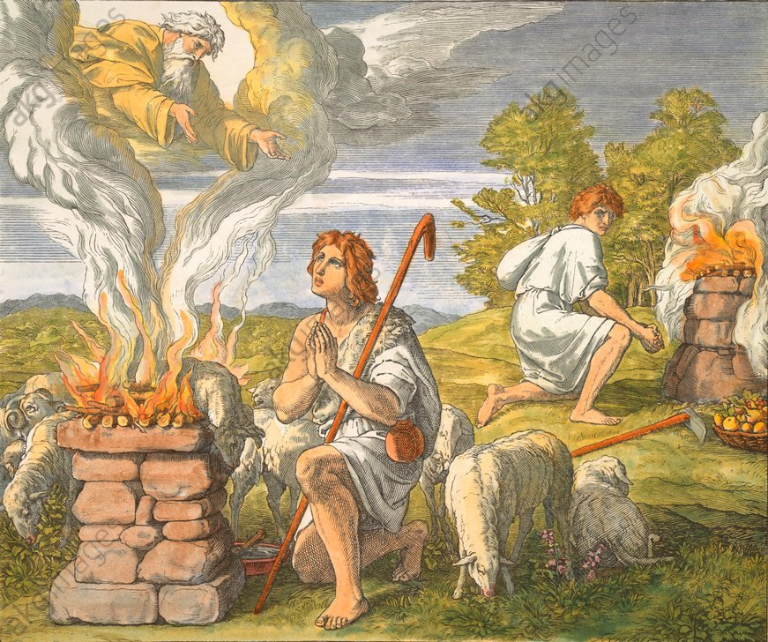
He is the Good Shepherd Who Leads Me to the Father
Cain’s and Abel’s offerings and the offering of oneself

Slide 31
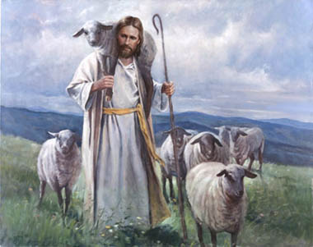
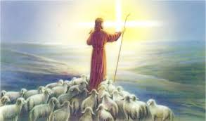
“The Lord is my shepherd”,
the evangelization of my being

Slide 32
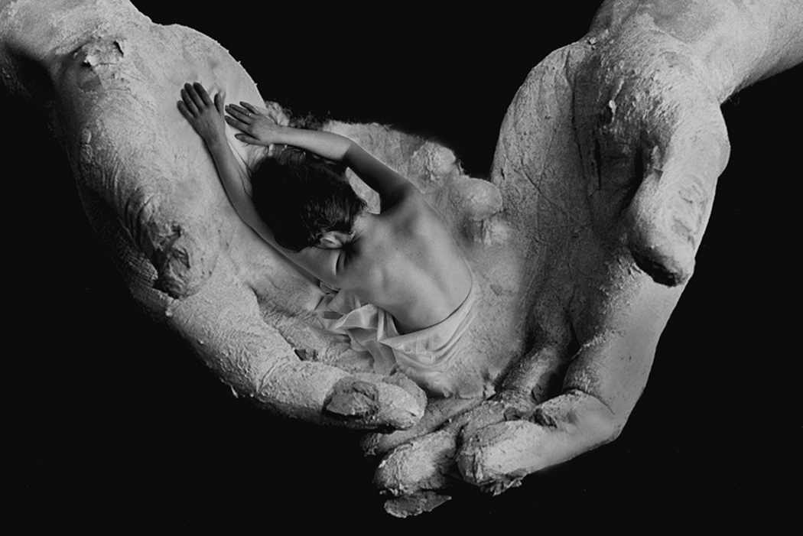
“The clay in the potter’s hands”

Slide 33
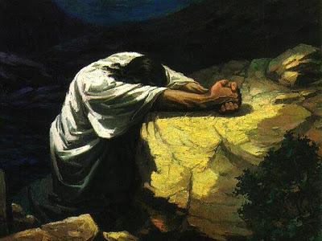
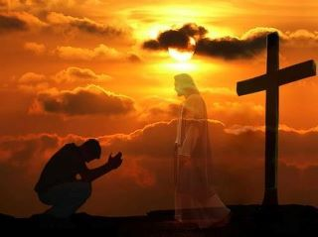
“Not what I will, but what you will”

Slide 34
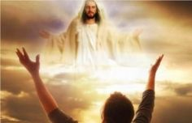
“Abba, Father”,
adoration: remedy for pride and despair

Slide 35
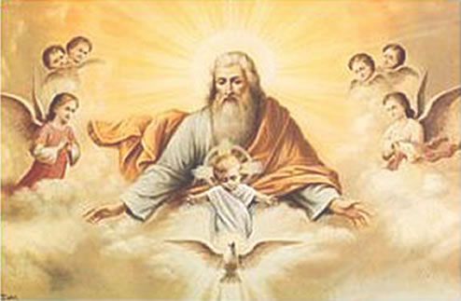
Spiritual Warfare
Be still, and know that I am God

Slide 36
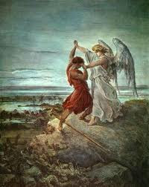
Jacob’s struggle and spiritual advice

Slide 37
The trial of the wilderness (adoration in battle, recollection, contemplation)

Slide 38
Moses fights against the Amalekites, and the paralytic: the power of intercession

Slide 39
A prophet is without honor
in his own country

Slide 40
Part III (The Spirit):
Animated by the Spirit,
Engaging in the Church’s Mission
(14 stages)

Slide 41
In the School of Mary, Eucharistic and Missionary Woman

Slide 42
The Mass and the Annunciation

Slide 43
The Magnificat,
Mary: Ark of
the New Covenant

Slide 44
Jacob’s ladder and the angels,
Our Lady of Fatima

Slide 45
The living Water that Flows from the Pierced Heart

Slide 46
Our Lady of Lourdes

Slide 47
The water gushing from Christ’s side

Slide 48
The Mass and the disciples at Emmaus

Slide 49
“All Things New” (3 stages)
The sorrowful Heart of Jesus and Mary, Our Lady of the Blessed Sacrament

Slide 50
Mary gives birth to a people of adorers

Slide 51
The Lamb shall be its Light

Slide 52
The Five Graces of Adoration
and Mission
The Transfiguration and mission

Slide 53
“Abide in my love”
(the grace of transformation)

Slide 54
Vocations
(graces of reparation and salvation)

Slide 55
The reign of the Eucharist in the soul (grace of sanctification)

Slide 56
The Samaritan Woman
(grace of restoration)

