Slide 1
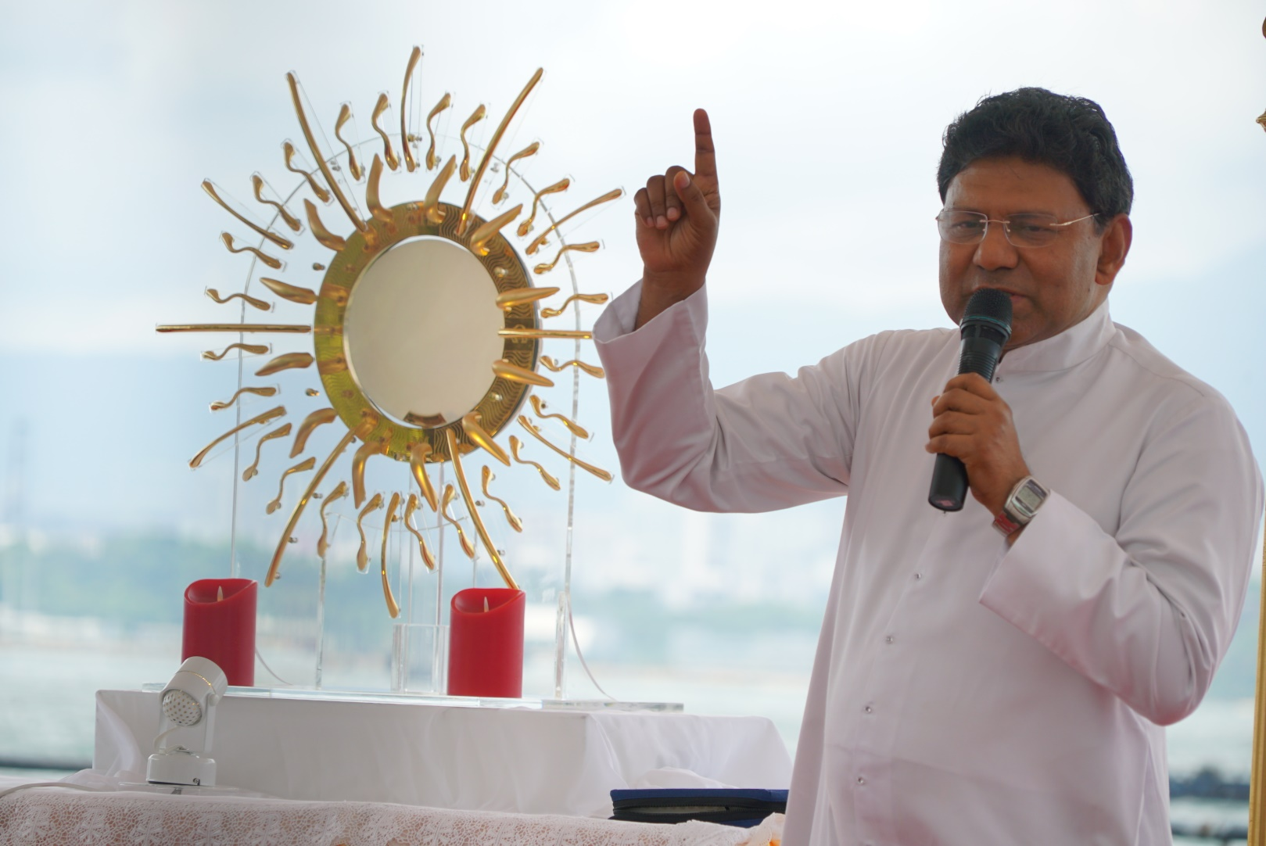
“Behold, I am with you always,
until the end of the age.” says the Lord.

Slide 2
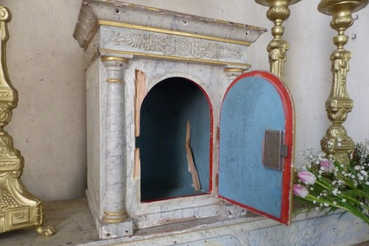
Never Abandon
the Eucharistic Lord

Slide 3
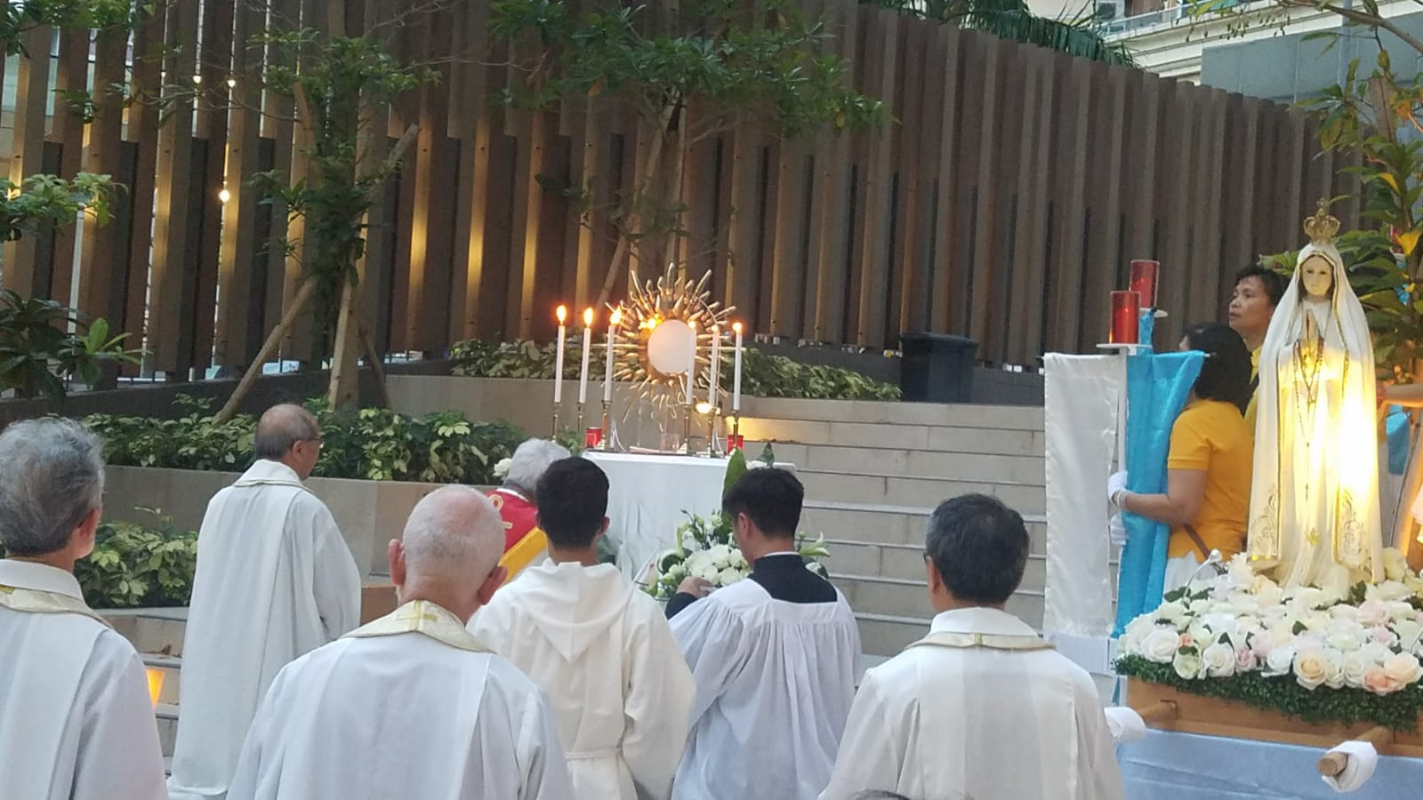
The Savior’s loving presence in the Holy Eucharist
invites everyone to adore.

Slide 4
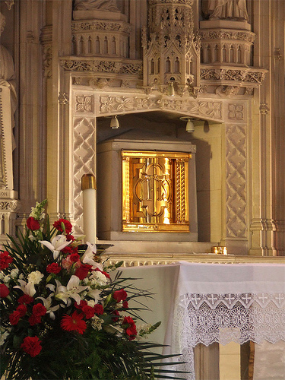
Never to abandon the tabernacle, either exteriorly or interiorly.

Slide 5
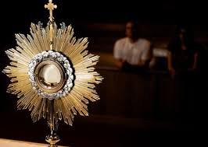
Abandonment exteriorly:
“The habitual and
voluntary absence
of Catholics
who know Jesus
but do not visit Him”

Slide 6
They do not receive him in Holy Communion, nor visit him, nor have a friendly relationship with him --- even though they live close to a Church, and otherwise have time and energy for recreational activities.

Slide 7
Abandonment exteriorly:
Unbelievers, or of the irreligious, or of uncatechized Catholics,
from whom Jesus in the Blessed Sacrament will feel persecuted, hatred, slandered, or unrecognized, rather than abandoned.

Slide 8
Abandonment Interiorly:
It is to receive him with the body, but not with the heart.
It is to go to him saying words, bowing our heads, kneeling down, but not performing these acts of piety with our hearts.
3. It is when we do not meditate on what we are receiving.

Slide 9
4. It is when we do not prepare ourselves to receive him with a clean heart and with great spiritual hunger.
5. It is when we do not taste and give thanks for the Food we have received. It is when we do not talk to or listen to the Guest who is visiting us.

Slide 10
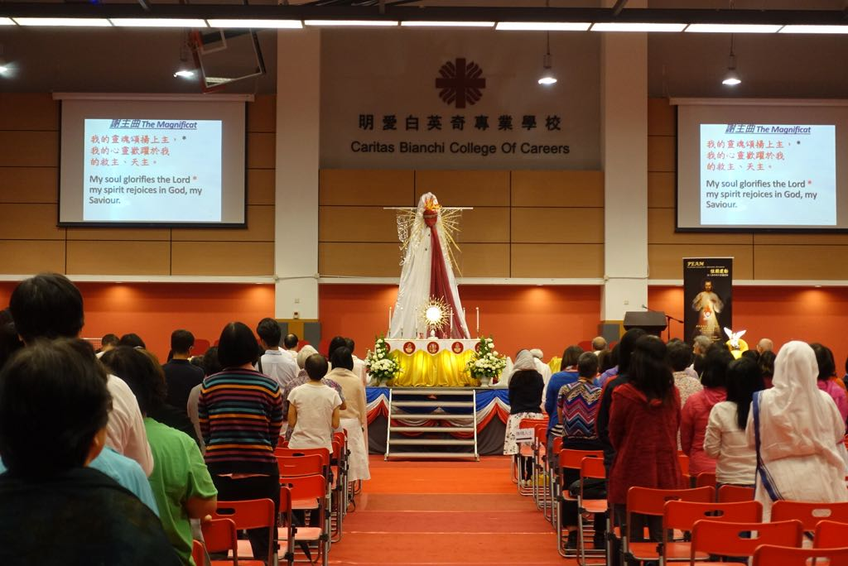
6. It is when we are not open to receive and keep the graces he brings us, the warnings he gives us, the example he teaches us, the desires he reveals to us, the love he shares with us.

Slide 11
Jesus, alone, abandoned in the hearts of his friends!
Jesus visits souls and lives in the “homes” of his friends (through Holy Communion) without being understood or listened to or assisted or asked his opinion or even taken into account!
This interior abandonment is repeated in alarmingly great proportions.

Slide 12
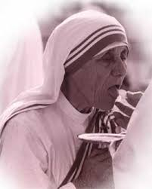
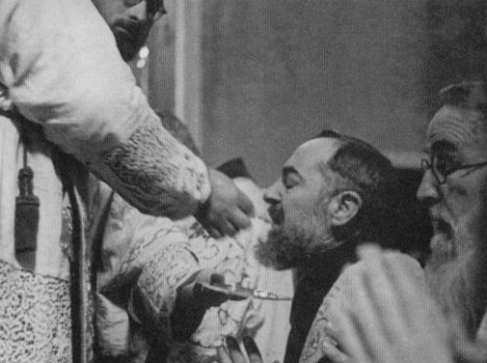
The practice of spending time silence after Mass is an essential means of expressing our gratitude for the sublime gift we receive in the Eucharist.

Slide 13
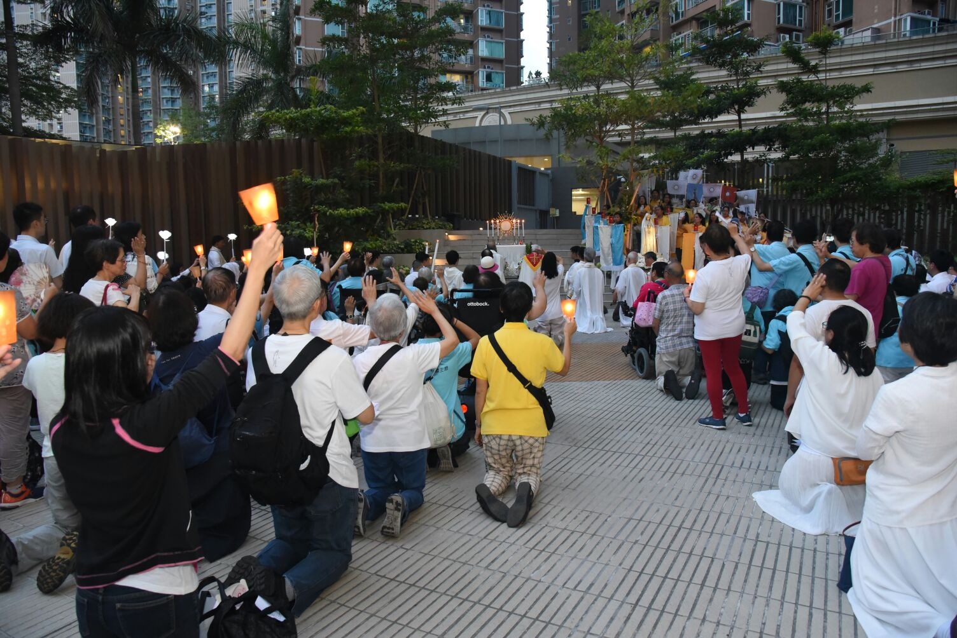
The Eucharist is the miracle of the perpetual dwelling of Jesus with us,
the abandonment of the Eucharist is the practical frustration of that miracle and, along with that, of the merciful and holy purposes of his dwelling with us.

Slide 14
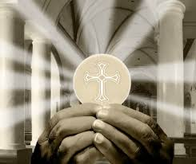
The abandonment of the Eucharist hinders Jesus because of his great and bitter disappointment, and thereby deprives souls and societies of receiving rivers and seas of heavenly graces.

Slide 15
Abandonment is the evil
of those who know that Jesus has eyes yet will not allow him to look at them.
They know that he has ears, yet do not talk to him.
They know Jesus has hands and they do not go to him to receive his gifts.
They know that he has a Heart with a burning love for them and they do not love him or try to please him!

Slide 16
This interior abandonment wounds the Hearts of Jesus, causing him great bitterness.
It is the bitterness of a hope that is dashed and a plea for help that is spurned.
This abandonment reveals a profound lack of love.

Slide 17
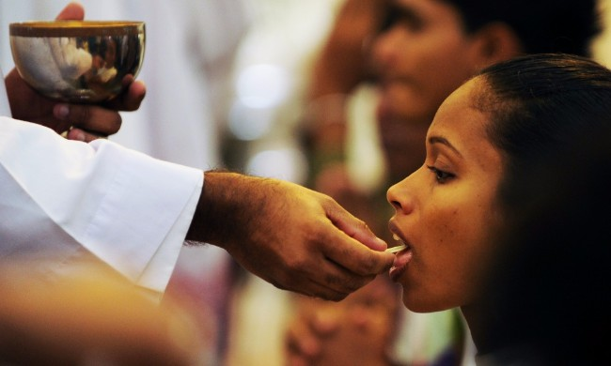
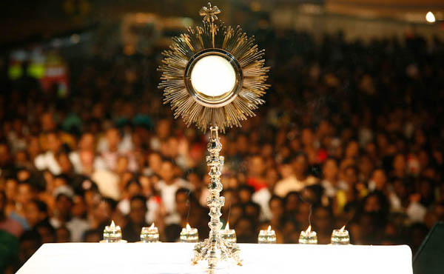
When we do not meditate on
what we are receiving.
“It is when we do not prepare ourselves to receive Him with a clean heart and with great spiritual hunger. ”

Slide 18
It would be sad if, after so long, the Savior’s loving presence were still be unknown by humanity.
“No room in the Inn” (Jn 2:7)
“Do you also want to leave Me?”
(Jn 6:67)

Slide 19
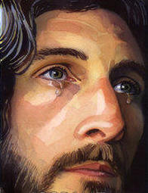
** All of this sadness was there in that tabernacle, oppressing and crushing the
Sweet Heart of Jesus and drawing bitter tears from his eyes.

Slide 20

The calling of PEAM
To see, understand, and feel what would consume the whole of one’s ministry.

Slide 21
To dedicate my life to taking care of Jesus in the needs of his life in the tabernacle:
To feed him with my love,
To keep him warm with my presence,
3. To entertain him with my conversations,
4. To defend him against abandonment and ingratitude,

Slide 22
5. To give relief to his Heart with my sacrifices,
6. To serve him with my feet by going to adore him wherever I can, and with my hands by giving alms in his name, even to those who do not love him, and with mouth by speaking of him and consoling others in his name, and by crying out to those who do not want to hear him, until finally they would listen and begin to follow him.

Slide 23
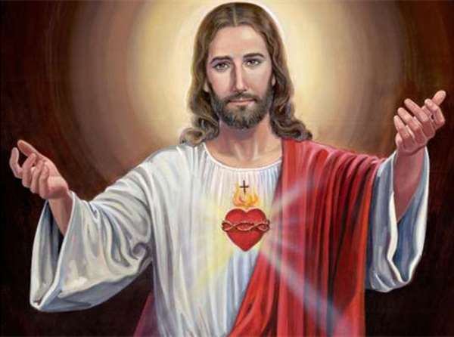
Our world needs the science of the love of Jesus Christ.
This science is learned more by the heart than by the mind.

Slide 24
Eucharistic Reparation
Person of Christ in the Eucharist had to be the source, the center, and the summit of the Church’s evangelization and catechesis.
As long as there were still generous souls willing to keep Christ company in Eucharistic Adoration, there was still great hope for the Church. **

Slide 25
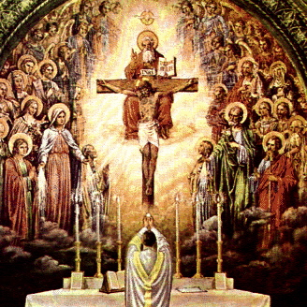
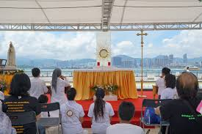
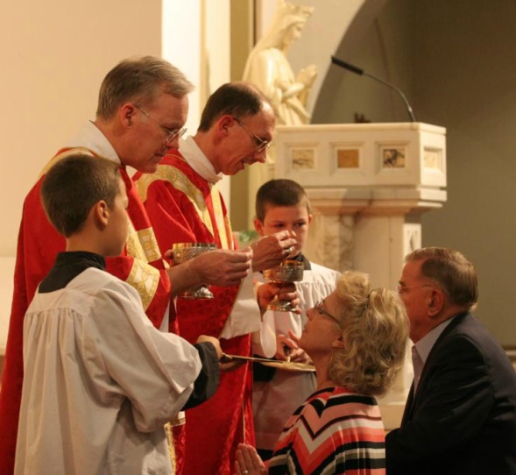
Three fundamental dimensions of the Eucharistic Mystery:
1) the Holy Sacrifice of the Mass,
2) the sacramental gift of Holy Communion,
3) the Real Presence of the Lord in the Blessed Sacrament.

Slide 26
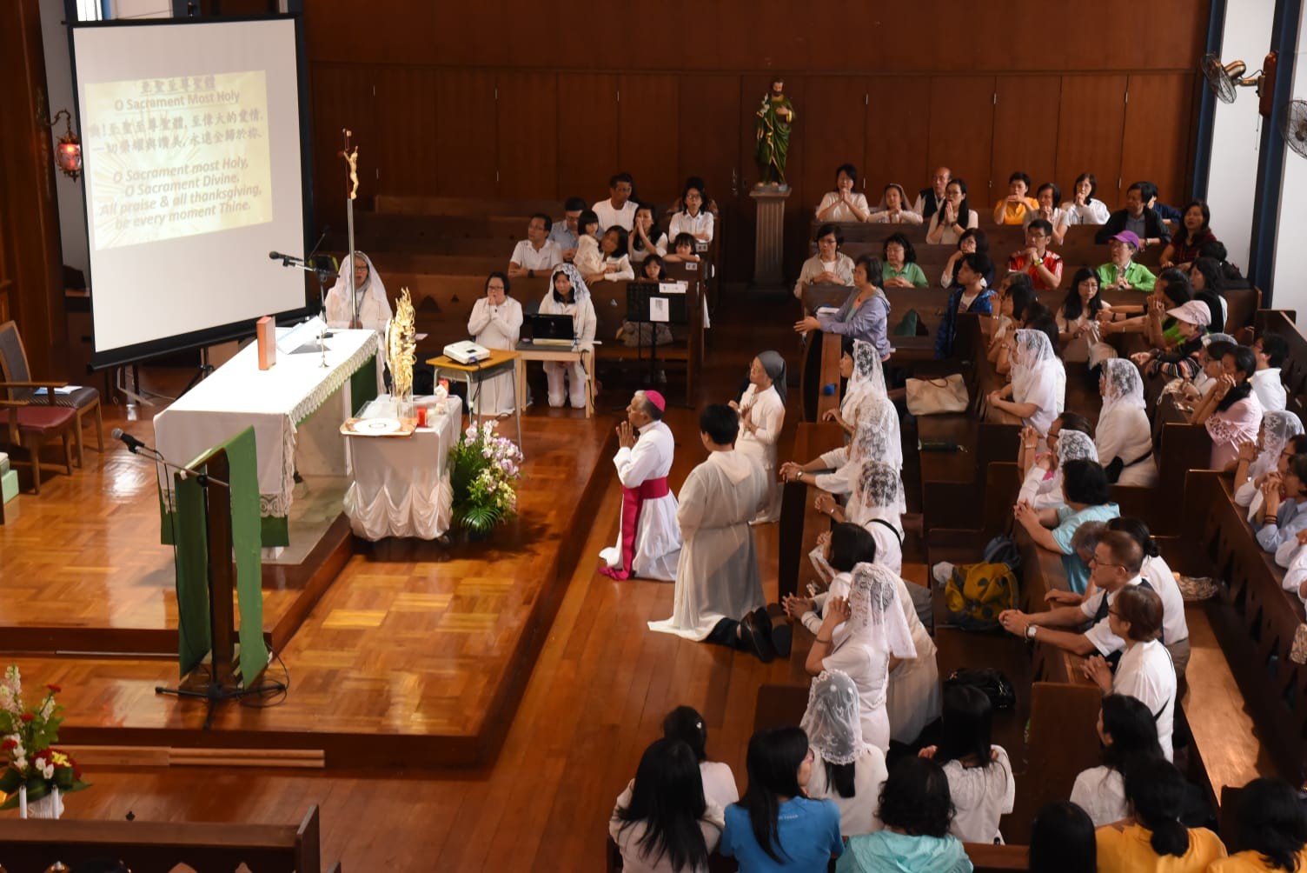
To spread Eucharistic Adoration and loving reverence for the abandonment tabernacle.

Slide 27
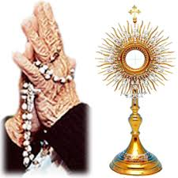
Eucharistic faith has to be nourished by daily Adoration, which is what permits us to receive Holy Communion fruitfully.
Adoration is spiritual contact with the Person of Christ in the Host, and this contact enables us to have deep personal contact with him when he comes in Holy Communion.

Slide 28
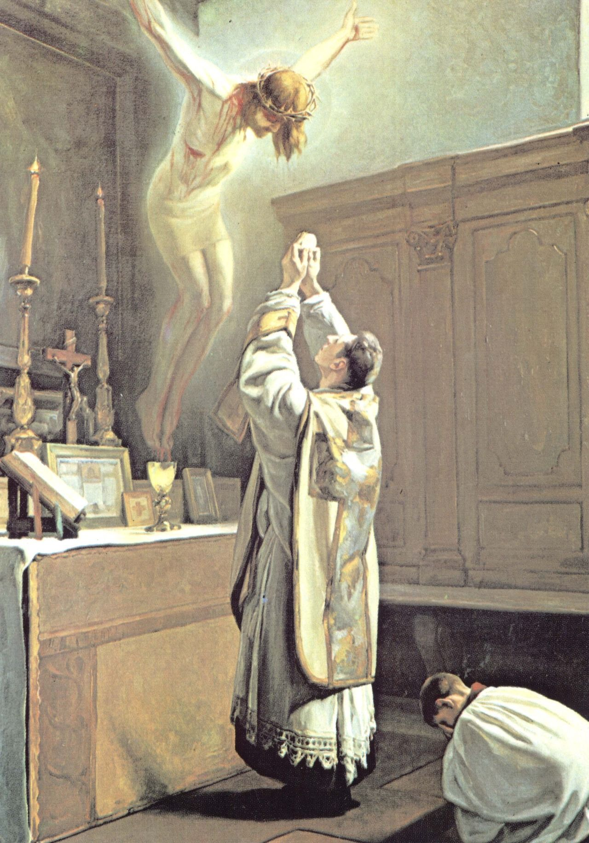
Only if we encounter Christ as a living Person in the tabernacle will we encounter him as a living Person in Holy Communion.

Slide 29
Owing to our limitations and the weakness of our condition, we find living in faith difficult since it is hard to go against our human nature. In spite of our frequent Holy Communions, we have the tendency to get tired, distracted, become lukewarm, and even cut off communication with him whom we cannot know, love, nor enjoy in the present life except through a living faith and self-denial.

Slide 30
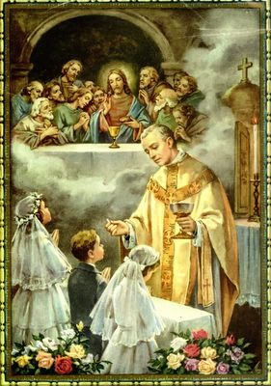
Only those who will journey along this way of living faith and self-denial will give the Heart of Jesus the company he wishes and will receive from him all the fruits that on can hope for in receiving him (in Holy Communion) and becoming united to him.

Slide 31
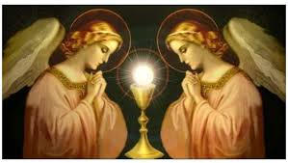
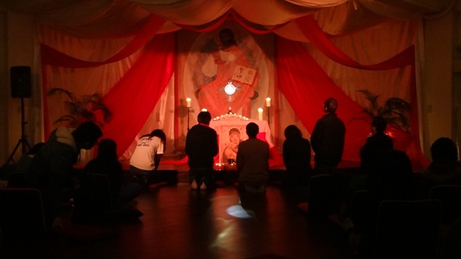
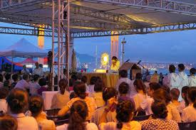
Living faith and self-denial are expressed by making frequent visits to the Blessed Sacrament.
There is no greater penance than to deny ourselves the pursuit of other activities so as to make time for Eucharistic Adoration.

Slide 32
Let us adore Him daily
with love

