Slide 1
至圣至尊圣体
O Sacrament Most Holy
噢!至圣至尊圣体,
至伟大的爱情.
一切荣耀与赞美,
永远全归于祢.
O Sacrament most Holy,
O Sacrament Divine.
All praise & all thanksgiving,
be every moment Thine.

Slide 2
天使的祈祷 Angel's Prayer
(唱)我上主，我信祢，钦崇祢，依靠祢并爱祢，我求祢宽赦那些不信，不钦崇，不依靠，不爱祢的人。 (x3) (Sing) Oh my God I believe I adore I hope and I love you, I beg your pardon for those who do not believe, do not adore, do not hope, and do not love you. (x3)

Slide 3
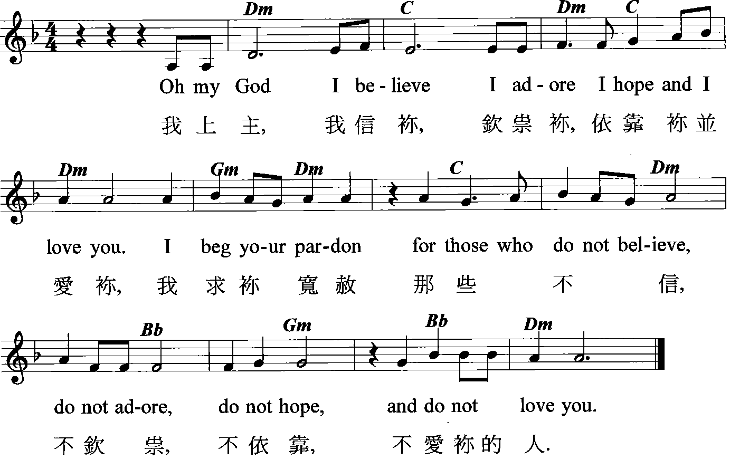

Slide 4
至圣圣三,父子及圣神,我深深地钦崇祢,并将存于世界每一圣体龛内的耶稣基督至尊圣体宝血,灵魂和天主性全献于祢,为补偿祢因他人之冒犯,
O Most Holy Trinity, Father, Son and Holy Spirit, I adore Thee profoundly. I offer Thee the most Precious Body, Blood, Soul and Divinity of Jesus Christ, present in all the tabernacles of the world,

Slide 5
所受的侮辱、亵渎以及慢待,并透过耶稣至圣圣心和玛利亚无玷之心,我恳求祢赏赐罪人悔改.亚孟.
in reparation for the outrages, sacrileges and indifferences by which He is offended. By the infinite merits of the Sacred Heart of Jesus and the Immaculate Heart of Mary, I beg for the conversion of poor sinners. Amen.

Slide 6
天使的祈祷
我上主,我信祢,钦崇祢,依靠祢并爱祢.我求祢宽赦那些不信、不钦崇、不依靠,不爱祢的人.
Prayer of the Angel of Fatima
Oh my God, I believe, I adore, I hope, and I love you. I beg your pardon for those who do not believe, do not adore, do not hope, and do not love you.

Slide 7
天使的祈祷
我的天主,我信祢,钦崇祢,依靠祢并爱祢.我求祢宽赦那些不信、不钦崇、不依靠和不爱祢的人.至圣圣三,父子及
The Angel's Prayer
My God, I believe, I adore, I hope, and I love thee! I beg pardon for those who do not believe, do not adore, do not hope, and do not love Thee. O Most Holy Trinity, Father, Son

Slide 8
圣神,我深深地钦崇祢,并将存于世界每一圣体龛内的耶稣基督至尊圣体宝血,灵魂和天主性全献于祢,为补偿祢因他人之冒犯,所受的侮辱、亵
and Holy Spirit, I adore Thee profoundly. I offer Thee the most Precious Body, Blood, Soul and Divinity of Jesus Christ, present in all the tabernacles of the world, in reparation for the outrages, sacrileges and indifferences by

Slide 9
渎以及慢待,并透过耶稣至圣圣心和玛利亚无玷之心,我恳求祢赏赐罪人悔改.亚孟.
which He is offended. By the infinite merits of the Sacred Heart of Jesus and the Immaculate Heart of Mary, I beg for the conversion of poor sinners. Amen.

Slide 10
Prayer for Restraining Dark Forces before Community Eucharistic Healing
团体[圣体医治祈祷]前
捆绑黑暗势力的祷文

Slide 11
Lord Jesus, we thank you for dwelling among us as true God and true man in the Blessed Sacrament. In the name, the power and the authority of our Lord Jesus Christ, I forbid all evil spirits which are attached to
主耶稣,感谢祢真人真天主在圣体内临到我们的中间!我因主耶稣基督祢的圣名及权威,禁止所有依附于在场

Slide 12
any person / thing / water / air to disturb our prayers. In the name and power of our Lord Jesus Christ, I restrain you, all spirits that do not belong to Christ, and forbid you from influencing the
任何人/物/水/空气中的邪灵,干扰我们的祈祷.我因主耶稣基督的圣名及权威捆绑你们
–所有不属于基督的灵–禁止你们影响任何在场人士的

Slide 13
will, mind, imagination, emotion, memory, speech or body of those present here. With the Holy Spirit as our defense, I forbid you from arousing grief, fear or other agitated emotions in those
意志、理智、想象、情绪、记忆、说话及身体.我以圣神作利剑,禁止你们激起在场人士的悲愤、恐惧或任何其他激动

Slide 14
present here. I command you to remain silent during our healing prayer and depart from any person / thing / water / air to which you have attached. Return immediately and quietly to the place where Jesus has banished
的情绪.我命令你们,在我们作医治祈祷时,保持静止缄默,离开所依附的人/物/水/空气,并立即静悄悄地去到耶稣驱赶

Slide 15
you and never to return or do harm.
你们去的地方,不得胡作妄为,也不得再回头.
All: Amen.
众:亚孟.
(next page /见下页)

Slide 16
All: St.Michael the Archangel, with your heavenly host, please safeguard all the participants here from any hurt, especially those who rest in the Holy Spirit.
(众)圣弥额尔总领天使，请带领天军在所有在场人士身旁扎营护守，保护所有在圣神内休息的人安全。 亚孟。

Slide 18
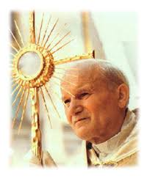

Slide 19
皇皇圣体 /Tantum Ergo
皇皇圣体尊高无比，
我们俯首致钦崇。
古教旧礼已成陈迹，
新约礼仪继圣功。
Come adore this wondrous presence, bow to Christ the source of grace.
Here is kept the ancient promise of God’s earthly dwelling place.

Slide 20
五官之力有所不及，
应由信德来补充。
赞美圣父赞美圣子，
欢欣踊跃来主前。
Sight is blind before God’s glory, faith alone may see his face.
Glory be to God the Father, praise to his coequal Son.

Slide 21
歌颂救主凯旋胜利，
颂扬主德浩无边。
圣神发自圣父圣子，
同尊同荣同威严。亚孟。
Adoration to the Spirit, bond of love, in Godhead one.
Blest be God by all creation, joyously while ages run, Amen.

Slide 22
主礼:主,祢赐给我们天国的食粮。
众:它给我们带来了喜乐.
You have given Your
people bread from heaven. (Alleluia)
The bread which is
full of all goodness. (Alleluia)

Slide 23
主礼: 请众同祷：主, 祢在这奇妙的圣事内,留给了我们受难的纪念;
V. O God. Who in this wonderful sacrament, has left us a memorial of Your passion;

Slide 24
求祢帮助我们虔诚钦崇祢体血的神圣奥迹,俾能常常领受祢救赎的功效.祢永生永王. 众:亚孟.
grant us we beseech You, so to venerate the sacred mysteries of you body and blood, that we may ever feel within us the fruit of your redemption. Who lives etc. R. Amen.

Slide 25
赞美天主The Divine Praises
赞美天主.
赞美天主圣名.
赞美耶稣基利斯督,
真是天主又真是人.
Blessed be God.
Blessed be His holy name.
Blessed be Jesus Christ,
True God and true man.

Slide 26
赞美耶稣圣名.
赞美耶稣至圣之心.
赞美耶稣宝血.
Blessed be the name of Jesus.
Blessed be His most sacred heart.
Blessed be His most precious blood.

Slide 27
赞美耶稣在至圣之
圣体圣事内.
赞美师保圣神.
Blessed be Jesus in the
most holy sacrament of the altar.
Blessed be the Holy Spirit, the paraclete.

Slide 28
赞美至高至圣玛利亚
天主之母.
赞美圣母至圣而无玷
之始胎.
Blessed be the great mother of God, Mary most Holy.
Blessed be her holy and Immaculate Conception.

Slide 29
赞美圣母蒙召升天.
赞美童贞圣母玛利亚之名.
Blessed be her glorious assumption.
Blessed be the name of Mary, virgin and mother.

Slide 30
赞美圣若瑟圣母之净配.
赞美天主于其天神及诸圣人中,至于世世. 亚孟.
Blessed be Saint Joseph, her most chaste spouse.
Blessed be God in His angels and His saints. Amen.

Slide 31
我的灵魂 / Magnificat
我的灵魂颂扬上主,
衷心赞美我们的天主上主,衷心赞美,衷心赞美,
衷心赞美我们的上主.
Magni-fi-cat, ma-gni-fi-cat,
Ma-gni-fi-cat a-ni
ma me-a Do-mi-num.
Ma-gni-fi-cat, ma-gni-fi-cat,
Ma-gni-fi-cat a-ni ma me-a.

Slide 33
心颂#576 圣母颂
万福玛利亚，
满被圣宠者，
主与你相偕，
主与你相偕。
女子之中唯你堪受赞美，也堪受赞颂你圣胎之子主耶稣。

Slide 34
万福玛利亚，天主之母；
万福玛利亚，天主之母。
为我等罪人祈祷。
此刻，并于我等死候。亚孟。
万福玛利亚，天主之母，为我等祈求，为我等祈。

Slide 35
颂恩#234 圣母经
万福玛利亚,满被圣宠者,
主与尔皆焉,
女人中尔为赞美,
尔胎子耶稣并为赞美.
天主圣母玛利亚,
为我等罪人,今祈天主,
及我等死候.亚孟.

Slide 36
万福玛利亚，天主之母；
万福玛利亚，天主之母。
为我等罪人祈祷。
此刻，并于我等死候。亚孟。
万福玛利亚，天主之母，为我等祈求，为我等祈。

Slide 37
三钟经 The Angelus
启:主的天使向玛利亚报喜。
应:祂因圣神受孕。 (圣母经一篇)
The Angel of the Lord declared to Mary: And she conceived of the Holy Spirit. (Hail Mary)

Slide 38
圣母经/The Hail Mary:
万福玛利亚,你充满圣宠,主与你同在,你在妇女中受赞颂,你的亲子耶稣同受赞颂.天主圣母玛利亚,求您现在和我们临终时,为我们罪人祈求天主.亚孟.
Hail Mary, full of grace; the Lord is with thee: blessed art thou among women, and blessed is the fruit of thy womb, Jesus. Holy Mary, Mother of God, pray for us sinners, now and at the hour of our death. Amen

Slide 39
启:我是主的婢女。
应:请依照祢的话在我身上 成就吧。 (圣母经一篇)
Behold the handmaid of the Lord:
Be it done unto me according to Thy word.
(Hail Mary)

Slide 40
圣母经/The Hail Mary:
万福玛利亚,你充满圣宠,主与你同在,你在妇女中受赞颂,你的亲子耶稣同受赞颂.天主圣母玛利亚,求您现在和我们临终时,为我们罪人祈求天主.亚孟.
Hail Mary, full of grace; the Lord is with thee: blessed art thou among women, and blessed is the fruit of thy womb, Jesus. Holy Mary, Mother of God, pray for us sinners, now and at the hour of our death. Amen

Slide 41
启:天主圣子降生成人。
应:居住在我们人间。
(圣母经一篇)
And the Word was made Flesh:
And dwelt among us.
(Hail Mary)

Slide 42
圣母经/The Hail Mary:
万福玛利亚,你充满圣宠,主与你同在,你在妇女中受赞颂,你的亲子耶稣同受赞颂.天主圣母玛利亚,求您现在和我们临终时,为我们罪人祈求天主.亚孟.
Hail Mary, full of grace; the Lord is with thee: blessed art thou among women, and blessed is the fruit of thy womb, Jesus. Holy Mary, Mother of God, pray for us sinners, now and at the hour of our death. Amen

Slide 43
启:天主圣母，请为我们祈求。
应:使我们堪当承受基督的恩 许。
Pray for us, O Holy Mother of God, that we may be made worthy of the promises of Christ.

Slide 44
启:请众同祷。
应:天主，求祢把祢的圣宠注入我们心中，我们既因天使的预报，得知祢的圣子
Let us pray:
Pour forth, we beseech Thee, O Lord, Thy grace into our hearts; that we, to whom the incarnation of Christ, Thy Son, was made known by the

Slide 45
降生成人，亦愿赖着祂的苦难及祂的十字圣架，获享复活的光荣。因我们的主基督。
应：亚孟。
message of an angel, may by His Passion and Cross be brought to the glory of His Resurrection, through the same Christ Our Lord. Amen.

Slide 46
圣三光荣经/Glory Be to the Father:
:
愿光荣归于父,及子,及圣神,起初如何,今日亦然,直到永远.亚孟.
(圣三光荣经三篇)
Glory be to the Father, and to the Son and to the Holy Ghost. As it was in the beginning, is now and ever shall be, world without end. Amen. (x3)

Slide 47
为炼灵祈祷文
Prayers For Souls In Purgatory
望主赐伊等永光安，及永光照之，息止安所，凡诸信者灵魂，赖天主仁慈，息之安所。亚孟。
Eternal rest grant unto them, O Lord; And let perpetual light shine upon them. May they rest in peace. Amen

