Slide 1
——The beautiful dream of lover——
「PEAM」

Slide 2
“I came to bring fire to the earth, and how I wish it were already kindled!”
(Luke 12:49)

Slide 3
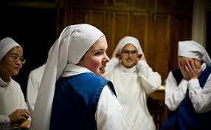
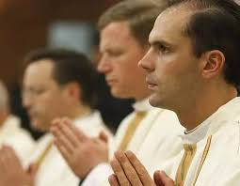
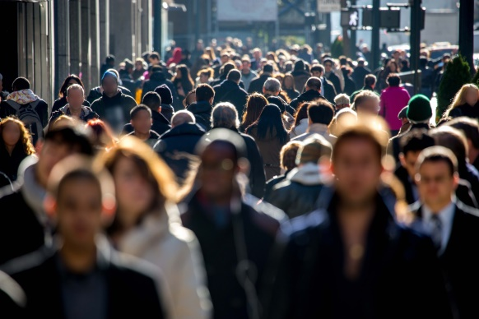
Chapter 1 Purpose of PEAM
Perpetual Eucharistic Adoration Movement” (PEAM) is a universal movement launched in response to the repeated calls from St. John Paul II to promote and establish Perpetual Eucharistic Adoration in parishes, Christian communities, and academic institutes throughout the world in the name of the Catholic Church.

Slide 4
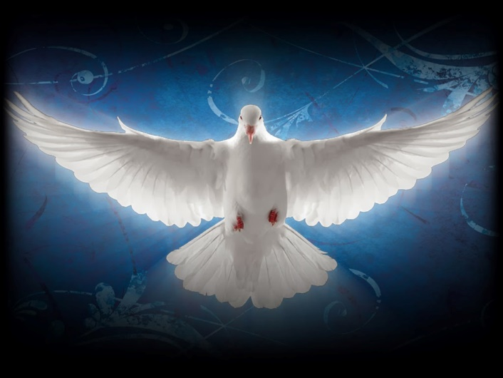
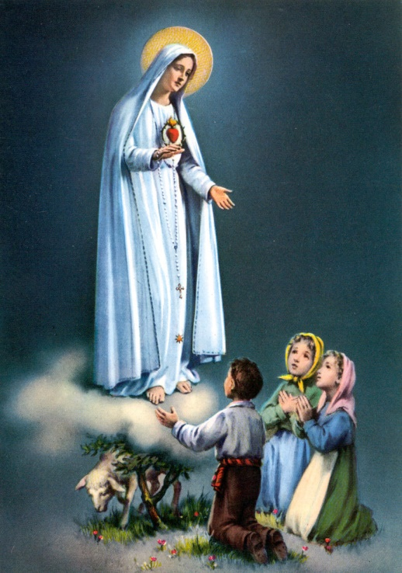
2017 The centennial of
the apparitions of Our Lady at Fatima.
PEAM was instituted on the Solemnity of Our Lord Jesus Christ, King of the Universe,
May 13th, 2018
1st apparition, Mother of the Eucharist,
& the Solemnity of the Ascension of Jesus Christ,
Officially established
its headquarters
in the Diocese of Macau
and was registered as a
“Public Association of the Faithful”

Slide 5
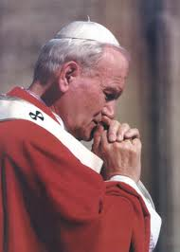
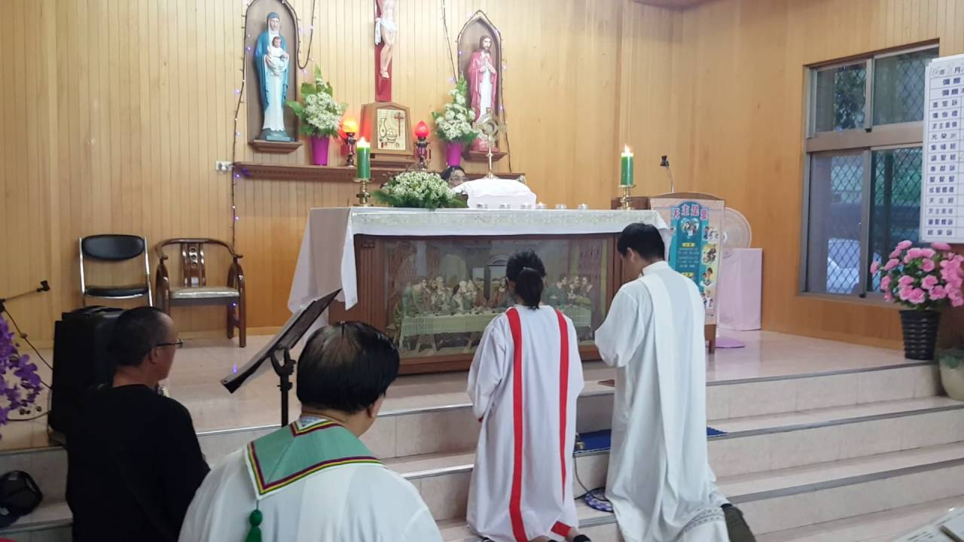
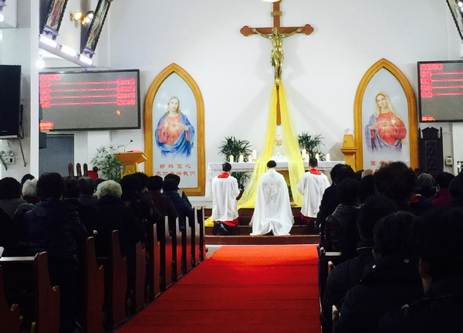
The purpose of PEAM is to make Perpetual Eucharistic Adoration widely known and practised. Simply put, Eucharistic Adoration should no longer be a devotion observed only by the religious or the fervent few. Rather, it should be lived out by all and any, especially those broken in body, heart and spirit.

Slide 6
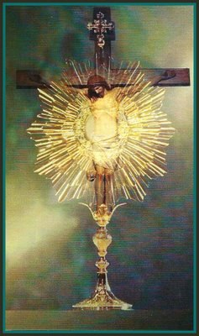
When adoring Jesus in the Eucharist, we respond to His love and mercy with our complete trust. We pray to Him for forgiveness, strength, healing and grace of salvation for ourselves, our families, friends and the whole humanity. In addition, we must also be merciful towards others in need, and encourage them, regardless of their age, gender, race, religion, background, especially those who are broken and distressed to bravely come to the Eucharistic Lord, to worship Him, pray for graces and receive healing. This in turn would kindle in the world the fire of love for the Eucharist and for our neighbours.

Slide 7
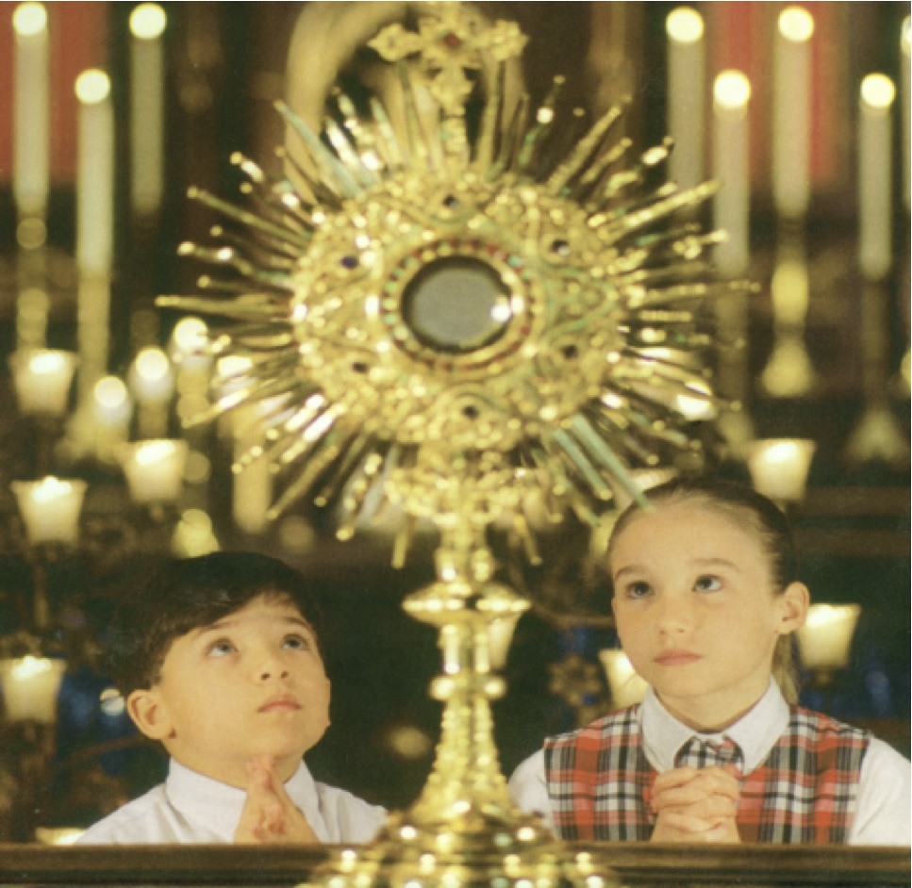
Chapter 2: Aim of PEAM

Slide 8
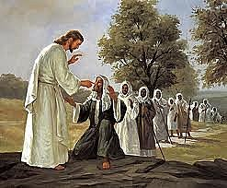
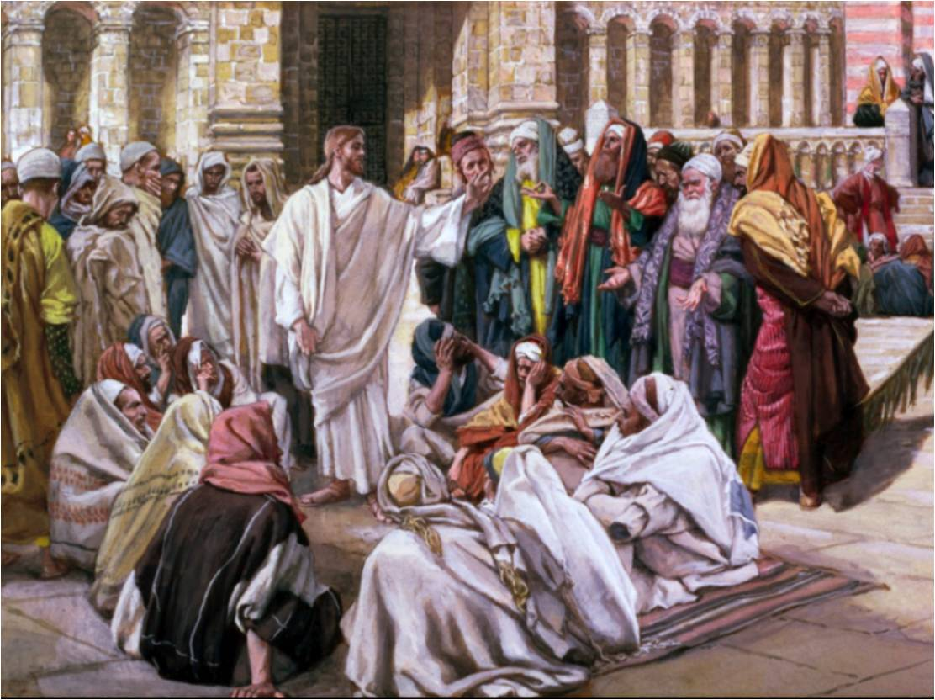
“Jesus went up the mountain, where He sat down. Great crowds came to Him, bringing with them the lame, the maimed, the blind, the mute, and many others. They put them at His feet, and He cured them” (Matthew 15:29-30)

Slide 9
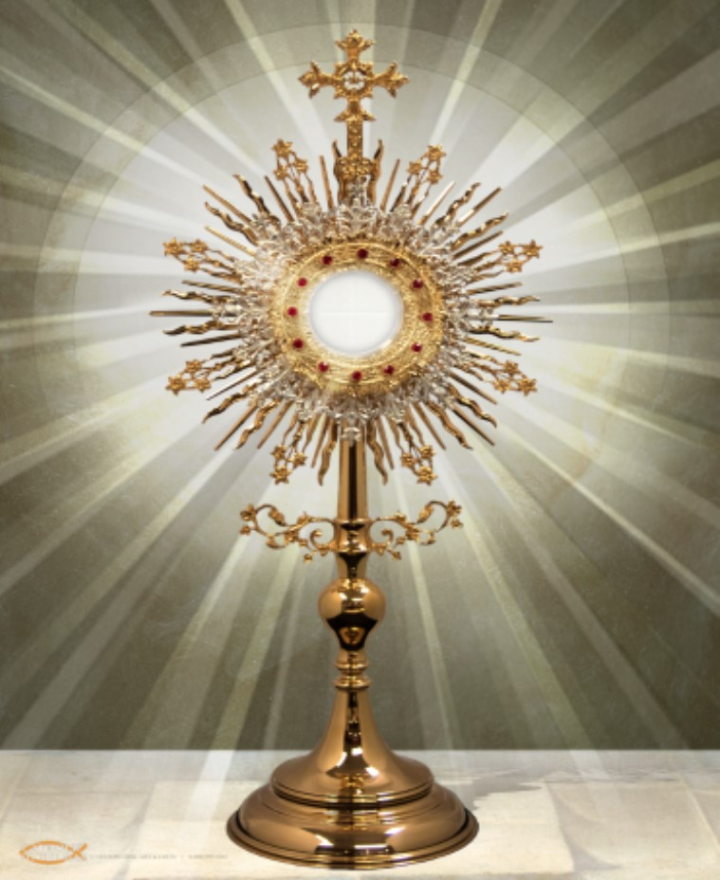
None of us with sincere introspection would deny our brokenness and defects in body, heart and spirit. Hidden deep under our strong and superior outer image were our inner weaknesses and wounds
More than ever before, this generation is filled with evil and torn apart. And yet, this is the time of God’s mercy. It is the time for Lord Jesus Christ to bestow abundant graces onto the world through our Eucharistic Adoration.

Slide 10
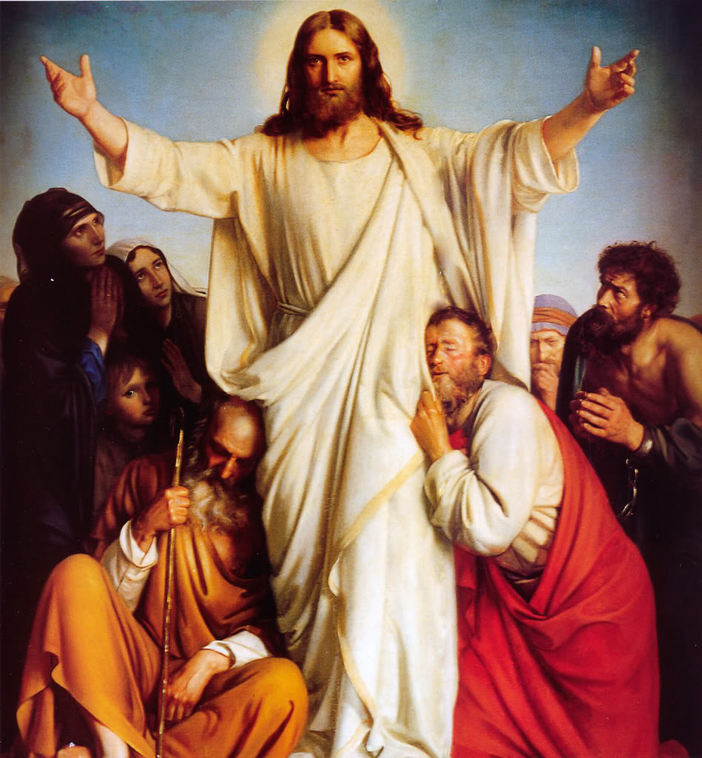
The crowds that came to Jesus at that time were not necessarily His disciples. They might not even have met Him. However, they heard of what Jesus said and did, and were willing to bring their anguished families and friends to humbly come to this stranger Jesus.

Slide 11
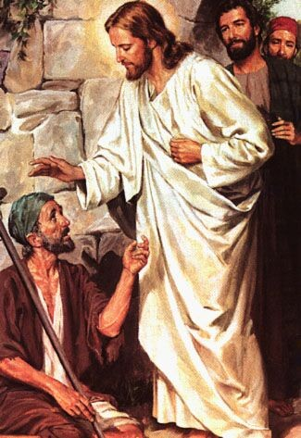
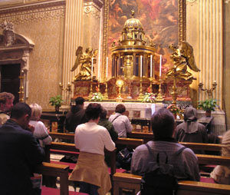
They admitted their weaknesses; and with great faith, implored for healing. What Jesus did was not only to heal their physical illnesses, but more importantly, He granted them spiritual and emotional deliverance and peace, and let them experience the love and forgiveness of God.

Slide 12
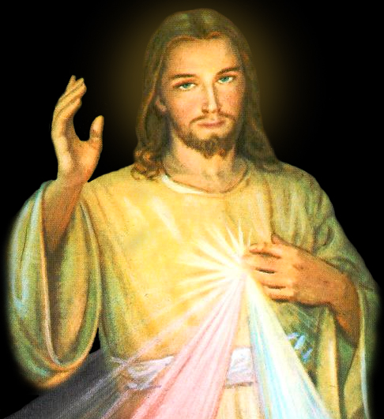
Today, Jesus is present in the Blessed Sacrament, fulfilling His promise to us that,
“I am with you always, to the end of the age” (Mt 28:20). He only wants us to come to Him with full trust, and to receive His love, mercy, peace and healing. He never judges, denounces or rejects us. He only loves, and loves us to the end!

Slide 13
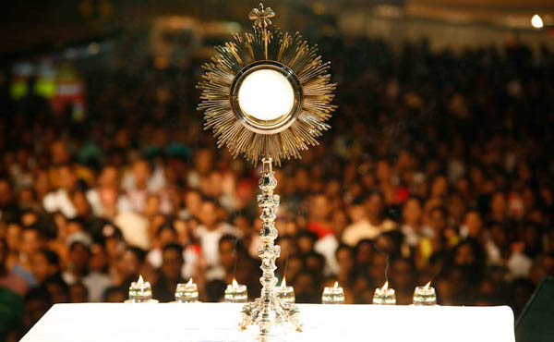
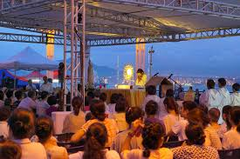
The first and foremost aim of PEAM is to appeal, on behalf of the entire broken humanity, to all Catholic parishes and communities around the world to establish Perpetual Eucharistic Adoration, so that anyone can come to worship the Eucharistic Lord and pray for healing anytime, anywhere. In addition, PEAM encourages everyone to approach the Eucharistic Lord without fear.

Slide 14
PEAM members
become the rescue team
in the “spiritual disaster”
of the present world, pulling out their suffering families, friends and the whole humanity from the “rubble” and bringing them to the Eucharistic Lord for healing.

Slide 15
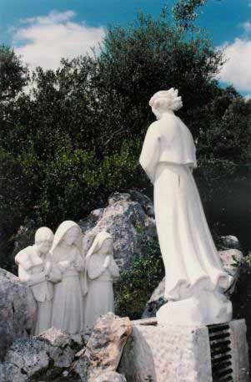
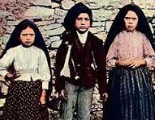
Chapter 3 Spirituality of PEAM
In 1916, St. Michael the Archangel taught the three shepherd children, Lucia, Francisco and Jacinta, at Fatima a prayer for Eucharistic Adoration.

Slide 16
“My God, I believe, I adore, I hope, and I love You! I beg pardon for those who do not believe, do not adore, do not hope, and do not love You. O Most Holy Trinity, Father, Son and Holy Spirit, I adore You profoundly. (bow)
I offer You the Most Precious Body, Blood, Soul and Divinity of Jesus Christ, present in all the tabernacles of the world, in reparation for the outrages, sacrileges and indifferences by which He is offended. By the infinite merits of the Sacred Heart of Jesus and the Immaculate Heart of Mary, I beg for the conversion of poor sinners. Amen.”

Slide 17
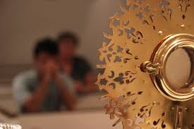
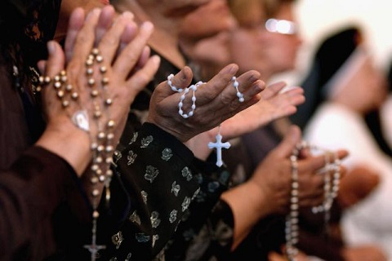
This prayer teaches us the attitude we should have towards the Blessed Sacrament. Every time when we recite this prayer, we need to examine our conscience:
When I am in front of the Eucharist, do I worship God in spirit and in truth?
Do I truly believe, adore, hope and love God?

Slide 18
Do I recognise that the Eucharist in front of me is the all-powerful, all-knowing and all-loving God? Do I acknowledge my nothingness, brokenness, sinfulness and desperate need of God’s salvation?
Am I fully aware of the severe sinfulness of myself, my family, friends and the whole humanity, that we should suffer eternal damnation for our sins against God of all goodness?

Slide 19
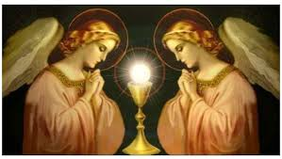
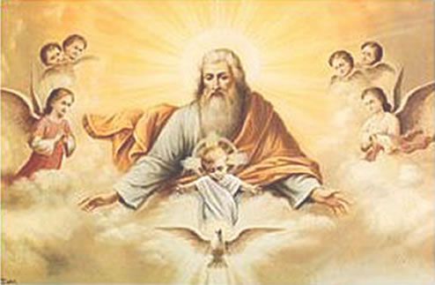
Am I ever grateful for Jesus who died and redeemed me?
Do I strongly believe that, Jesus, true God and true man, is present with His Body, Blood, Soul and Divinity in each consecrated host?
Do I believe that the Heavenly Father and the Holy Spirit are also present with Jesus in the Eucharist in front of me?

Slide 20
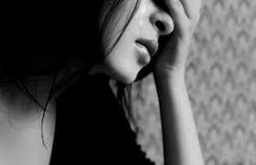
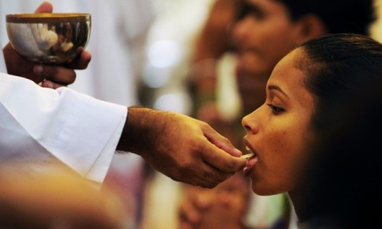
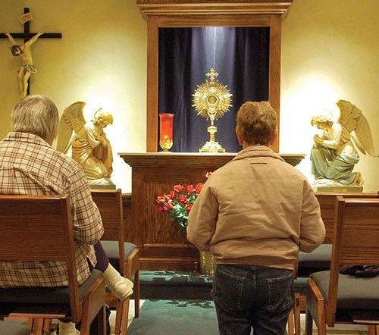
Have I offended the Eucharistic Lord? Have I felt angry, distressed and sorrowful for the outrages, sacrileges and indifferences towards the Eucharist by my family, friends and the whole world?
Do I receive the Holy Communion consciously and worthily?
Do I pray in front of the Eucharist for the grace of conversion of myself, my family, friends and the whole world?

Slide 21
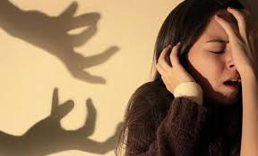
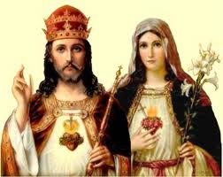
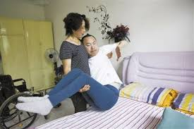
Do I unite the difficulties of my daily life, my physical sickness, my spiritual brokenness with the merits of the Sacred Heart of Jesus and the Immaculate Heart of Mary, and offer them to the Heavenly Father for the conversion of sinners?

Slide 22
The Angel’s prayer is the spirituality of PEAM.
And in the wisdom of God, this prayer is consistent with the Chaplet of Divine Mercy:
“Eternal Father, I offer You the Body and Blood, Soul and Divinity of Your Dearly Beloved Son, Our Lord, Jesus Christ, in atonement for our sins and those of the whole world. ... For the sake of His sorrowful Passion, have mercy on us and on the whole world. ... Holy God, Holy Mighty One, Holy Immortal One, have mercy on us and on the whole world.”

Slide 23
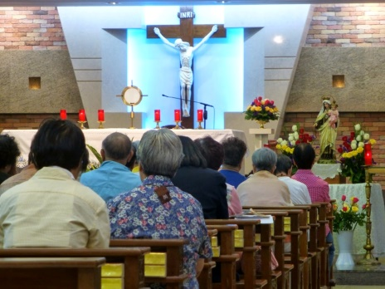
When we recite these prayers in front of the Blessed Sacrament, we need to humbly admit our lowliness and to worship the Almighty God in spirit. We also have to grieve for our sins, for our society being torn apart, and for the brokenness of the humanity, imploring for God’s mercy and forgiveness.

Slide 24
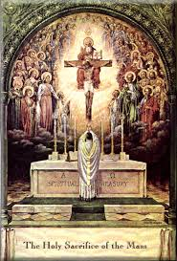
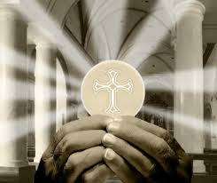
We offer to the Heavenly Father the Blessed Sacrament (that is, the Body, Blood, Soul and Divinity of Lord Jesus) from all Masses celebrated and inside all tabernacles throughout the world, together with all joys and sorrows, problems and challenges of our daily life, for the reparation of our sins, to avert God's wrath and to beseech Him for graces. These prayers epitomize Jesus’ sacrifice on the Calvary and of the Holy Mass.

Slide 25
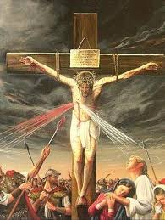
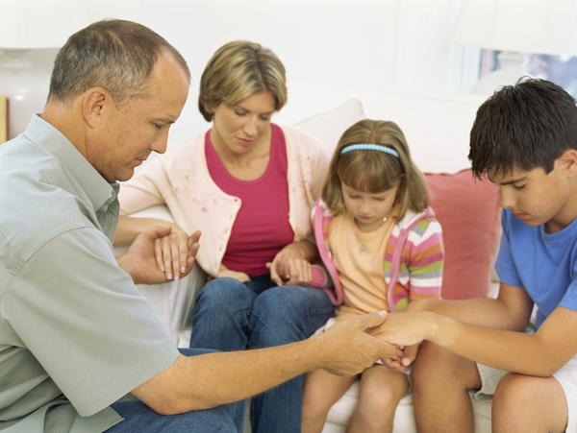
Eucharistic Adoration perpetuates the mystery of the Holy Mass. We place ourselves at the feet of the cross, standing together with Mother Mary and Saint John the Apostle; and, with complete trust, bring our families, friends and the whole humanity into the Sacred Heart of Jesus. We pray that the Blood and Water gushing forth from His pierced heart would save and heal all mortals.

Slide 26
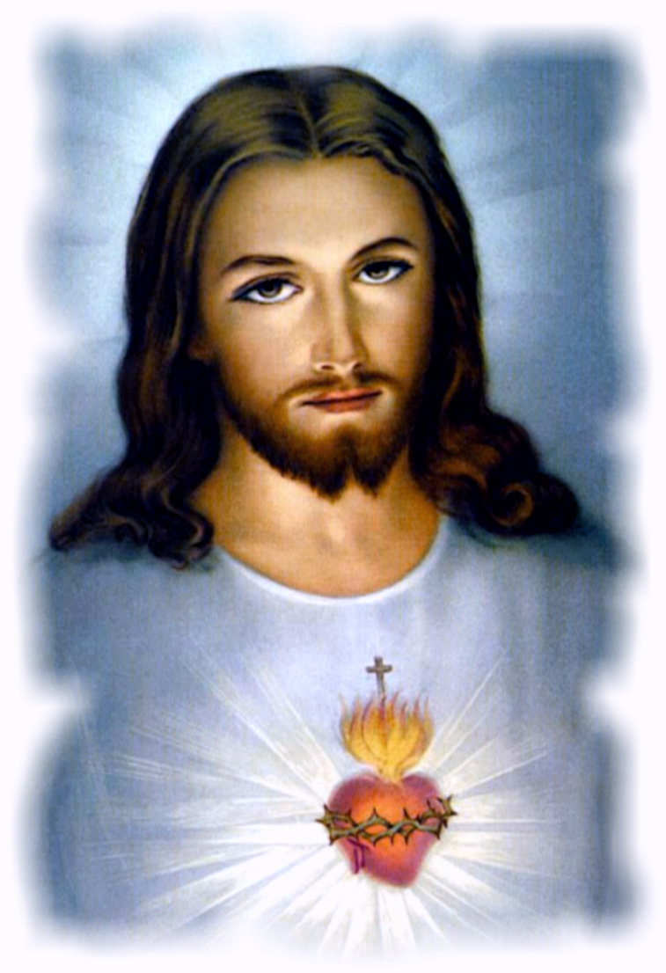
PEAM counteracts the evil in the present world. We pray for the conversion of sinners, make reparation for the sacrilege and the indifferences of the world (including the Catholics) towards the Eucharist, and console the Sacred Heart of Jesus who loves humanity to the end.

Slide 27
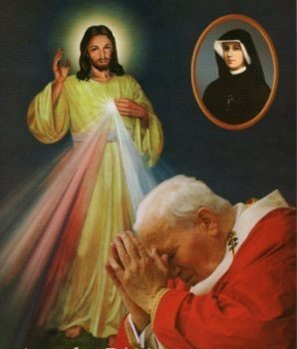
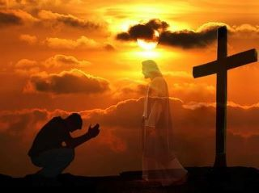
PEAM unites Eucharistic Adoration with devotions to the Divine Mercy and to the Sacred Heart, in order to lift up the endless “sighs, mourning and weeping from this valley of tears” to the Eucharistic throne of Jesus, who bestows onto the world His infinite mercy and grace.

Slide 28
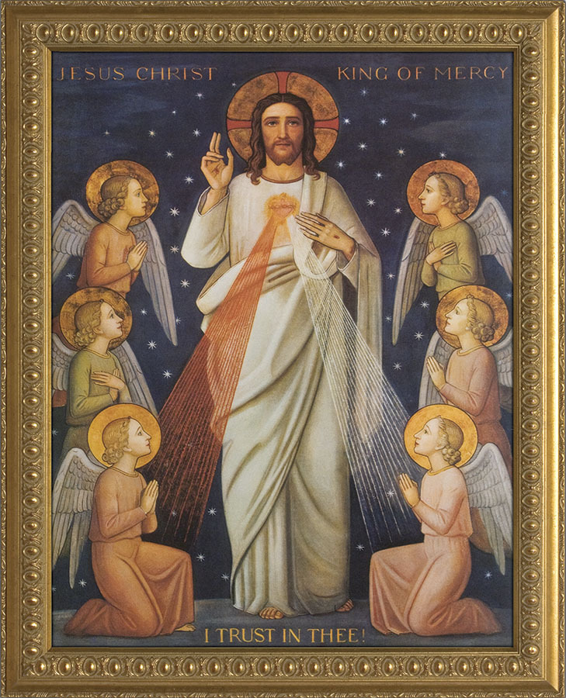
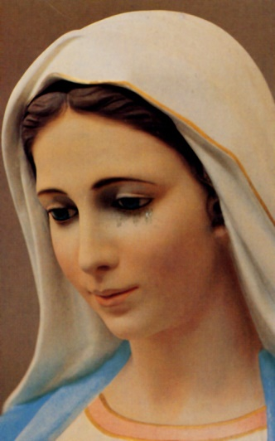
The Eucharist is the Sacred Heart of Lord Jesus and the source of mercy. Whenever the Eucharist is being exposed, the reign of Jesus is manifested. All angels and saints, together with Blessed Virgin Mary, prostrate and worship Christ the King who is sitting on His throne.

Slide 29
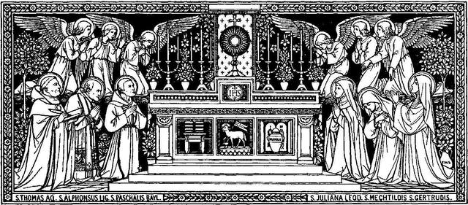
Praying in front of the Blessed Sacrament in exposition is a foretaste of the heavenly experience of seeing Jesus face to face. It is the most powerful way of intercession and is far more efficacious than just praying at home, in an assembly or in a church without Eucharist Adoration.

Slide 30
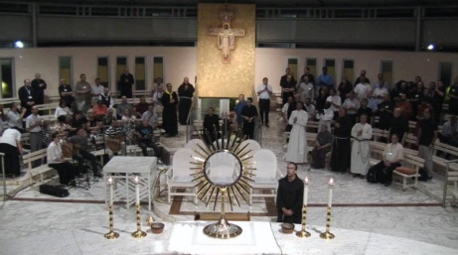
Chapter 4 Member of PEAM
are those who are lowly, broken, struggling in sin, but sincerely willing to return to God. When Lord Jesus, Son of the Most High, took human flesh and became man, He did not come to the world as a prominent royalty or a high-ranking official. Instead, He took the status of a servant, and set Himself among the lowly, sinful, and poor. Now, He is even more humble than He was on earth, hiding His resurrected and glorious Body in a little piece of wafer, in order for us to come to Him more at ease.
The forgiveness, peace, and joy given by the Eucharistic Lord are not meant for the powerful and arrogant.

Slide 31
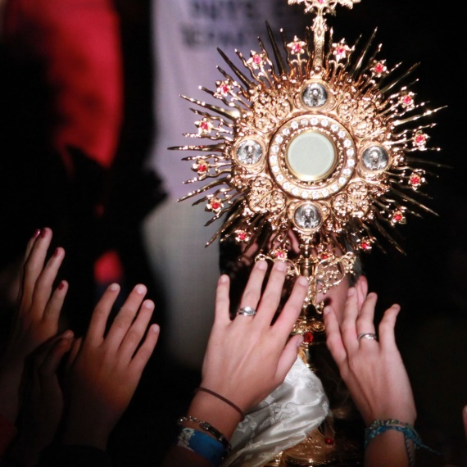
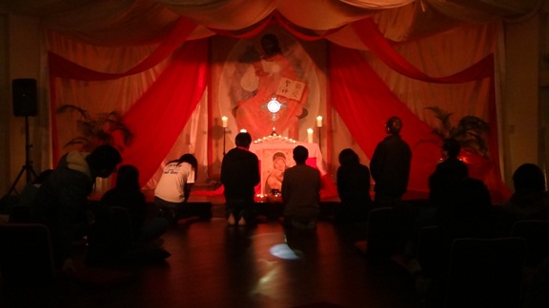
Only those who are willing to humble themselves, truly grieve for their sins, embrace their brokenness and nothingness can experience the infinite graces that Jesus bestows through the Eucharist. We need not dread Jesus’ reprimand or mask our true self before Him. Without fear, we lay down our sins, sufferings of our body, and wounds of our soul all at His feet. When we were still sinners, he had already loved us, and willingly took up our sins on His shoulder, suffered and be crucified for us. He shed His last drop of Blood on the cross to prove that He would love us to the end!

Slide 32
Therefore, PEAM members should have extraordinary trust in Jesus, read and meditate on His Word. This is the sign of our response to His love for us, and is the vessel we use to receive His graces for ourselves and for others. The greater trust we have, the bigger this vessel will become, and the richer the graces we can obtain. Jesus once said to Saint Faustina that our distrust hurt His Sacred Heart more than any sin.

Slide 33
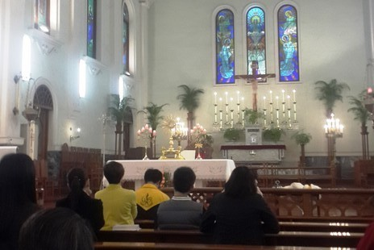
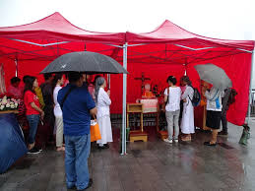
PEAM members are like the moon. The moon itself does not radiate light, but reflects the light from the sun and brightens up the dark night. As regular adorers of the Eucharist, we mirror the light from the Eucharistic Lord with our life to shine in the dark world. We lead, assist and encourage others to come to the Eucharistic Lord.

Slide 34
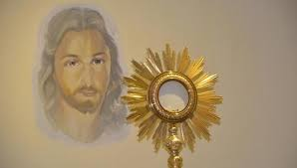
Each one of us is a
“walking monstrance”,
bringing graces and blessings from the Eucharistic Lord to wherever we go.

Slide 35
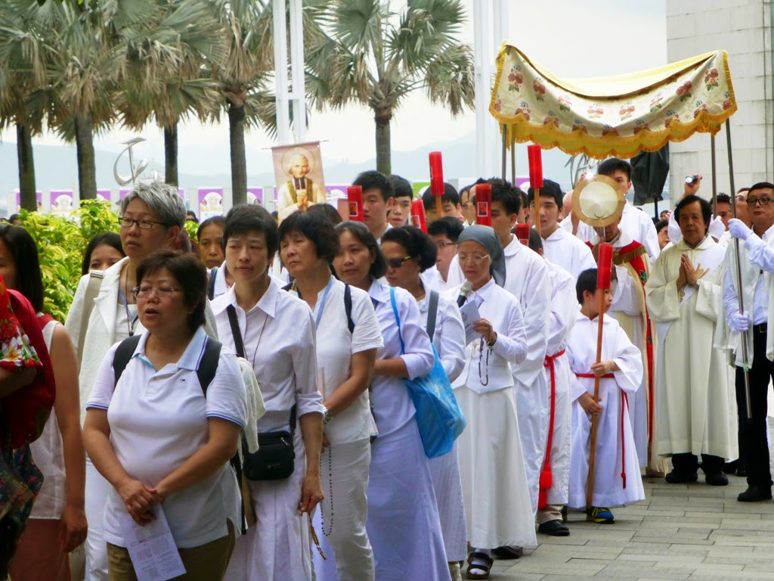
PEAM members are also called
“Eucharistic Disciples”
who serve the Eucharistic Lord, learn His humility and meekness, and allow Him to transform and
sanctify us,
and through us
make others holy.

Slide 36
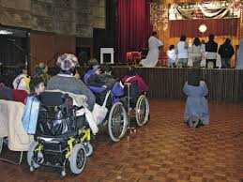
Not only do we receive graces from the merciful Jesus in the Eucharist, we also
embrace others with a merciful heart.
PEAM aims to encourage all broken sinners to come to the Eucharist; hence, we with the Heart of Jesus who loves humanity to the extreme should welcome and accept all who come to Eucharistic Adoration. We should not judge or refuse anyone because of their age, gender, race, religion, background or outlook.

Slide 37
We have to remember always that we too are broken sinners. We are blessed to come to the Adoration not because we are holy, but merely by the saving grace of Lord Jesus. Therefore, we should hope for others with brokenness in body, heart and spirit to enjoy the same grace. Eucharistic Adoration is not just for our own benefit. We need to pray for the grace of salvation for the whole humanity.

Slide 38
In order to participate and promote PEAM, we must have the passionate love for the Eucharist, and have to adore steadfastly Lord Jesus Christ hidden in the host.
The key to the success of PEAM
depends on how zealous we are.
Despite realizing our deficiency, we should be willing to be led by the Holy Spirit to overcome all obstacles, and bravely and proactively lead souls to the Eucharistic Throne.

Slide 39
Moreover, we must imitate the humble and hidden nature of the Eucharist.
We must not boast ourselves, or desire for any rights or benefits. With perseverance, we must offer our energy and time to the Eucharistic Lord with all our hearts, all our souls, all our minds and all our strength, to serve Him, to console His wounded Sacred Heart and to participate in the salvation of souls.

Slide 40
Jesus said, “I came to bring fire to the earth, and how I wish it were already kindled!” (Lk 12:49) PEAM members are like sparks, and a single spark can start a prairie fire. With our humble fire of love for the Eucharistic Lord, we ignite the fire of passionate love for the Eucharist in others’ hearts.

Slide 41
Relying merely on our own strength, it is very difficult to truly live out the PEAM spirit, to make reparation for the sins of ours and of the world, or to console the Sacred Heart of Jesus in the Eucharist. Thanks be to God! Blessed Virgin Mary, Mother of the Eucharist, is our aid. Her Immaculate Heart purifies our thoughts, words and deeds. She offers all difficulties of our daily life, our sorrows and sicknesses to Her Son.

Slide 42
PEAM members should have piety and love towards Mother Mary. We learn from her examples and consecrate ourselves to Her Immaculate Heart. We allow her to look after and protect us so that we can be faithful to our commitment of Eucharistic Adoration.

Slide 43
Chapter 5 Spread of PEAM
PEAM is a new direction for new evangelisation in the new millennium. Evangelisation of the Church aims to enable non-believers to encounter Jesus Christ, and to accept Him as Lord of their lives and Redeemer for their sins. While many church communities spend a lot of time and energy to evangelise through gimmicks, activities, or social media platforms, they have not been successful in attracting people into the Church.

Slide 44
PEAM, on the other hand, brings both believers and non-believers together to meet Jesus face to face. We are like Andrew and Philip in the Gospel. After they met Jesus, they brought Simon Peter and Nathanael, respectively to Jesus, telling them, “Come and see” (Jn 1:46).
And when Simon Peter and Nathanael met with Jesus, they were also touched by His love. Our words or works alone cannot transform hearts and convert people. Only Jesus truly present in the Eucharist can touch hearts and bless all who come to Him.

Slide 45
PEAM aims to promote Perpetual Eucharistic Adoration throughout the world in two areas; that is, in dioceses and parishes, and in academic institutes and youth ministries.

Slide 46
Catholic bishops who accept the PEAM spirituality and are willing to promote it can establish Eucharistic Adoration, even Perpetual Eucharistic Adoration, in their dioceses or parishes.
If necessary, they can set up core groups to manage the practical arrangement of the Adoration, but the structure of such groups has to be as simple as possible. Bishops can also consider register PEAM in their dioceses as a public association of the faithful, but its constitution needs to be consistent with the PEAM spirituality and charism.

Slide 47
Catholic organisations, religious communities and academic institutes who understand and are willing to follow PEAM spirituality and charism are also welcome to ally with PEAM.
Eucharistic Adoration and promotion of PEAM in additional to their original charisms and ministries can enhance and elevate their evangelising works. For Catholic schools and universities, Eucharistic Adoration can be held before and after class, or during lunch break in their chapels.

Slide 48
They can also institute some Adoration time after school Mass, so that both Catholic and non-Catholic students can have the chance to come and pray in front of the Eucharistic Lord. If needed, they can organise some core groups to manage the Adoration arrangement.

Slide 49
The managerial structure of PEAM should not be complex. Instead, it should be like dandelion seeds, so light that it can be carried away by the breeze of the Holy Spirit to wherever God wills. When promoting PEAM, there is no need for any gimmicks. Instead, it has to be humble and straightforward. The most important thing is to let more people know the love of the Eucharist, and to establish more places for Perpetual Eucharistic Adoration, so that more people would have chance to worship the Eucharistic Lord.

Slide 50
Chapter 6 Benefits of PEAM
Unlike the many and diverse diocesan associations or parish groups, PEAM is a universal movement dedicated to renew the Catholic Church and to bring Heaven onto earth. Its ultimate goal is to bring the whole humanity directly to the Eucharistic Lord. Through participating in PEAM, believers come to love Jesus more zealously, receive the Eucharist at Mass more worthily, and receive the Sacrament of Reconciliation more regularly.

Slide 51
This will then sanctify their lives and in turn make holy the world. In addition, the merciful love of the Eucharistic Lord is not exclusive to believers. Those who are not baptised can also receive abundant blessings through Eucharistic Adoration.
The purpose of PEAM is to bring all those in need of God’s mercy to the Eucharistic Lord for His healing. Some people may not be able to receive the Eucharist at Mass, but they can come to Jesus during Eucharistic Adoration to receive His healing.

Slide 52
After healing and conversion, they may be baptised into the Catholic Church, receive the Blessed Sacrament, and grow in holiness in the embrace of the Mother Church. If, for some reasons, they cannot be baptised into the Catholic Church, they can still receive blessings through Eucharistic Adoration.

Slide 53
PEAM is a universal movement ...
It is a spiritual movement! Those who are involved in PEAM are closely united with Christ, often read and meditate on the Scripture, and actively participate in the salvation of souls. They enable the Eucharistic Lord to shine through the darkness, and bestow life in the culture of death

Slide 54
It is a movement to rekindle the fire of the stray and lukewarm Catholics! A parish with Perpetual Eucharistic Adoration enables their stray and lukewarm parishioners to experience the true presence of Lord Jesus Christ outside Mass. Compared with other parish activities, Eucharistic Adoration can touch people more deeply and effectively. The Eucharist Itself is the ultimate aim of evangelisation. The Eucharistic Lord enthroned in parishes will also bless all their evangelising works.

Slide 55
It is a movement to enable the faithful from other Christian denominations to encounter and be touched by the Eucharistic Lord.
Through PEAM, they will be brought back to the Catholic Church – the Mother Church!
It is the most efficacious ecumenical movement.

Slide 56
It is a movement to lead unbelievers or people from other faiths to encounter Jesus Christ in the Eucharist. When touched and healed, they will accept Catholicism and come to the Catholic Church!

Slide 57
It is a movement to embrace sinners with God’s love and mercy and help them repent!
It is a movement to bring the wounded and broken humanity to receive holistic healing in the Eucharistic Lord!

Slide 58
It is a movement to renew the Catholic Church with the Eucharist as her heart through Eucharistic Adoration! Dioceses and parishes with Perpetual Eucharistic Adoration become more vibrant and have more vocations.

Slide 59
It is a movement to make the Kingdom of God present on earth! Cities or communities with Perpetual Eucharistic Adoration are being blessed and protected by the Eucharistic Lord.

Slide 60
Chapter 7 Importance of Perpetual Eucharistic Adoration
People nowadays lead hectic lives and can hardly spare extra time to care for the others. They either ignore or feel helpless with spiritual and emotional needs of their own family members. No priests, religious sisters, psychiatrists, families, spouses and loved ones can be available anytime anywhere to give a listening ear to those in need. Neither can they give these wounded ones holistic healing nor make them whole. Perpetual Eucharistic Adoration is an invitation of love open to the whole broken humanity. People can come to Jesus wherever they are and whenever they need.

Slide 61
A Perpetual Eucharistic Adoration Chapel that is open 24 hours all year round is a place where the afflicted mortals can find protection, consolation, healing, strength and love. It is indeed a spiritual power station, an emergency room to heal souls, a guarantee for complete joy, and a manifestation of Heaven on earth. The beauty of it all is that everybody can become an adorer. The more we acknowledge our brokenness, the closer we are to the Eucharistic Lord. The more we experience our brokenness, the more we need to adore the Eucharistic Lord.

Slide 62
Chapter 8 Implementation of PEAM
PEAM is different from the usual Eucharistic Adoration in most parishes. First of all, PEAM strongly encourages parishes to establish 24-hour Perpetual Eucharistic Adoration all year round. Secondly, PEAM is different from a sodality of Blessed Sacrament in a parish. PEAM members devote themselves to promoting Perpetual Eucharistic Adoration. The salvation of souls & the glory of the Eucharistic Lord is their first priority.

Slide 63
They strive to let the Blessed Sacrament be worshipped and glorified so that His graces can be bestowed onto the world unceasingly.
Many parishes find it difficult to recruit adorers to sustain the on-going 24-hour Adoration. For that, parishes should regularly organise seminars explaining what Eucharistic Adoration is and why it is important. This would inspire and instil the parishioners to come and worship the Eucharistic Lord and even will bring their families and friends along.

Slide 64
There has always been a misunderstanding that during Eucharistic Adoration, there must be complete silence. This misunderstanding has deterred many people from approaching the Eucharistic Lord. Of course, silently meditating on the Eucharist exposed on the altar, speaking to the Lord heart to heart, is the sweetest moment a soul would desire.

Slide 65
However, we can also recite prayers in front of the Eucharist. St John Paul II encouraged us to pray the Rosary in front of the exposed Blessed Sacrament and meditate on the life of Jesus with Mother Mary. He also urged us to recite the Divine Mercy Chaplet during Eucharistic Adoration to pray for the sinners and the dying. In addition, we can also read the Bible, stories of saints and other spiritual writings during Eucharistic Adoration.

Slide 66
Eucharistic Adoration is a binding force of parish life. All parishioners should actively participate in this devotion. Parishes with Perpetual Eucharistic Adoration can appropriately assign some time slots for special pastoral needs. E.g. there can be some time slots for young children and their parents. Through interactive prayers and actions, children can experience heartfelt conversation with the living Jesus.

Slide 67
Praying and adoring the Eucharistic Lord together brings parents and children closer to each other. Youth, on the other hand, can worship the Eucharistic Lord with music. Parish groups can pray communal Rosary during Eucharistic Adoration. The Charismatic Renewal prayer groups can pray in tongue with the Eucharist exposed. They can also administrate healing and deliverance ministries during Eucharistic Adoration.

Slide 68
For non-baptised visitors, the parishes can organise some Bible sharing sessions in which they can share their daily life experience in the light of the Scripture in front of the Eucharist exposed. The participants can pray for each other, especially for those visitors, with petitions and thanksgiving.

Slide 69
It is very important especially for parish council members, all committee members, Extraordinary Ministers of Holy Communion, altar servers and people serving in the liturgy to become the role models of adoring and loving the Eucharistic Lord. The ability to serve the parish is purely grace from God. Hence, those who are serving need to pray unceasingly for strength & wisdom in front of the Eucharistic Lord.

Slide 70
PEAM members should make Eucharistic Adoration part of our daily life and allow our hearts to be constantly drawn to the Eucharistic Lord. Every breath we take should carry His merciful spirit. Therefore, we should be faithful to our commitment to Eucharistic Adoration. Ordinary PEAM members should at least devote one hour per week to Adoration. They should also encourage their families and friends to join Adoration, and pray for their holistic healing.

Slide 71
More active PEAM members can become the core group members of their parishes, dioceses, schools or communities to manage Eucharistic Adoration at where they belong. Within their ability, they should also promote and establish Perpetual Eucharistic Adoration at other places. They should at least have three hours of Adoration per week. PEAM Council members constitute the top leadership of PEAM. They should try their best to have at least one hour of Eucharistic Adoration every day. For them and for the core group members, salvation of souls through Eucharistic Adoration is their priority in life, and they should never cut down adoration hours due to administrative works.

Slide 72
All PEAM members can engage in spiritual sharing through social media. They can also gather periodically for retreats or formation.
Any dioceses, parishes, religious communities, academic institutes, organisations or individuals who joined PEAM but do not follow its spirituality and charism, or in the name of PEAM facilitate activities unrelated to Perpetual Eucharistic Adoration, should withdraw from PEAM.

Slide 73
PEAM prayers

Slide 74
PEAM Pledge
I (_______) profoundly grateful for the abundant blessings from the Eucharist, pledge to remain faithful to my commitment of Eucharistic Adoration and to pray fervently in front of the Most Holy Blessed Sacrament for the youth to stay pure in body, heart and spirit, for sinners and the world to repent and believe in the gospel, and for the sanctification of the Church and the clergy.

Slide 75
PEAM Pledge
Lord, hide me in Your most holy Eucharistic Heart, let me drink from the fountain of mercy gushing from Your pierced heart, and empower me to persist in my commitment to promoting the study of the Word, worshiping the Eucharist, and serving as a channel of Your merciful love. Amen.

Slide 76
Angel’s Prayer
My God, I believe, I adore, I hope,
and I love You! I beg pardon for those who do not believe, do not adore,
do not hope, and do not love You.

Slide 77
Angel’s Prayer
O my God, I believe, I adore, I hope and
I love you. I beg your pardon
for those who do not believe,
do not adore, do not hope
and do not love you.
O most Holy Trinity, Father, Son
and Holy Spirit, I adore You profoundly. (bow)

Slide 78
Angel’s Prayer
I offer You the Most Precious Body, Blood, Soul and Divinity of Jesus Christ, present in all the tabernacles of the world, in reparation for the outrages, sacrileges and indifferences by which He is offended. By the infinite merits of the Sacred Heart of Jesus and the Immaculate Heart of Mary, I beg for the conversion of poor sinners. Amen

Slide 79
Act of Spiritual Communion
My Jesus, I believe that you are present in the most Blessed Sacrament. I love You above all things and I desire to receive You into my soul. Since I cannot now receive You sacramentally, come at least spiritually into my heart. I embrace You as if You have already come, and unite myself wholly to You. Never permit me to be separated from You. Amen.

Slide 80
PEAM Prayer for Priests
O Jesus, I pray for your faithful and fervent priests; for your unfaithful and tepid priests; for your priests laboring at home or abroad in distant mission fields; for your tempted priests; for your lonely and desolate priests; for your young priests; for your dying priests; for the souls of your priests in purgatory.

Slide 81
PEAM Prayer for Priests
But above all, I recommend to you the priests dearest to me: the priest who baptized me; the priests who absolved me from my sins; the priests at whose Masses I assisted and who gave me your Body and Blood in Holy Communion; the priests who taught and instructed me; all the priests to whom I am indebted in any other way.

Slide 82
PEAM Prayer for Priests
O Jesus,
keep them all close to your heart, and bless them abundantly
in time and in eternity.
Amen.

